Slide 1




Feces, Stress and Chickadees: My Research and Why it matters
By Domenico Comita
Supervisor: Dr. Matthew Reudink
Secondary Supervisor: Dr. Emily Studd

Slide 2
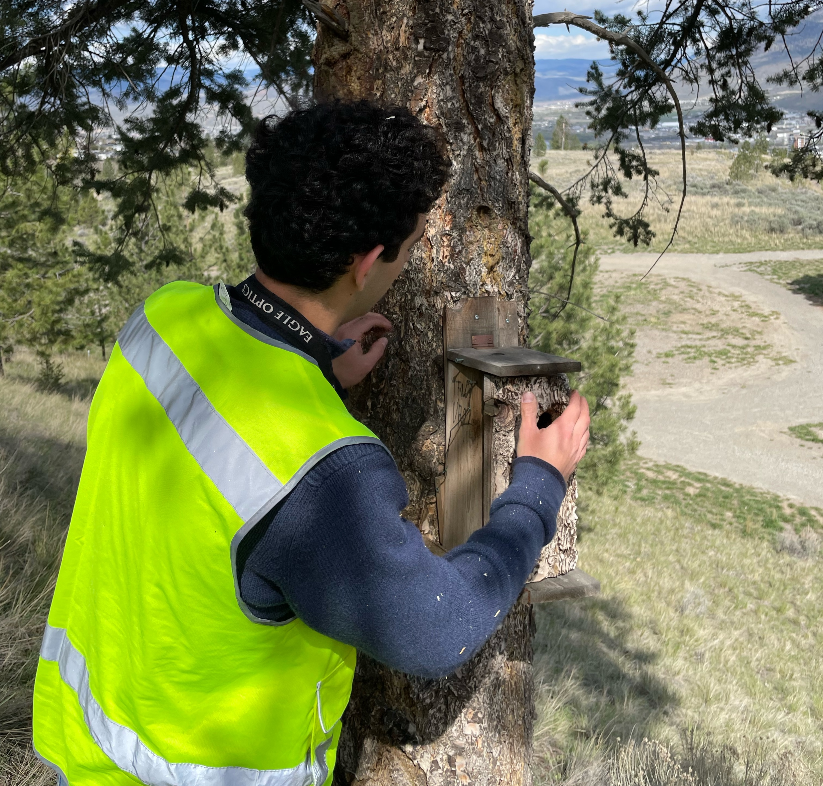
My Research Goals
1. Does stress differ in urban and rural mountain chickadee nestlings?

Slide 3
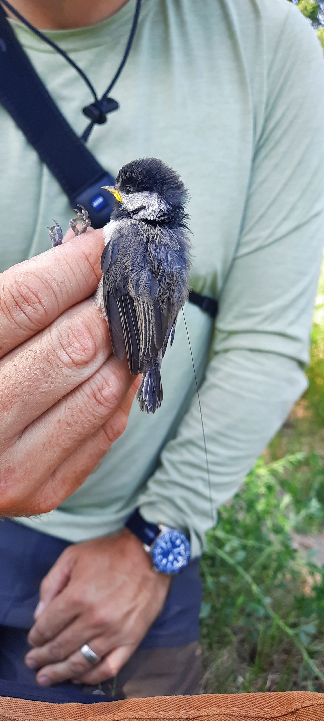


Quote
My Research Goals
2. Does stress vary with nestling age?
Early
Late
3. Do factors other than habitat affect stress?
Environment
Notes:
Early (8 days)
Late (18 days)
Environment (temperature and noise)

Slide 4
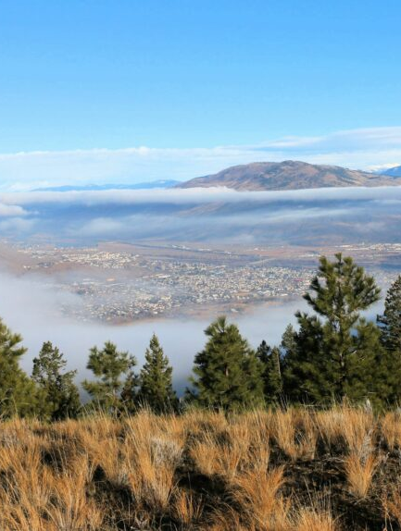
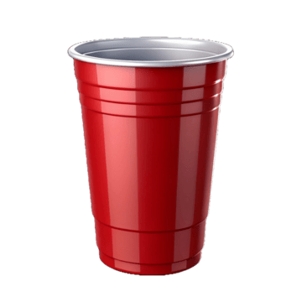
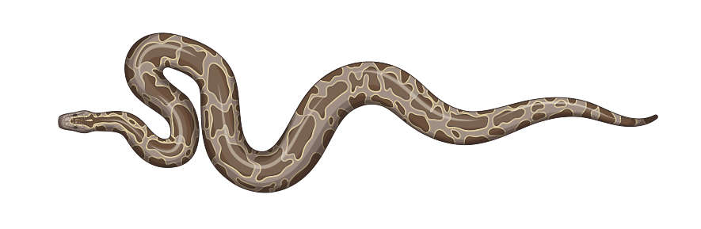
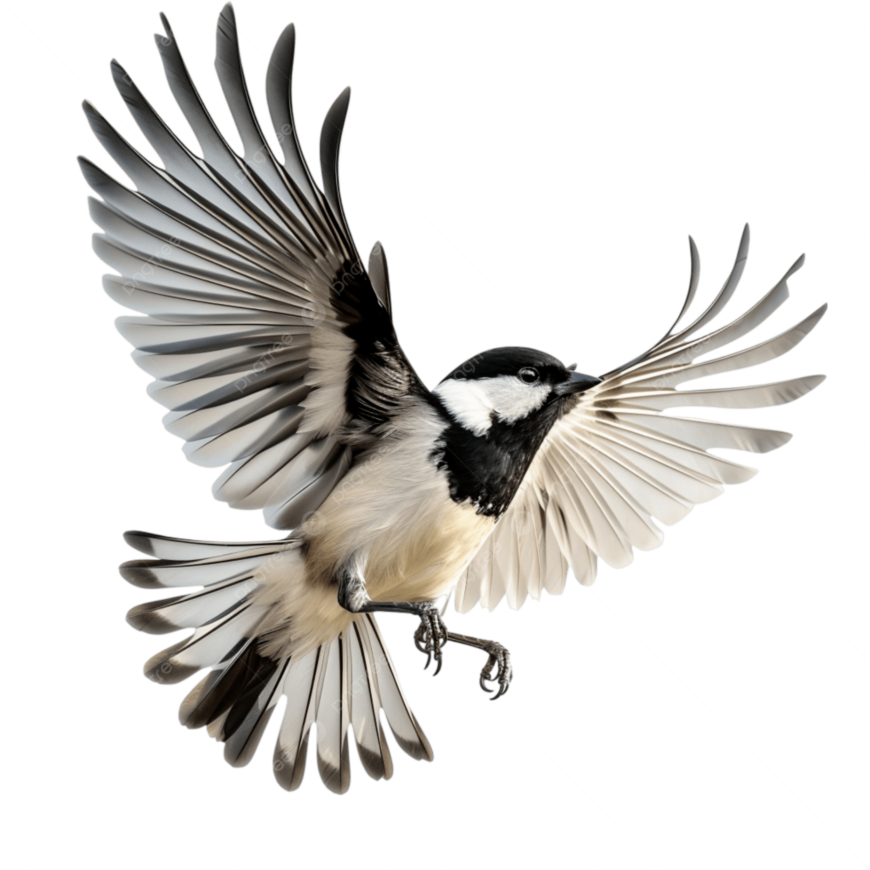

Mountain Chickadees
Current Understanding
Ongoing 12 year study
Response to novel objects
Response to Predators
Reproductive success
Reproductive Timing

Slide 5
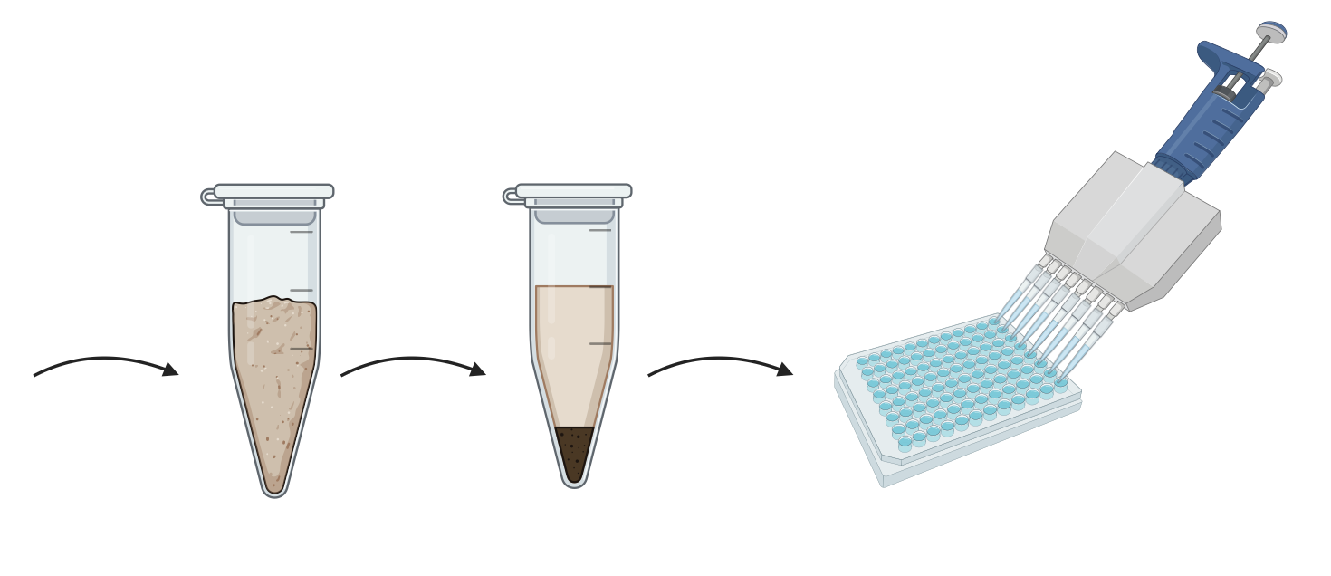

Current Understanding
Approach

Slide 6
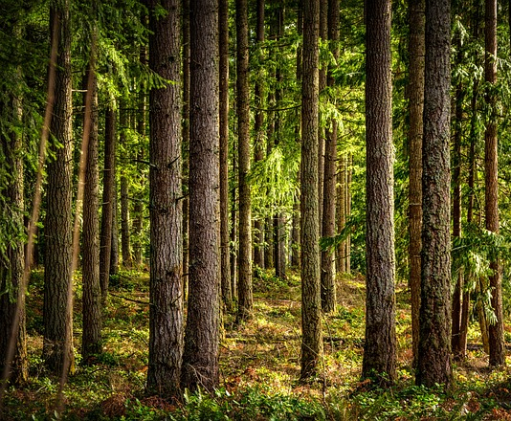

Why My Research Matters
Urbanization
Nestling Stress
Thrive?
Ecological trap?

Slide 7

COEXISTENCE

Slide 8
References
Brewer JH, O’Reilly KM, Buck CL. 2010. Effect of nestling status and brood size on concentration of corticosterone of free-living kittiwake chicks. General and Comparative Endocrinology. 166(1):19–24. doi:10.1016/j.ygcen.2009.08.005.
Heales HE, Flood NJ, Oud MD, Otter KA, Reudink MW. 2024. Exploring differences in neophobia and anti-predator behaviour between urban and rural mountain chickadees. Journal of Urban Ecology. 10(1):juae014. doi:10.1093/jue/juae014.
Palme R et al. 2013. Steroid extraction: Get the best out of faecal samples. WTM. [published online ahead of print]

Slide 9
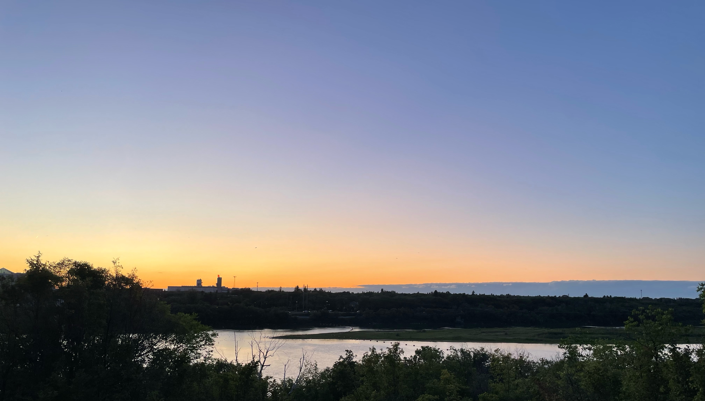
Questions?

