Slide 1
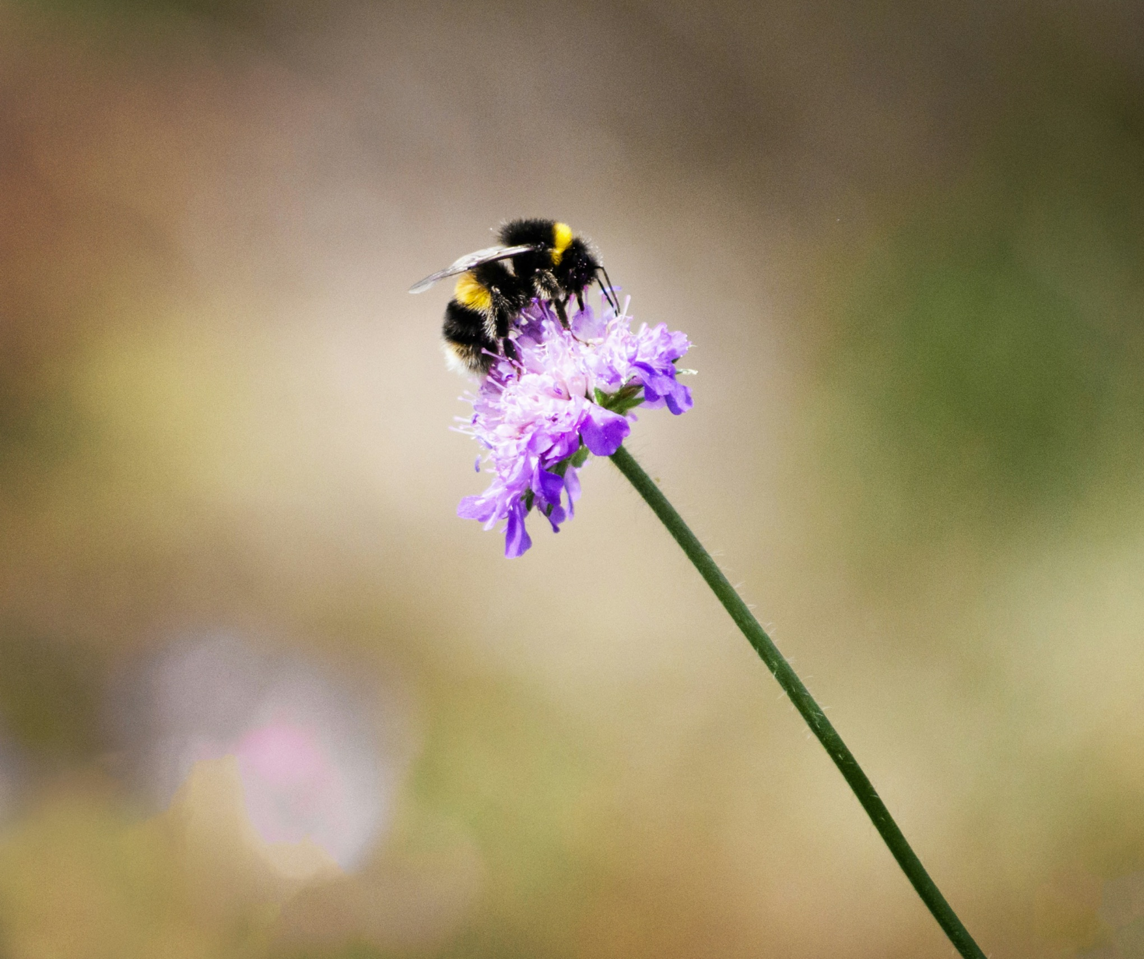
Social Learning in Bumblebees
By Domenico Comita

Slide 2
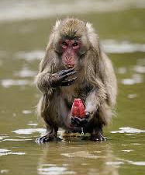
A Tale of Two Schools - Macaques
Kinji Iminashi suggested animal culture can be found in nonhumans
Animals are not just merely instinctual
Took time to be accepted in Western science
(Minakuchi., 2017)

Slide 3
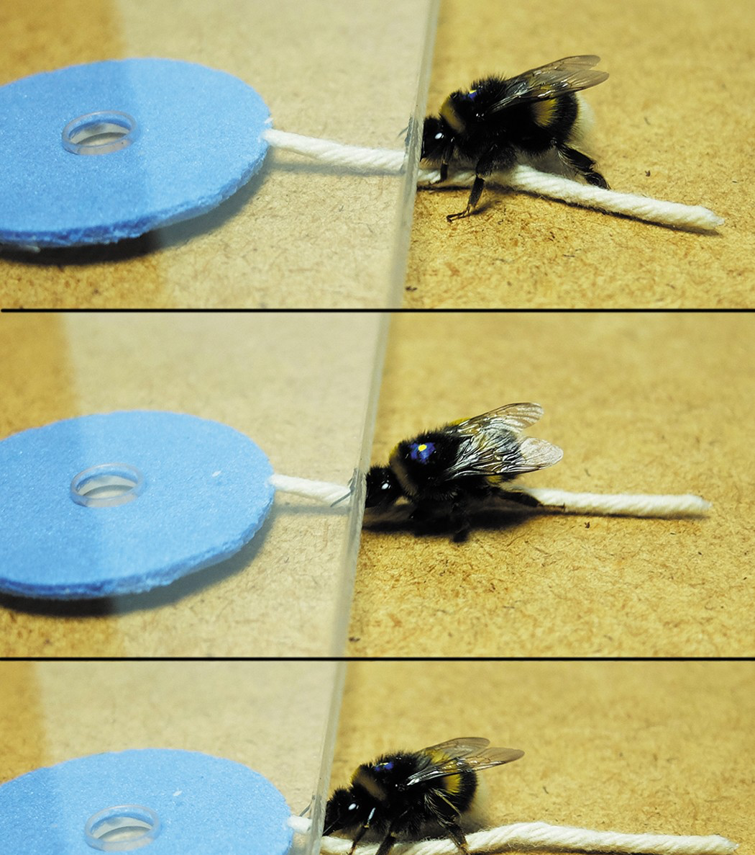
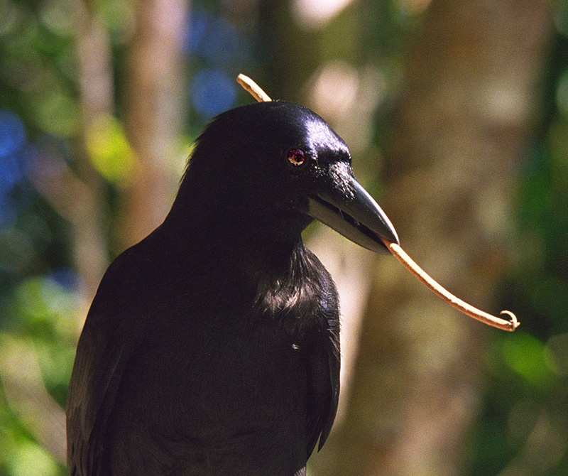
Previous Studies & Research
Bumblebees and social learning:
String pulling
Two-option puzzle box
Social learning in other species:
Macaques
New Caledonian crows
Changes of song in Savannah sparrows and humpback whales
(Alem et al., 2016)
(Hunt et al., 2003)

Slide 4
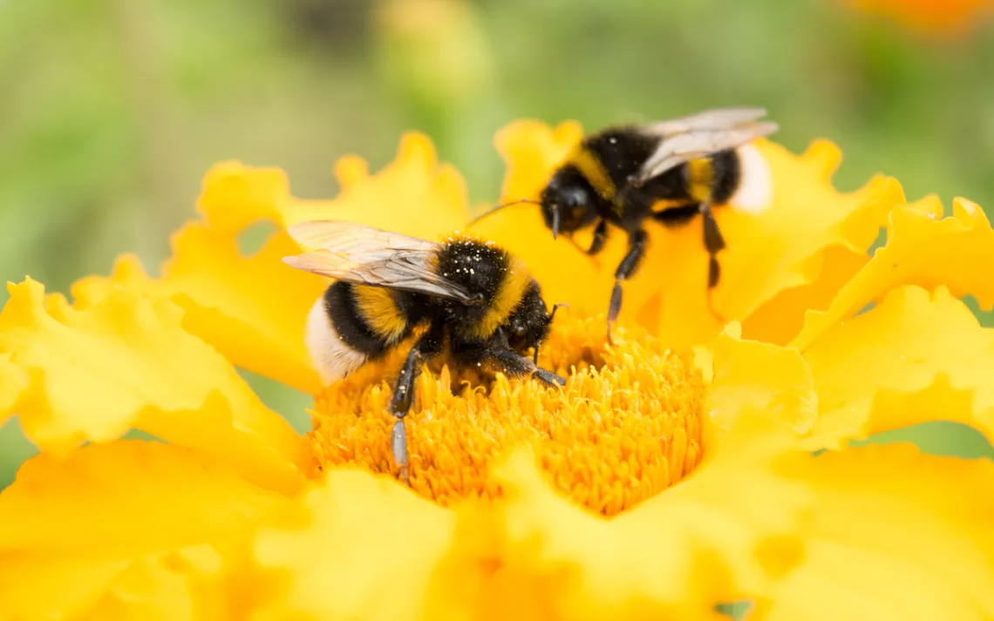
Purpose of the Study
To determine if bumblebees have the capacity to socially learn a behaviour that they would not be able to develop through individual trial and error alone.
(nnorozoff, 2019)

Slide 5

Materials
Two-step puzzle box
Flight arena connected to nest box
7 bee colonies
3/7 were control colonies
(Bridges et al., 2024)
(Bridges et al., 2024)

Slide 6
Methods
The Control Colonies
2 control colonies had isolated bees exposed to two-step puzzle boxes for 36 hours
1 control colony had isolated bees exposed to the two-step puzzle boxes for 72 hours.
The bees could not open the two-step puzzle when isolated

Slide 7
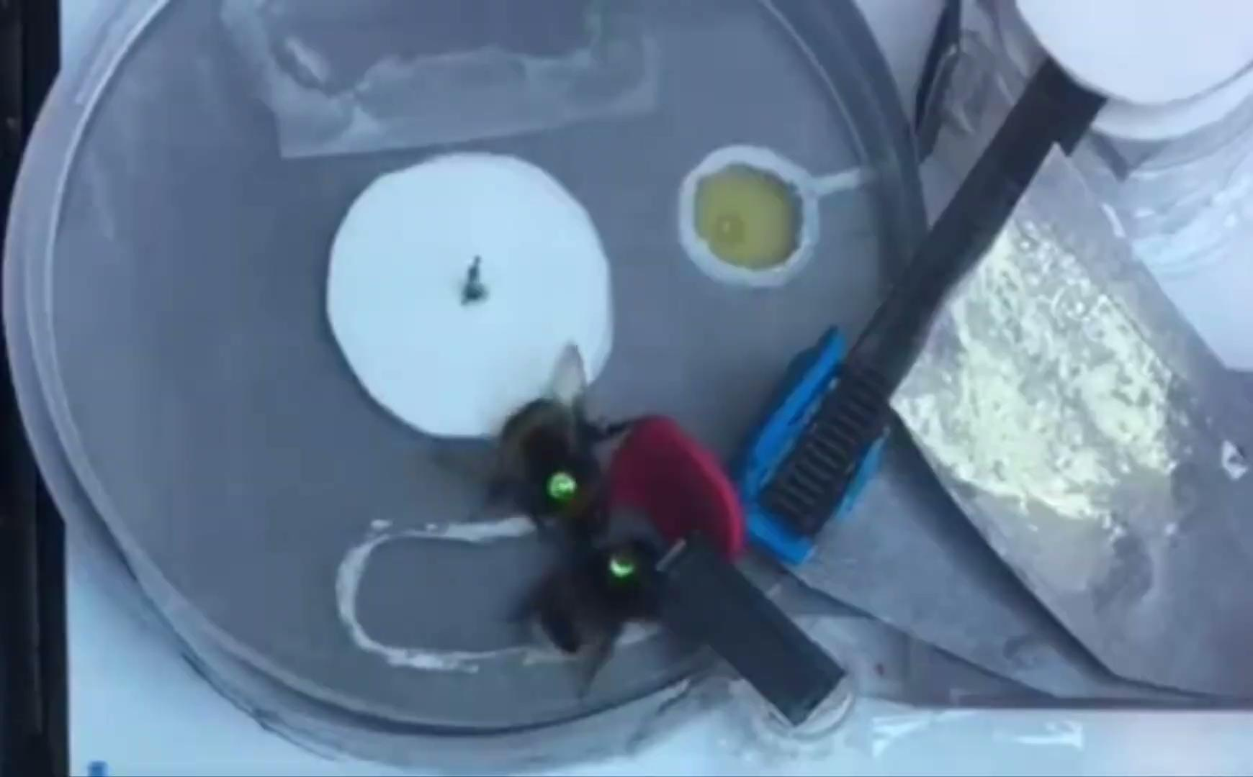
Methods
Dyad Experiments
Demonstrator Bees (n=9)
Learned two-step puzzle with help of temporary reward
Temporary reward taken away
Bee could still complete puzzle
Observer Bees (n=15)
Have never been exposed to two-step puzzle
(Bridges et al., 2024)

Slide 8
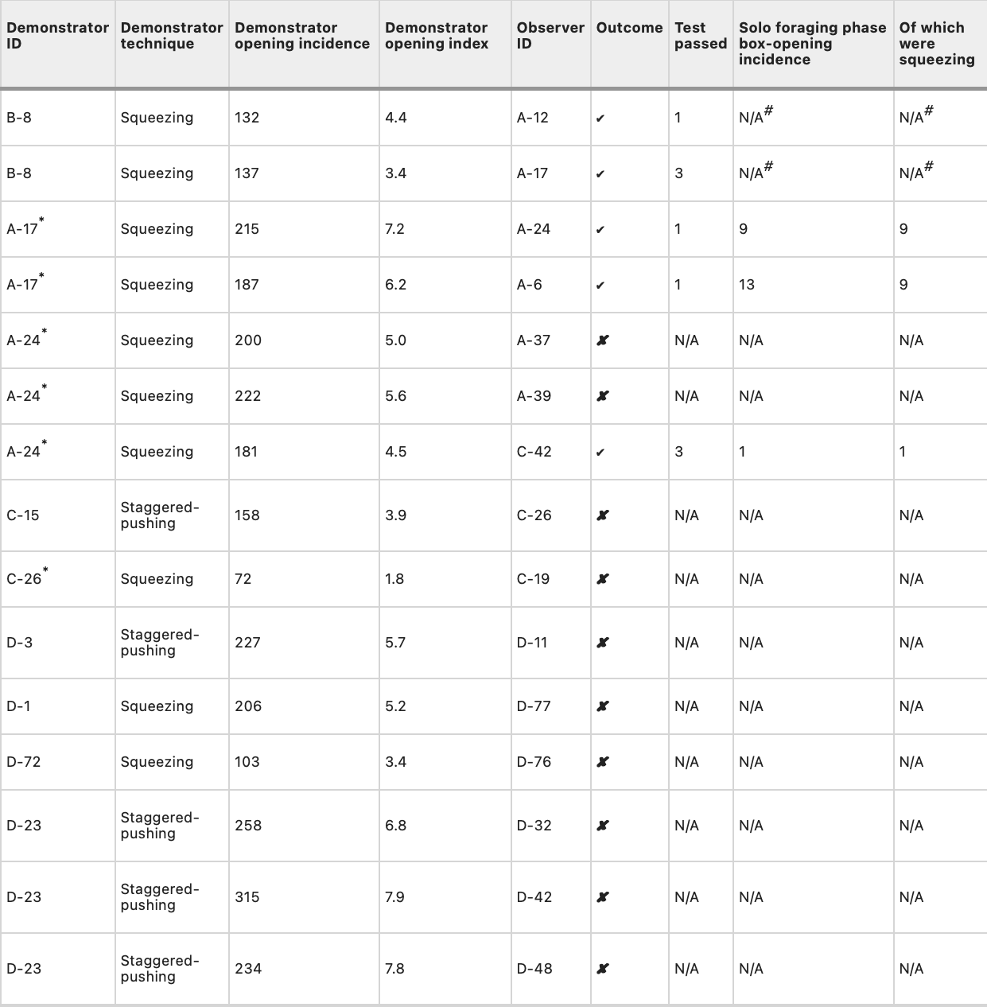
Results
5/15 observer bees completed the multistep puzzle in isolation after being exposed to the demonstrator bee.
(Bridges et al., 2024)

Slide 9
Conclusion
Bees may possess the capacity for cumulative culture
Bees are the first nonhuman animals that could learn a novel behaviour from a conspecific that cannot be learned through trial and error alone

Slide 10
Thanks For Listening!

Slide 11
References
Alem, S., Perry, C. J., Zhu, X., Loukola, O. J., Ingraham, T., Søvik, E., & Chittka, L. (2016). Associative mechanisms allow for social learning and cultural transmission of string pulling in an insect. PLOS Biology, 14(12). doi:10.1371/journal.pbio.1002589
Bridges, A. D., MaBouDi, H., Procenko, O., Lockwood, C., Mohammed, Y., Kowalewska, A., Chittka, L. (2023). Bumblebees acquire alternative puzzle-box solutions via Social Learning. PLOS Biology, 21(3). doi:10.1371/journal.pbio.3002019
Bridges, A. D., Royka, A., Wilson, T., Lockwood, C., Richter, J., Juusola, M., & Chittka, L. (2024). Bumblebees socially learn behaviour too complex to innovate alone. Nature, 627, 572–578. https://doi.org/10.1038/s41586-024-07126-4
De Waal, F. (2017). A Tale of Two Schools. In Are We Smart Enough to Know How Smart Animals Are? (pp. 29–62). New York: W.W. Norton & Company.
Eriksen, N., Miller, L. A., Tougaard, J., & Helweg, D. A. (2005). Cultural change in the songs of humpback whales (Megaptera novaeangliae) from Tonga. Behaviour, 142(3), 305–328. https://doi.org/10.1163/1568539053778283
Hunt, G. R., & Gray, R. D. (2003). Diversification and cumulative evolution in New Caledonian Crow Tool Manufacture. Proceedings of the Royal Society of London. Series B: Biological Sciences, 270(1517), 867–874. doi:10.1098/rspb.2002.2302
Williams, H., Levin, I. I., Norris, D. R., Newman, A. E. M. & Wheelwright, N. T. (2013). Three decades of cultural evolution in Savannah sparrow songs. Anim. Behav. 85, 213–223. https://doi.org/10.1016/j.anbehav.2012.10.028

