Slide 1
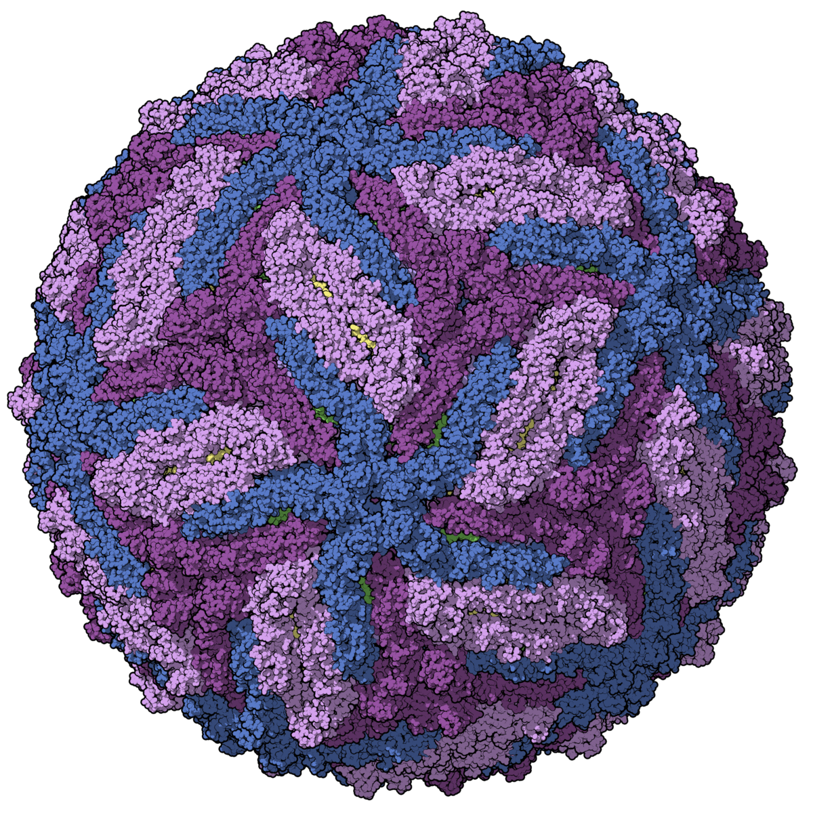
Zika Virus’ Stealth Transmission Through the Placenta
Presentation by: Domenico Comita, Samantha Haire, and Johnathan James

Slide 2
Paper Reviewed
Zika virus NS1 drives tunneling nanotube formation for mitochondrial transfer and stealth transmission in trophoblasts
Authors: Michita RT, Tran LB, Bark SJ, Kumar D, Toner SA, Jose J, Mysorekar IU, Narayanan A
Published: 20 February 2025

Slide 3

Introduction
Zika virus background and biological context

Slide 4
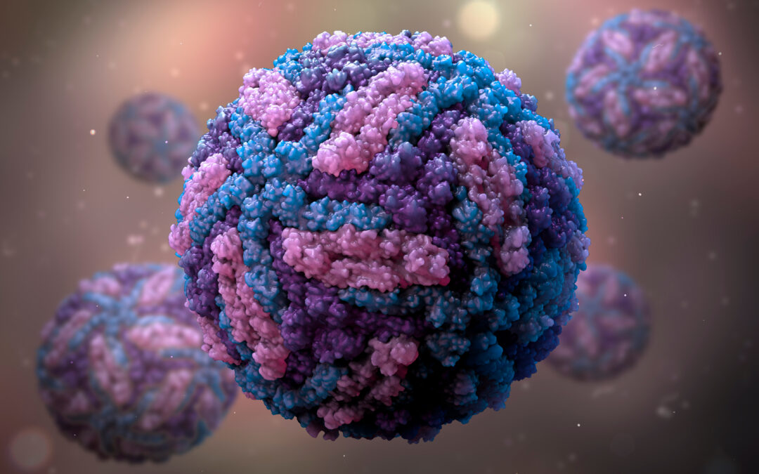
What is Zika Virus?
Introduction
●Mosquito-borne flavivirus (Aedes species)
●Also spreads via sexual contact and vertical transmission
●Usually mild symptoms, but serious during pregnancy
●Can cause microcephaly and other birth defects

Slide 5
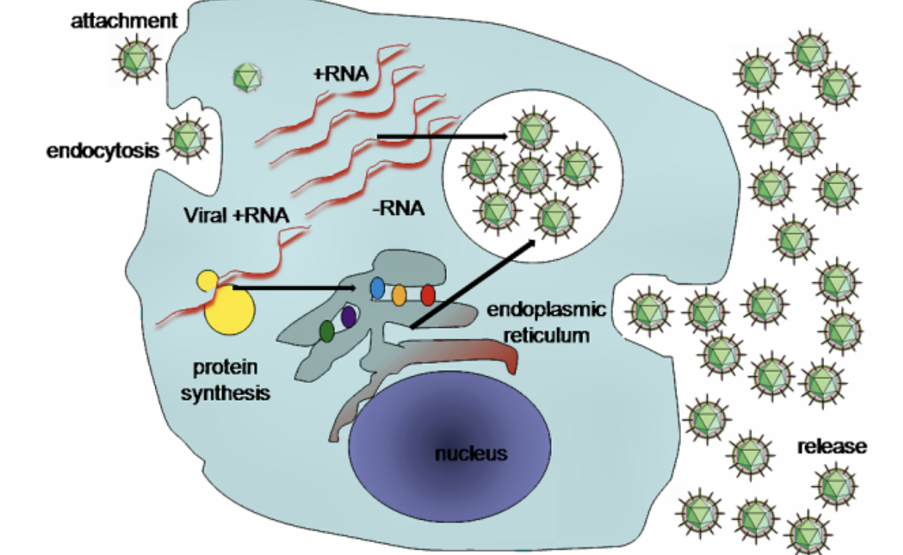
Zika Virus Lifecycle and Immune Evasion
Introduction
●Virus enters cells → releases RNA → replicates and assembles new virions
●Host cells respond with interferons and antibodies
●Zika proteins (NS1, NS5) block immune responses

Slide 6
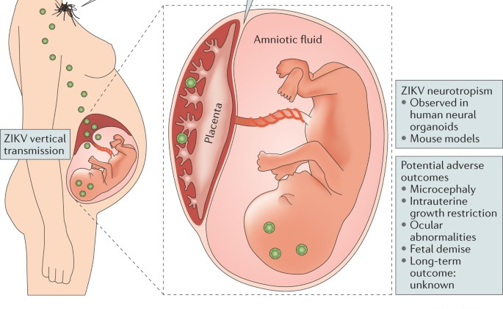
Introduction
Zika Virus and the Placenta
●Placenta normally protects fetus from infection
●Zika infects placental cells (trophoblasts)
●Can be found in placenta, amniotic fluid, and fetal tissues
●NS1 disrupts placental barriers to allow passage

Slide 7
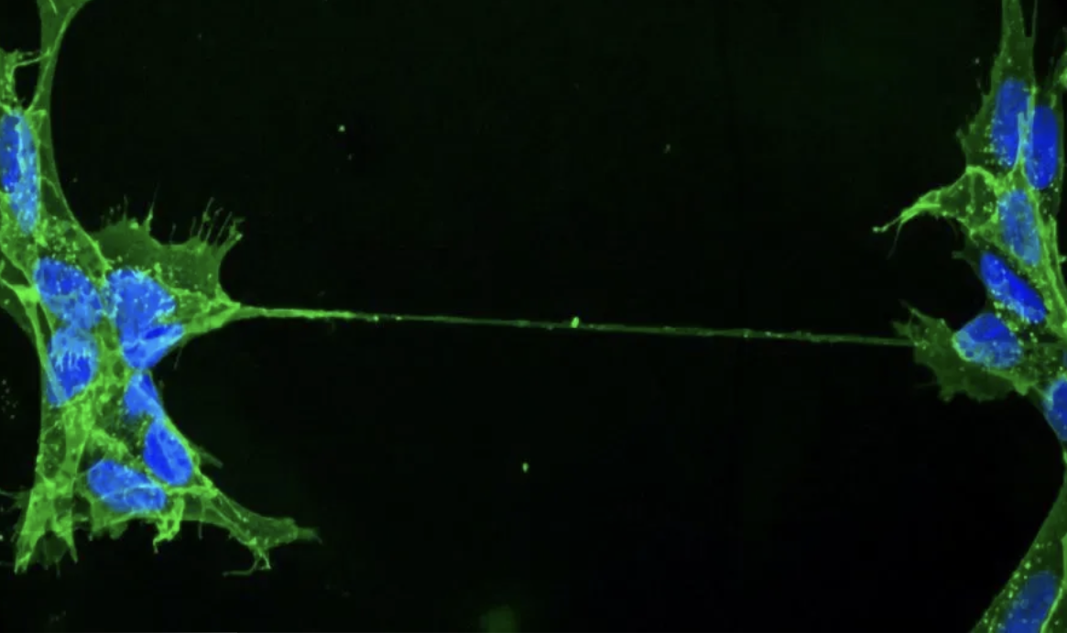
Tunneling Nanotubes (TNTs)
Introduction
●Thin tubes that connect cells and share contents
●Allow transfer of proteins, signals, even mitochondria
●Viruses like HIV and SARS-CoV-2 use TNTs for stealthy spread
●Zika might use TNTs in placental cells

Slide 8
Introduction
Research Questions and Objectives
● Does Zika use TNTs to spread in placental cells?
● Does NS1 protein trigger TNT formation?
● Can TNTs transfer mitochondria and viral components?
● Do TNTs help Zika evade immune detection?

Slide 9
Methods
How the study was conducted

Slide 10
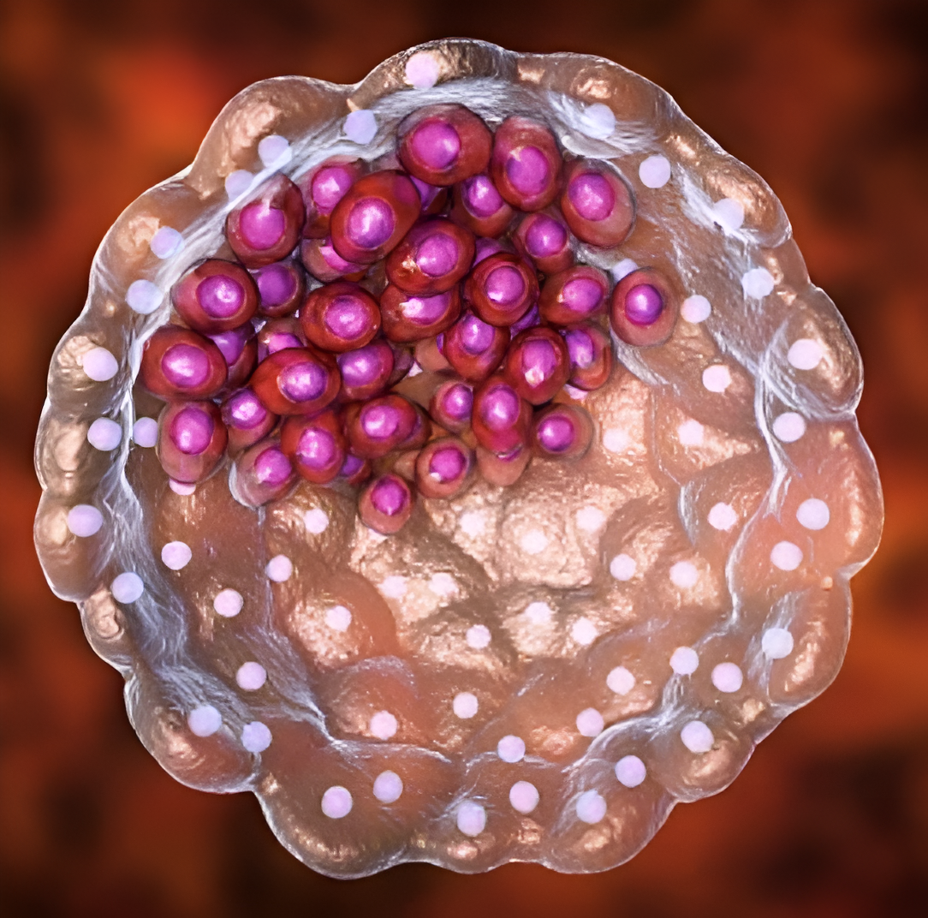
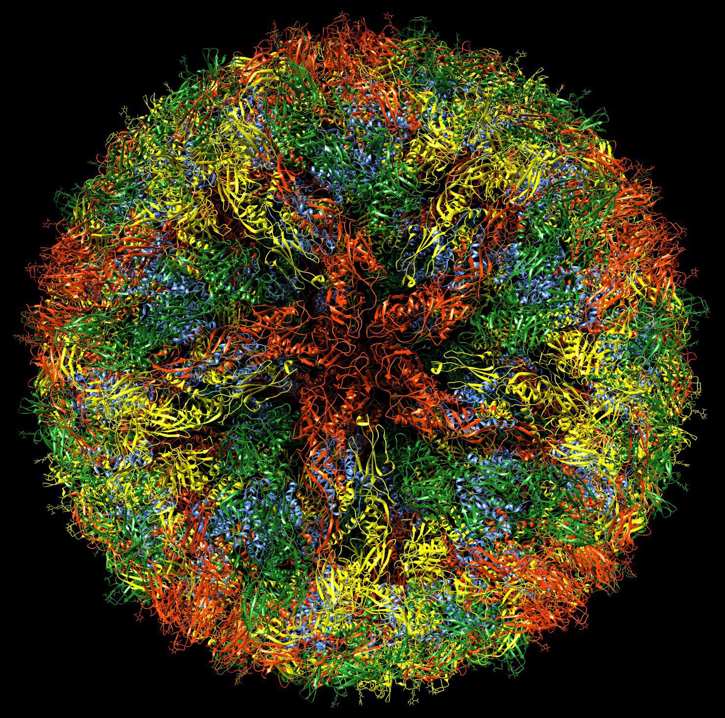
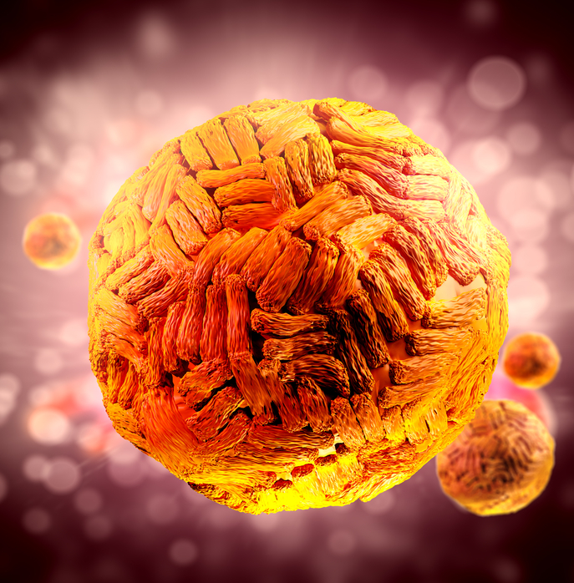
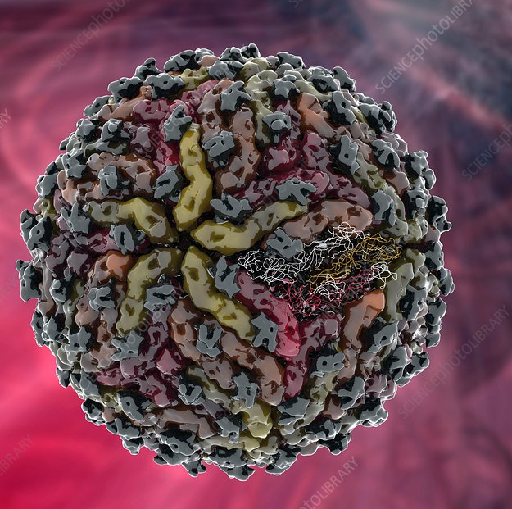
Methods
Cell Lines and Viral Strains Used
●Human trophoblasts: HTR8/SVneo, JEG3, placental explants
●ZIKV strains: MR-766 (African) and PRVABC-59 (Asian)
●Compared to DENV2 and YFV (other flaviviruses)

Slide 11
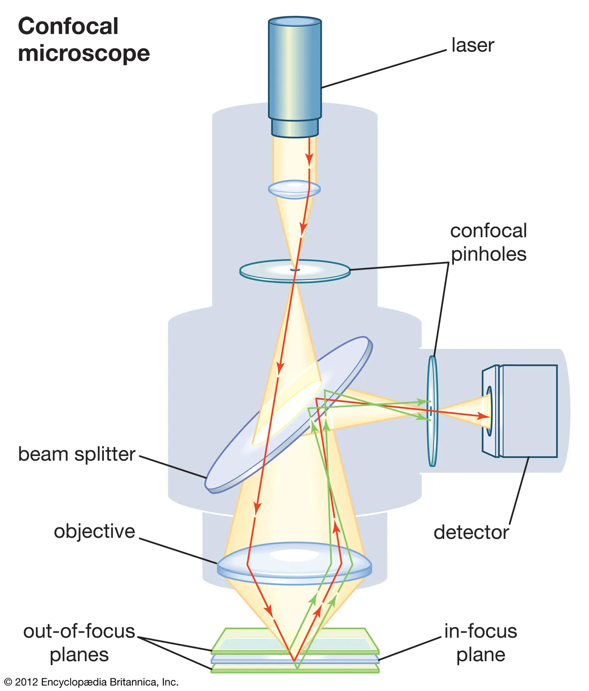
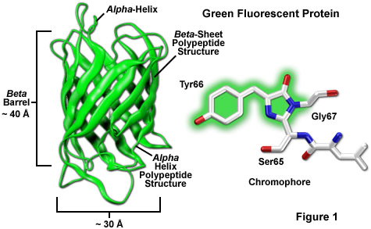
Visualizing TNTs and Mitochondria
Methods
●Used confocal microscopy and live-cell imaging
●Tagged NS1 with GFP to trace its location
●Labeled mitochondria to track their movement
●Defined TNTs as long, thin, floating, actin-based tubes

Slide 12
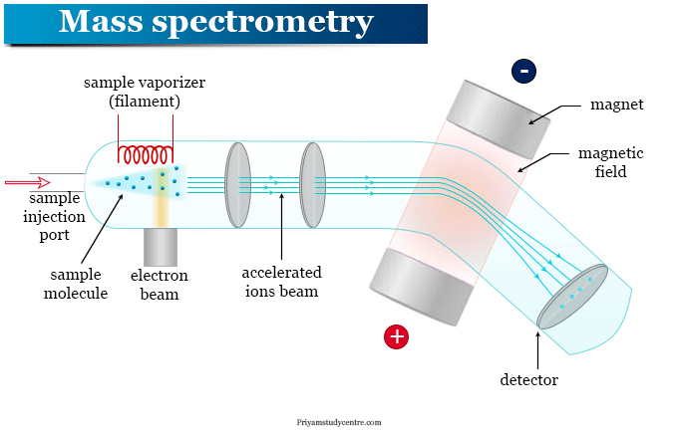
NS1 Host Interaction
Methods
●Pulled down NS1 and identified partners via mass spectrometry
●NS1 interacts with cytoskeleton, membrane, and mitochondrial proteins

Slide 13

Results
Most important findings and supplementary figures

Slide 14
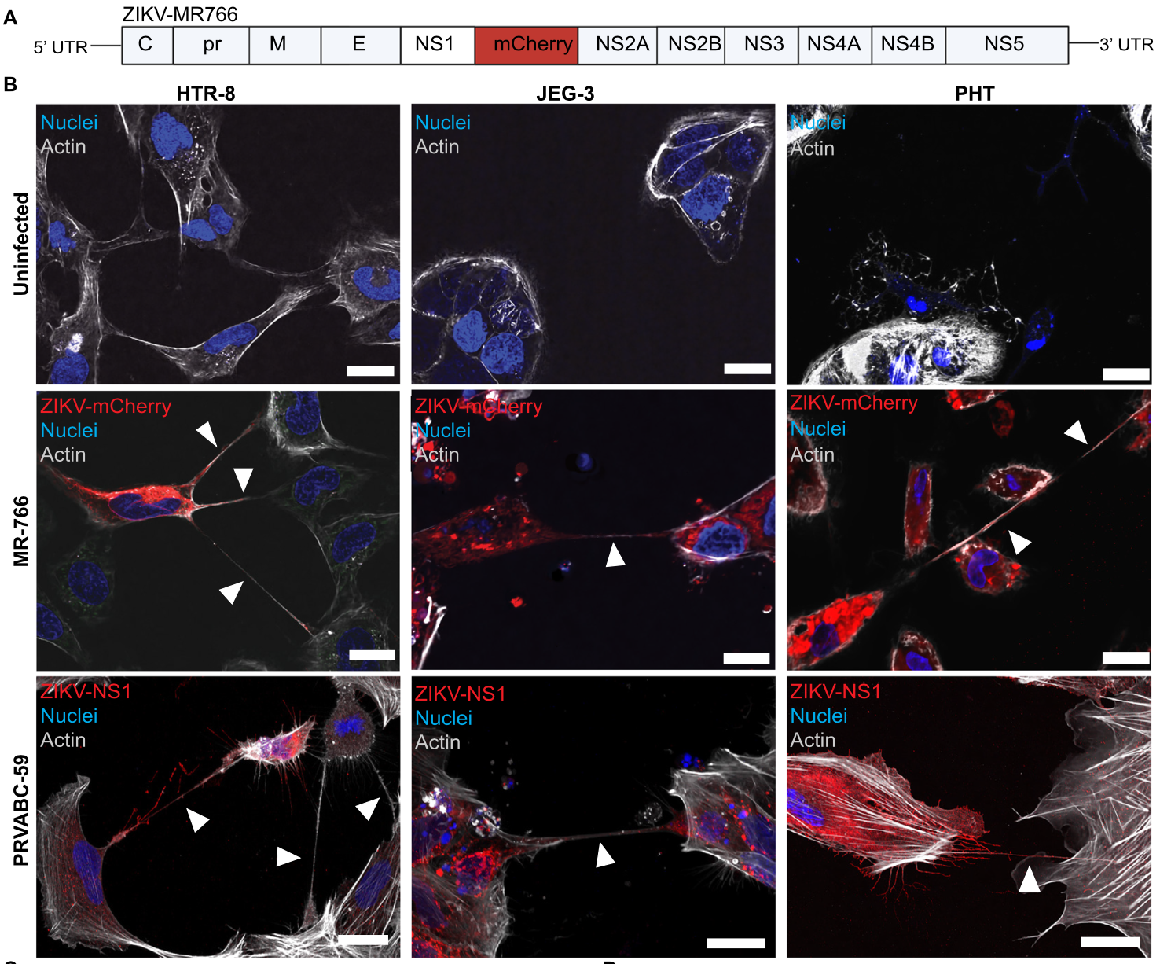
Zika Virus (ZIKV) induces the formation of tunnelling nanotubes (TNTs) in trophoblast cells
Results
By utilizing TNTs, ZIKV can cross trophoblast cells from the parent and transfer viral RNA into the fetus
ZIKV MR-766 and ZIKV PRVABC-59 generate TNTs in trophoblasts but other ortho flaviviruses in the Flaviviridae family like Dengue Fever (DENV2) and Yellow Fever Virus (YFV) cannot.

Slide 15
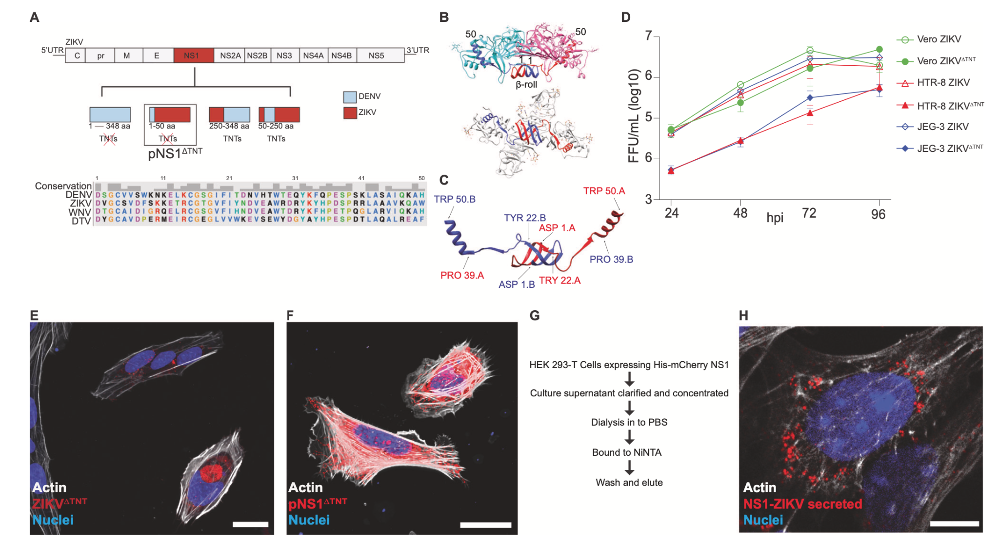
TNT formation is solely driven by the N-terminus of the non- structural protein ZIKV-NS1
Results

Slide 16
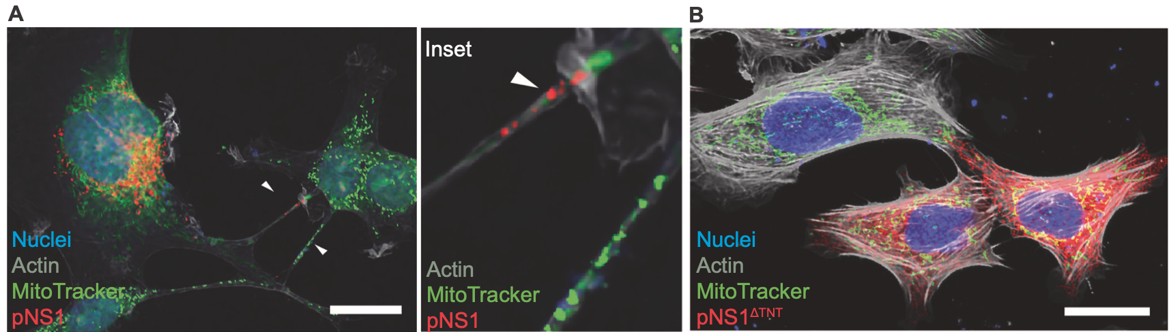
Zika Virus protein NS1 induces transfer of mitochondria between cells via TNTs
Results
NS1-expressing cells acquire mitochondria from donor cells via TNTs (A)
Cells expressing pNS1^{ΔTNT} lacking the ability to construct TNTs have very limited mitochondrial accumulation from surrounding donor cells (B)
JEG-3 cells are efficient mitochondrial donors and HTR-8 ZIKV-NS1 expressing cells are more effective mitochondria recipients

Slide 17
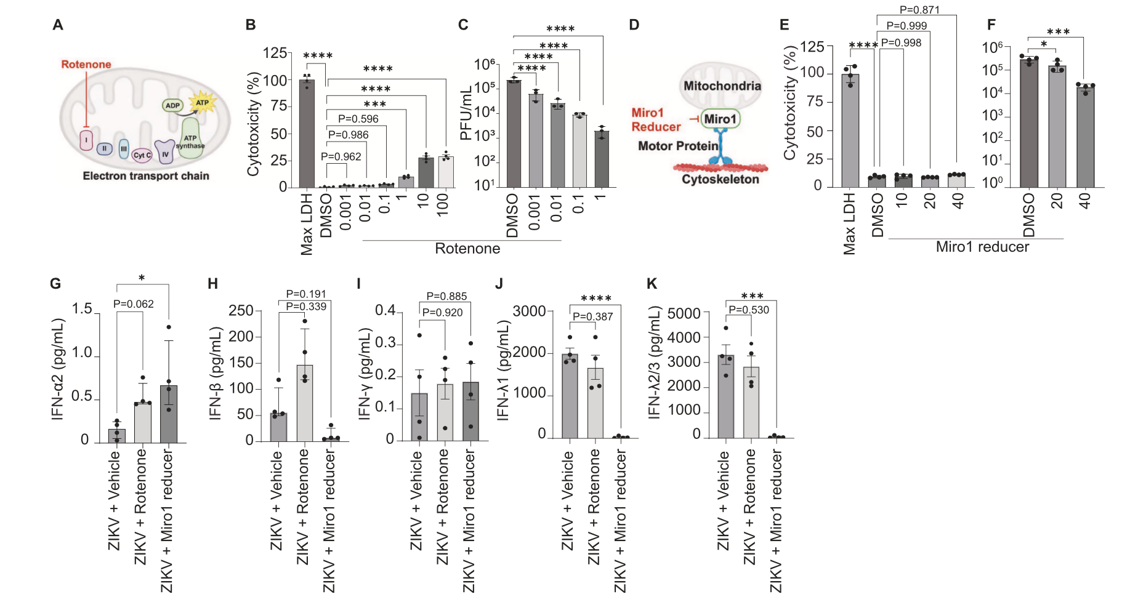
The growth of ZIKV and associated IFN response is affected by the inhibition of mitochondrial function
Results

Slide 18

Discussion
Main findings, limitations and future work

Slide 19
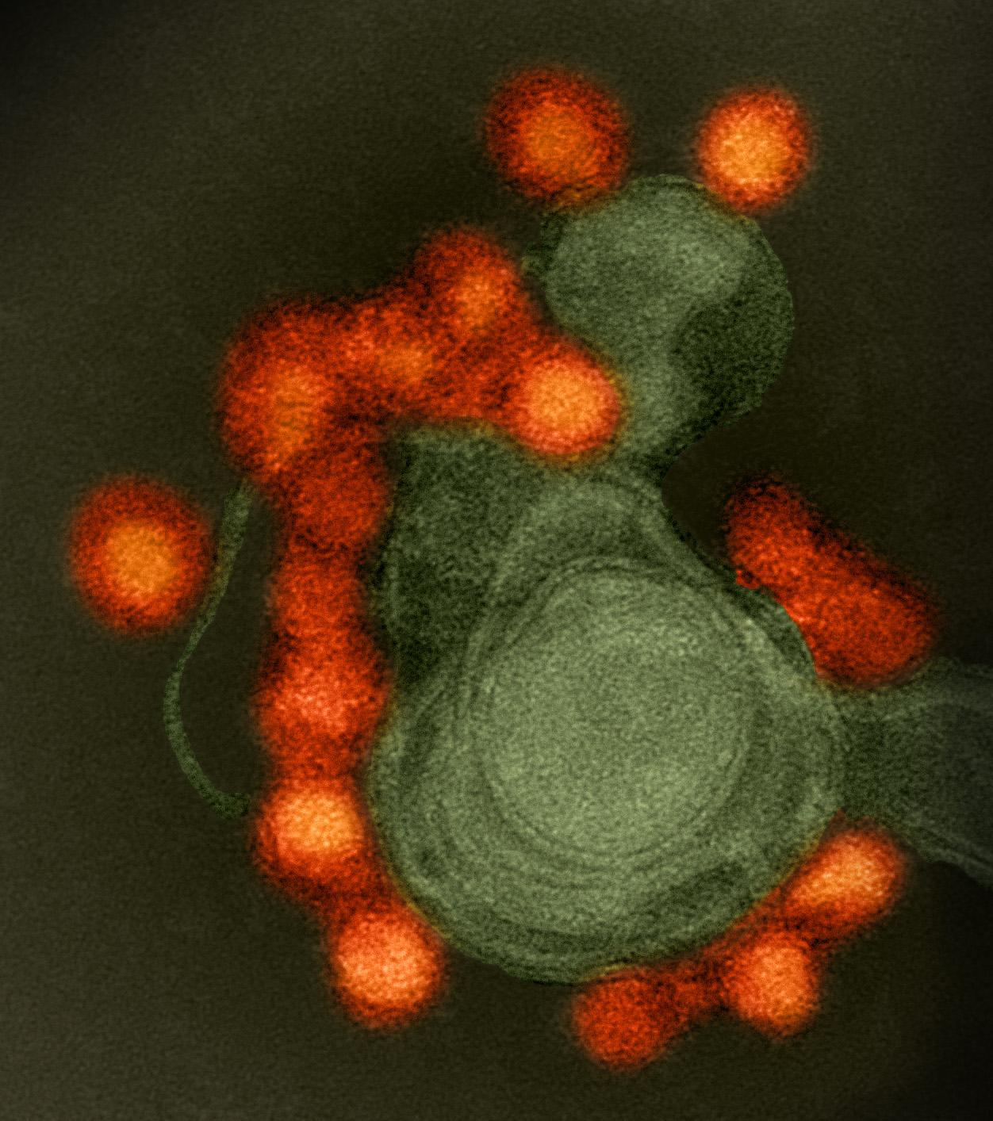
ZIKV NS1 Promotes TNT Formation
Discussion
ZIKV NS1 triggers TNTs unlike other flaviviruses (e.g., DENV, WNV)
TNTs help ZIKV spread between cells and evade antibodies
NS1’s membrane-binding domains likely drive this activity

Slide 20
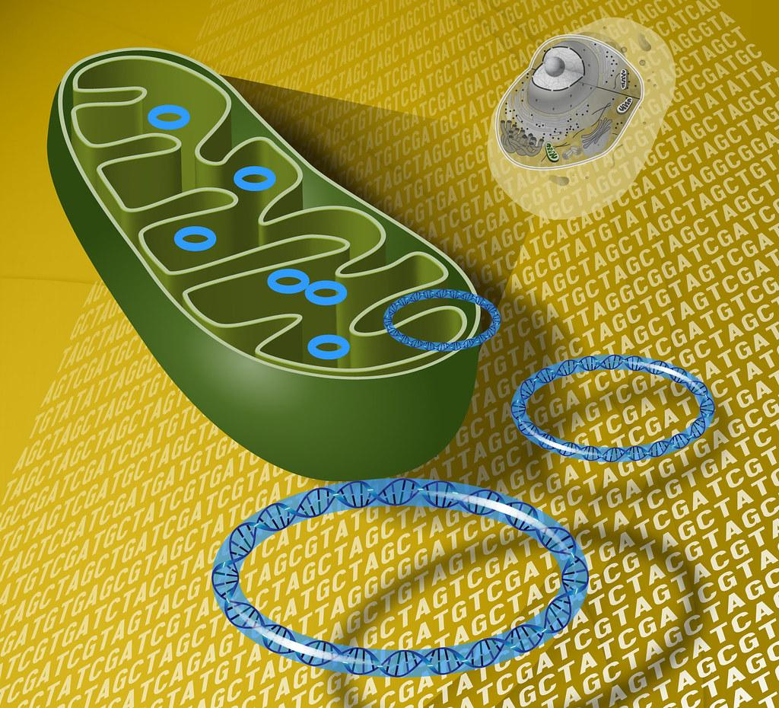
TNTs Facilitate Mitochondrial Hijacking
Discussion
ZIKV-infected cells accumulate mitochondria via TNTs
Mitochondria may support viral replication and delay cell death
NS1 colocalizes with mitochondria inside TNTs

Slide 21

Immune Evasion via TNTs
Discussion
The ZIKV TNT mutant triggers stronger IFN response
TNTs help hide viral RNA from innate immune sensors
Suggests TNTs are key to immune suppression in trophoblasts

Slide 22
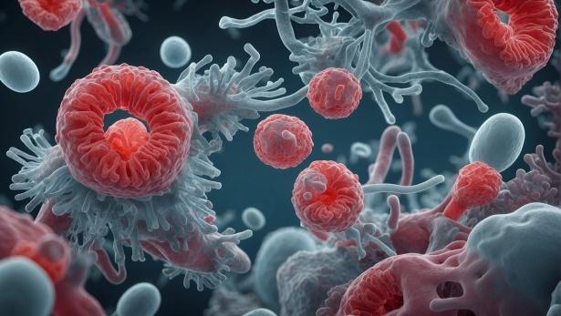
Cell-Type Specific Effects
Discussion
EVTs (HTR-8 cells) = more TNTs, weaker IFN response
STBs = resistant, strong baseline IFN-λ secretion
ZIKV may exploit EVTs for vertical transmission

Slide 23

Limitations and Future Directions
Discussion
Role of NS1 in IFN suppression still unclear
In vivo models needed to confirm TNT role in transmission
Organ-on-chip studies and placenta imaging show promise

Slide 24



Summary
Discussion
NS1-induced TNTs = viral spread + immune evasion
Mitochondrial transfer supports infected cells
Targeting TNTs or NS1 could limit ZIKV spread

Slide 25
Thanks for Listening!

Slide 26
References
Barrows NJ, Campos RK, Powell ST, Prasanth KR, Schott-Lerner G, Soto-Acosta R, Galarza-Muñoz G, McGrath EL, et al. 2016. A screen of FDA-approved drugs for inhibitors of Zika virus infection. Cell Host Microbe. 20(2):259-270. doi: 10.1016/j.chom.2016.07.004.
Cao-Lormeau VM, Blake A, Mons S, Lastère S, Roche C, Vanhomwegen J, Dub T, Baudouin L, et al. 2016. Guillain-Barré Syndrome outbreak associated with Zika virus infection in French Polynesia: a case-control study. Lancet. 387(10027):1531-1539. doi: 10.1016/S0140-6736(16)00562-6.
Li A, Yu J, Lu M, Ma Y, Attia Z, Shan C, Xue M, Liang X, et al. 2018. A Zika virus vaccine expressing premembrane-envelope-NS1 polyprotein. Nat Commun. 9(1):3067. doi: 10.1038/s41467-018-05276-4.
Miner JJ, Diamond MS. 2017. Zika virus pathogenesis and tissue tropism. Cell Host Microbe. 21(2).
Mlakar J, Korva M, Tul N, Popović M, Poljšak-Prijatelj M, Mraz J, Kolenc M, Resman Rus K, et al. 2016. Zika virus associated with microcephaly. N Engl J Med. 374(10):951-958. doi: 10.1056/NEJMoa1600651.
Morrison TE, Diamond MS. 2017. Animal models of Zika virus infection, pathogenesis, and immunity. J Virol. 91(8):e00009-17. doi: 10.1128/JVI.00009-17.
Mwaliko C, Nyaruaba R, Zhao L, Atoni E, Karungu S, Mwau M, Lavillette D, Xia H, Yuan Z. 2021. Zika virus pathogenesis and current therapeutic advances. Pathog Glob Health. 115(1):21-39. doi: 10.1080/20477724.2020.1845005.
Public Health Agency of Canada. 2016. Canadian recommendations on the prevention and treatment of Zika virus: update. Can Commun Dis Rep. 42(5):101-111. doi: 10.14745/ccdr.v42i05a01.
Public Health Agency of Canada. 2016. Zika virus: a guide for health professionals. [accessed 2025 Mar 22]. https://www.canada.ca/en/public-health/services/publications/diseases-conditions/zika-virus-counselling-travellers.html
Public Health Agency of Canada. 2016. Zika virus: pregnant or planning a pregnancy. [accessed 2025 Mar 22]. https://www.canada.ca/en/public-health/services/diseases/zika-virus/pregnant-planning-pregnancy.html
Public Health Agency of Canada. 2016. Zika virus: prevention and risks. [accessed 2025 Mar 22]. https://www.canada.ca/en/public-health/services/diseases/zika-virus/prevention-risks.html
Public Health Agency of Canada. 2016. Zika virus: prevention and treatment recommendations. [accessed 2025 Mar 23]. https://www.canada.ca/en/public-health/services/publications/diseases-conditions/zika-virus-prevention-treatment-recommendations.html
Public Health Agency of Canada. 2018. Zika virus: for health professionals. [accessed 2025 Mar 22]. https://www.canada.ca/en/public-health/services/diseases/zika-virus/health-professionals.html
Schoch CL, et al. 2020. NCBI Taxonomy: a comprehensive update on curation, resources and tools. Database (Oxford). 2020:baaa062. doi: 10.1093/database/baaa062.
Shan C, Xia H, Haller SL, Azar SR, Liu Y, Liu H, Xie X, Wang T, et al. 2017. A Zika virus envelope mutation preceding the 2015 epidemic enhances virulence and fitness for transmission. Proc Natl Acad Sci USA. 114(33):E10009-E10017. doi: 10.1073/pnas.1706035114.
Sirohi D, Chen Z, Sun L, Klose T, Pierson TC, Rossmann MG, Kuhn RJ. 2016. The 3.8 Å resolution cryo-EM structure of Zika virus. Science. 352(6284):467-470. doi: 10.1126/science.aaf5316.
Wang X, Zhang X, Dong X, Liu H, Luo Z, Zhang M, Li Y, Liu Y, et al. 2017. Atomic structure of Zika virus NS1 reveals a unique surface topology. Proc Natl Acad Sci USA. 114(28):E5865-E5874. doi: 10.1073/pnas.1704884114.
Wen Z, Song H, Ming GL. 2017. How does Zika virus cause microcephaly? Genes Dev. 31(9):849-861. doi: 10.1101/gad.298216.117.
Wu H, Huang XY, Sun MX, Wang Y, Zhou HY, Tian Y, He B, Li K, Li DY, Wu AP, et al. 2023. Zika virus targets human trophoblast stem cells and prevents syncytialization in placental trophoblast organoids. Nat Commun. 14(1):1543. doi: 10.1038/s41467-023-37135-1.

