Slide 1
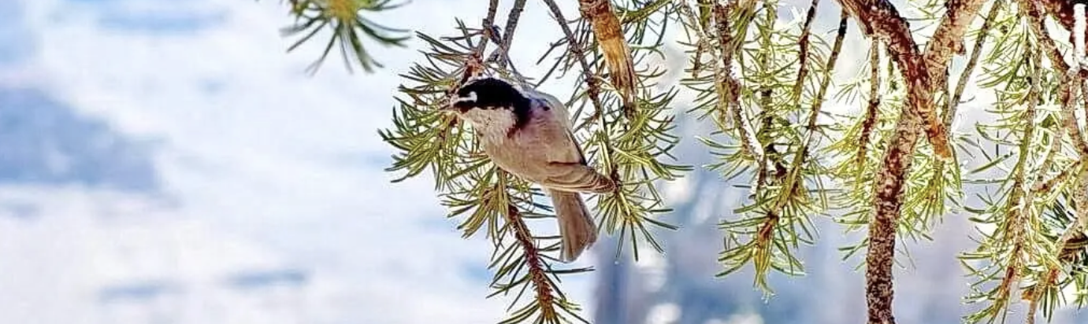
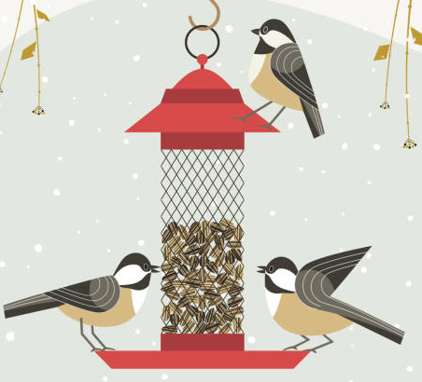



Feces, stress and chickadees: Fecal corticosterone analysis as a measurement of stress in urban and rural Mountain Chickadee (Poecile gambeli) nestlings.
Feces, Stress and Chickadees: Fecal Corticosterone Analysis as a Measurement of Stress in Urban and Rural Mountain Chickadee (Poecile gambeli) Nestlings.
Researcher - Domenico Comita; Primary Supervisory - Dr. Matthew Reudink; Secondary Supervisor - Dr. Emily Studd

Slide 2

Urbanization
How does it impact Mountain Chickadee populations?

Slide 3
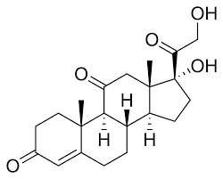
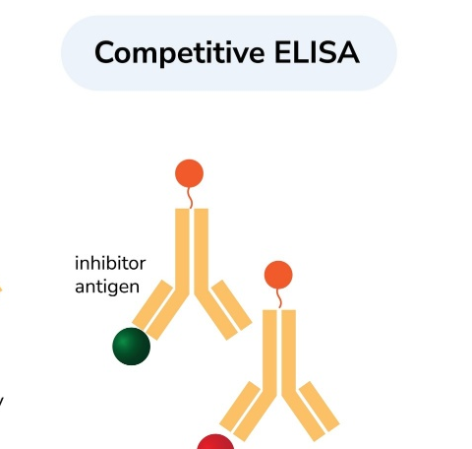

How is Stress Measured?

Slide 4
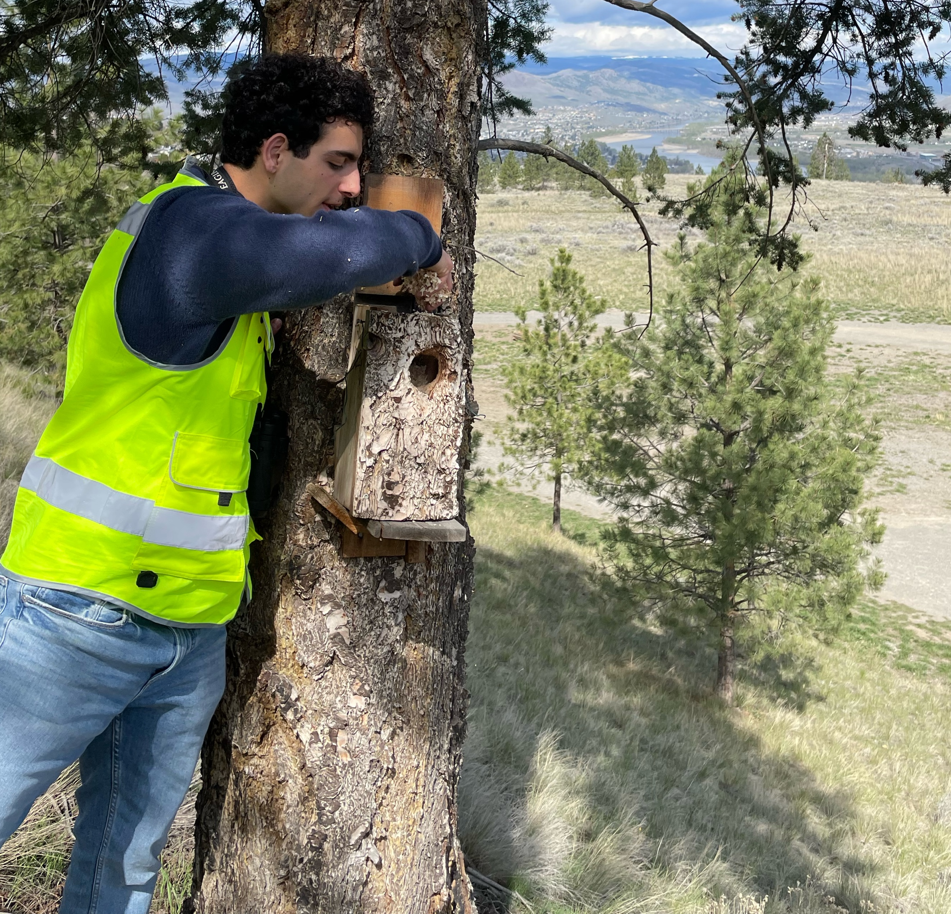
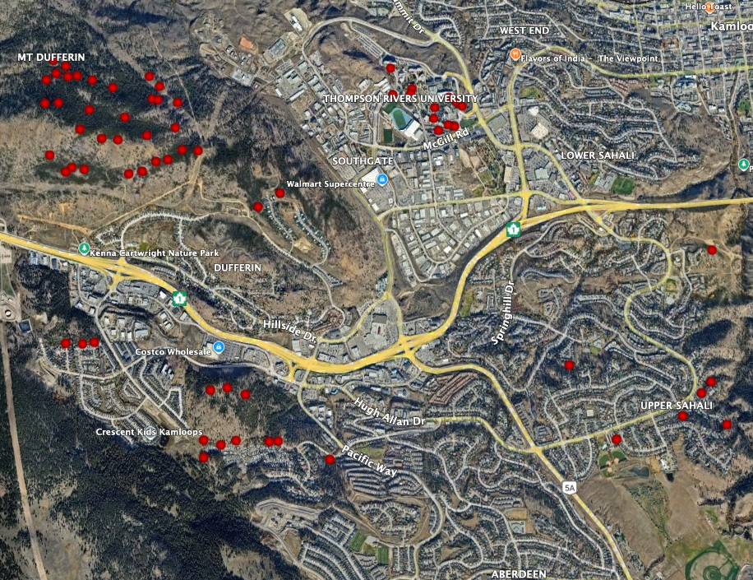
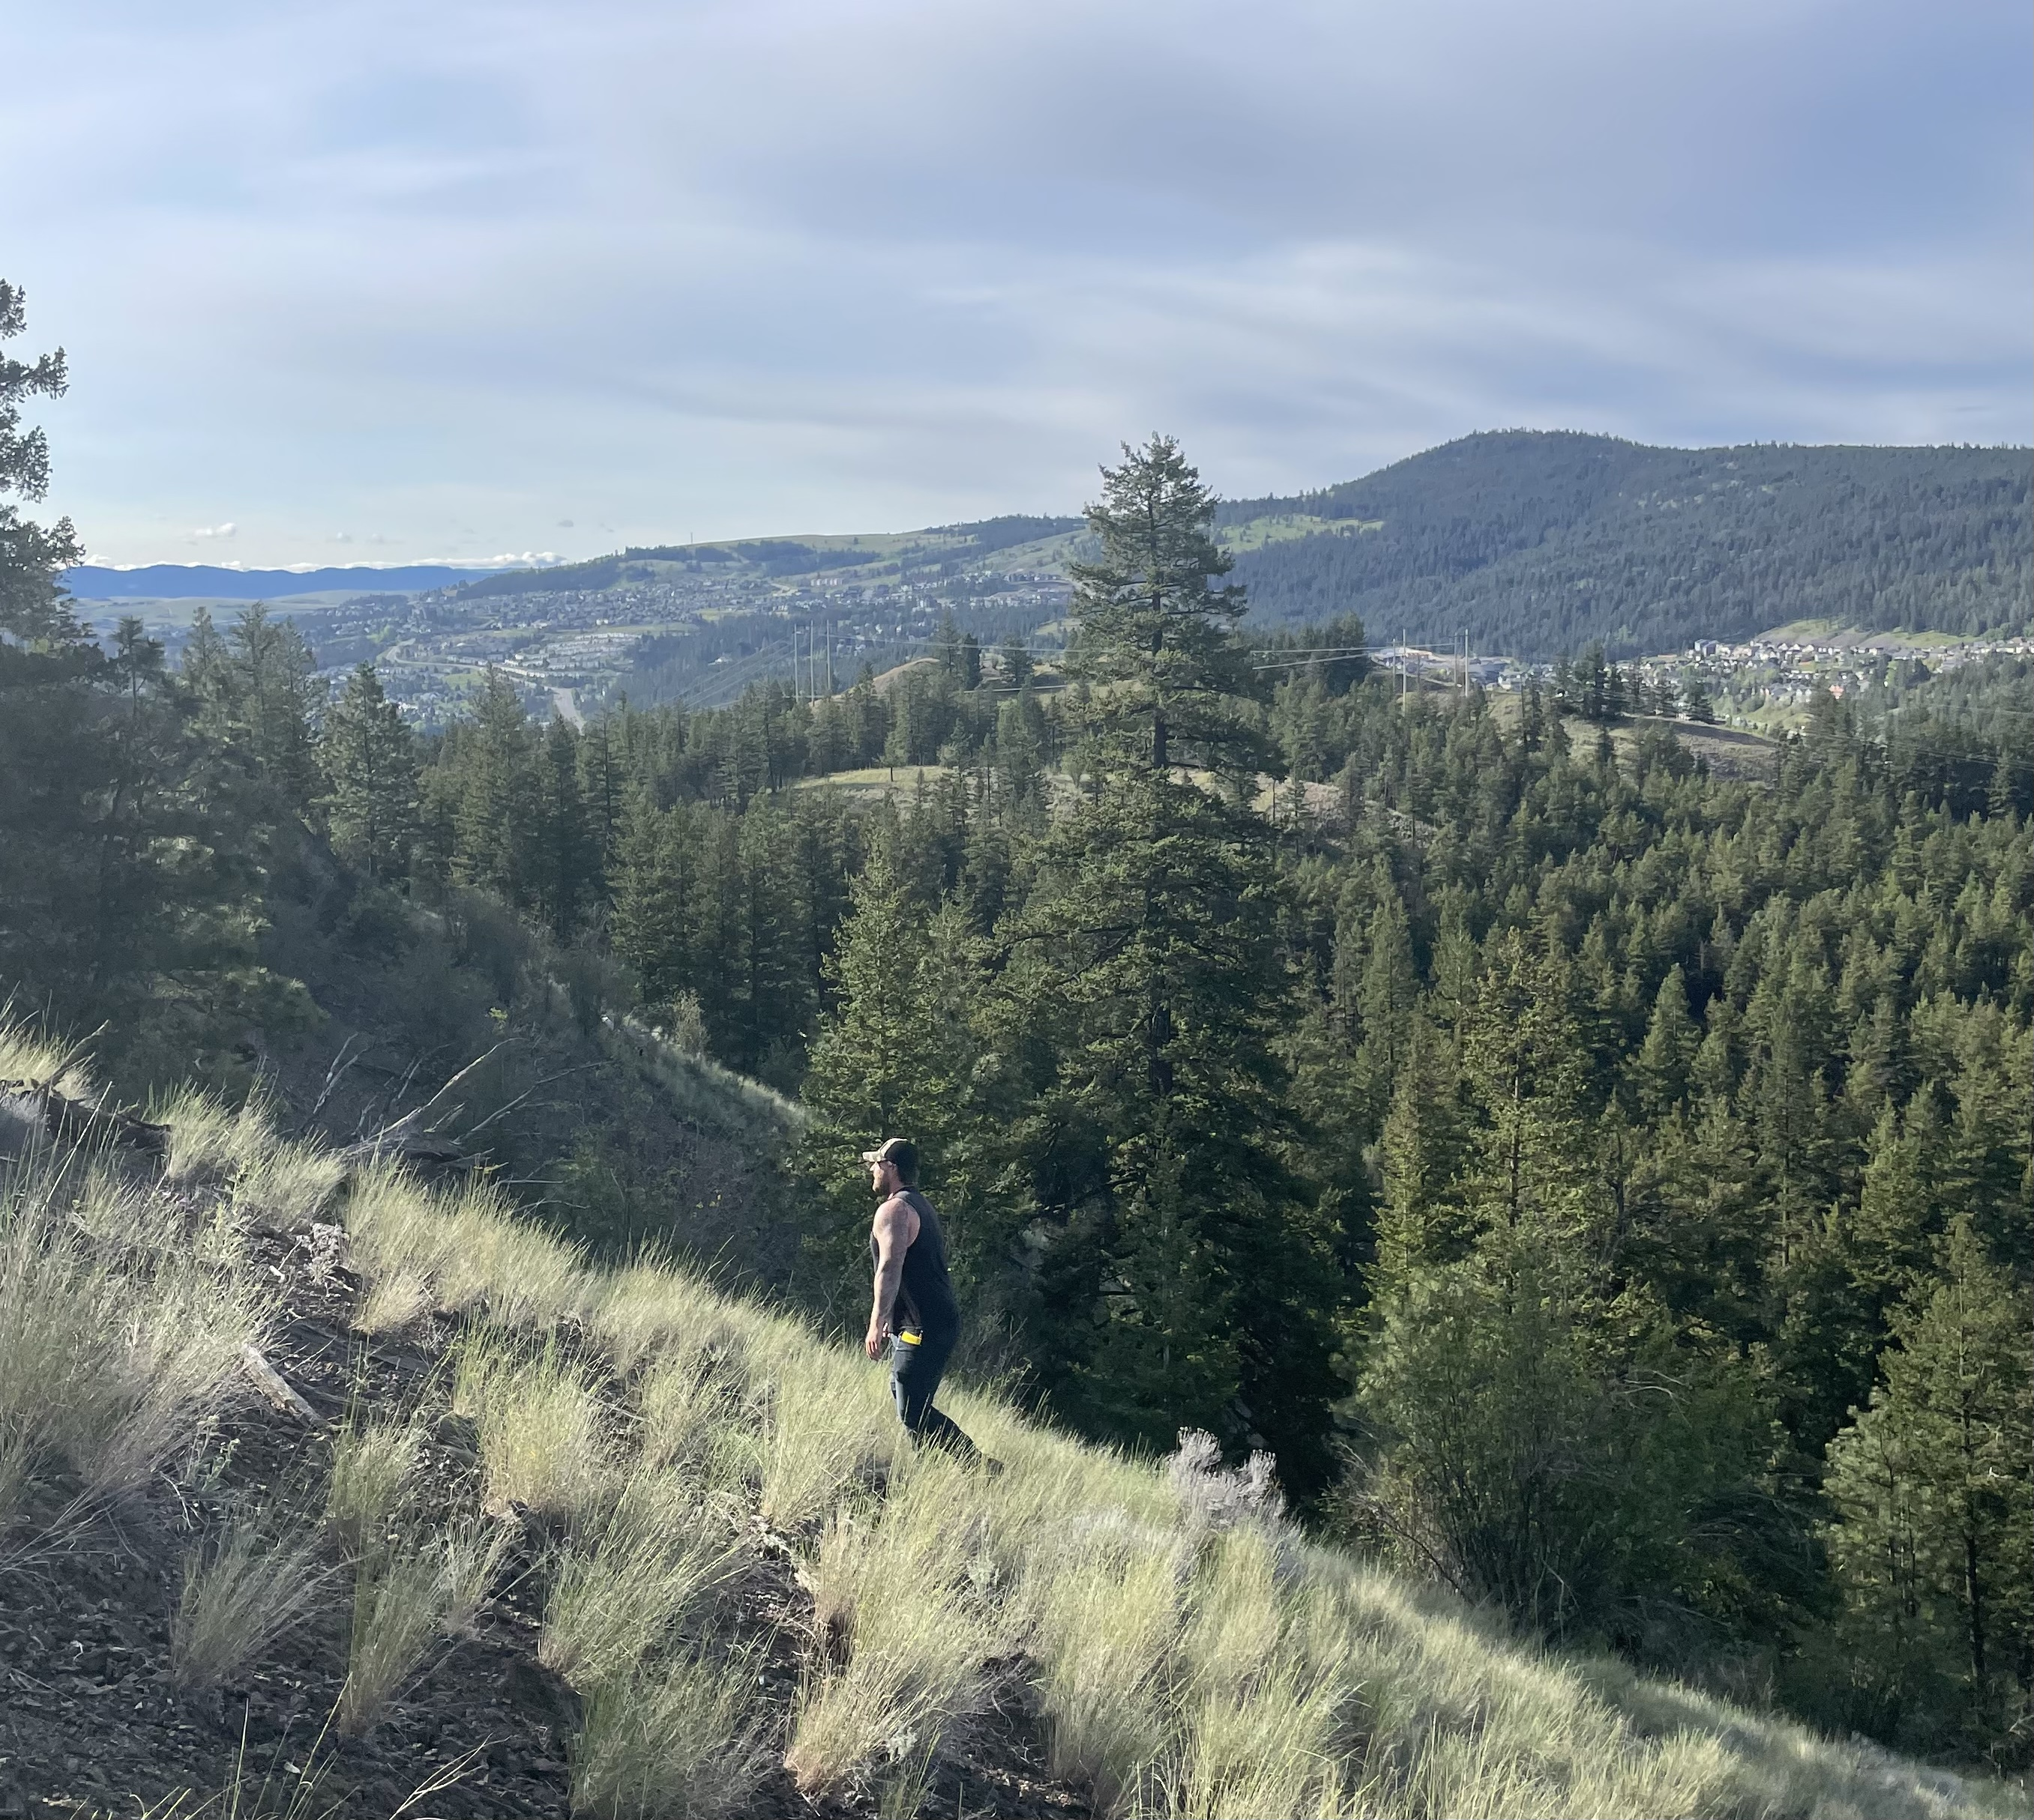
My Project
Part of a 12-year ongoing study
Nest Box Sites
Rural: Kenna Cartwright Nature Park
Urban: City of Kamloops
Why study stress?

Slide 5
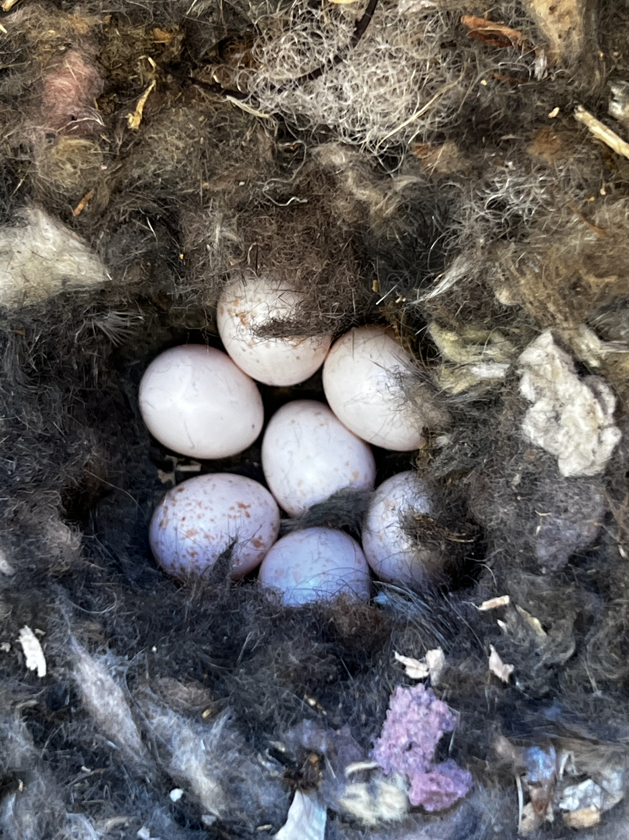

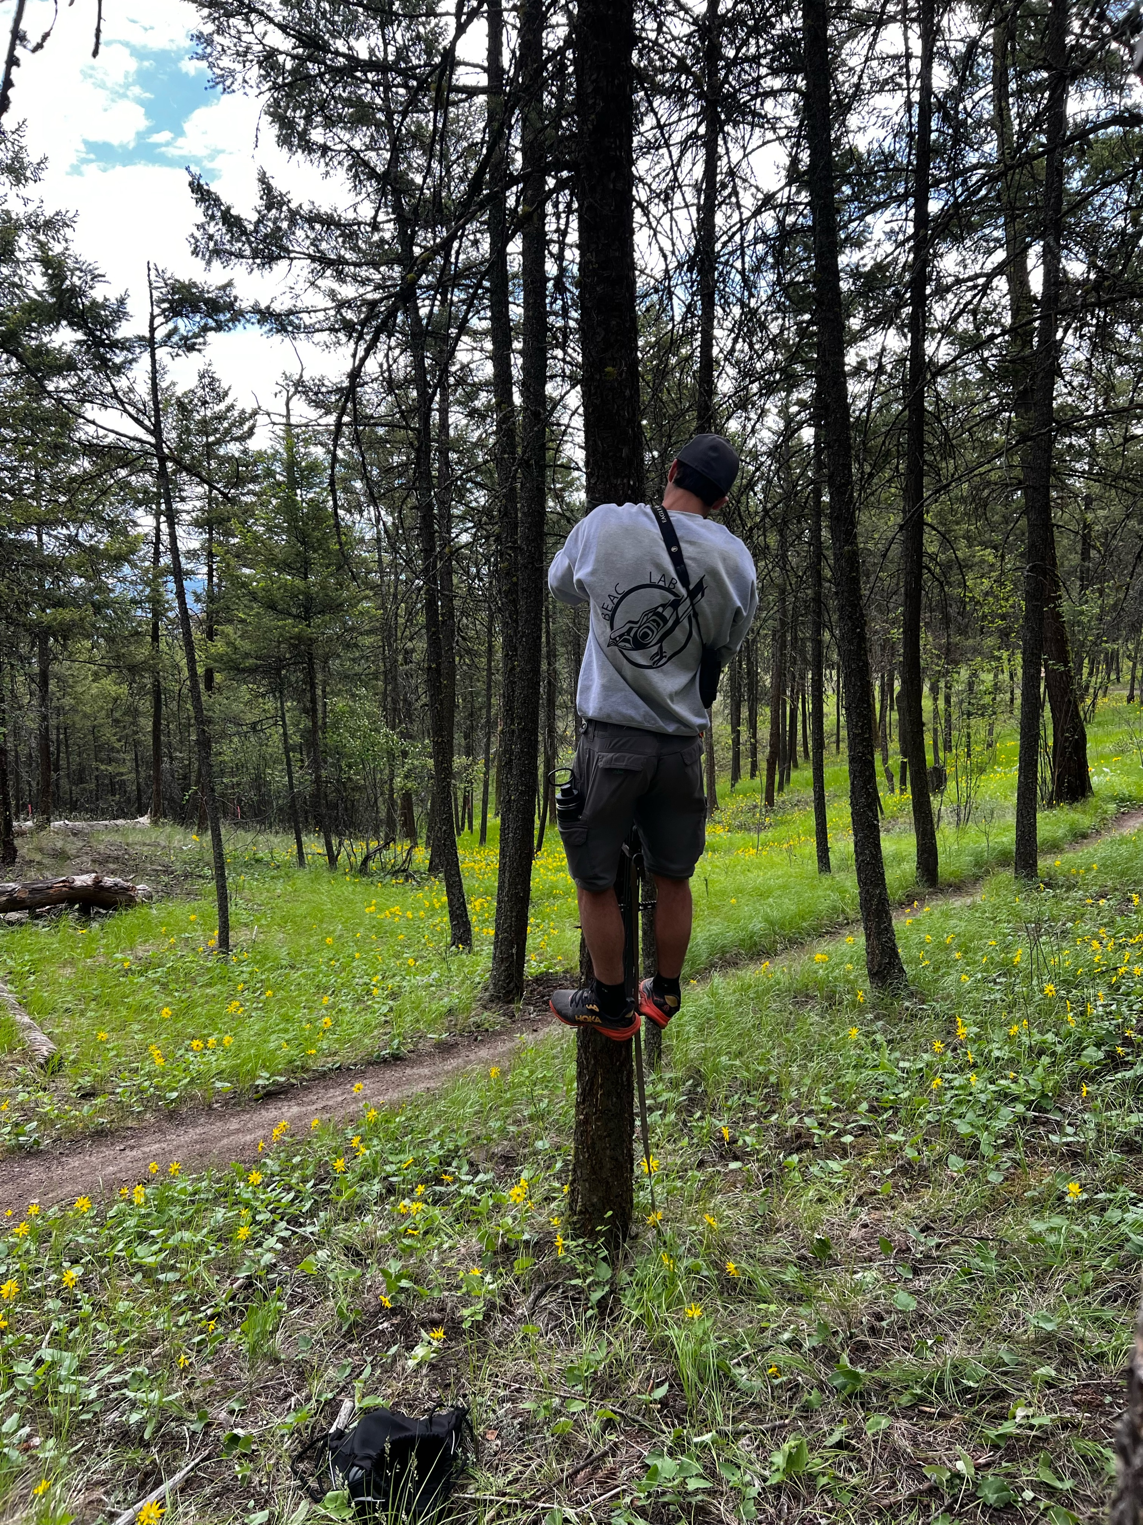
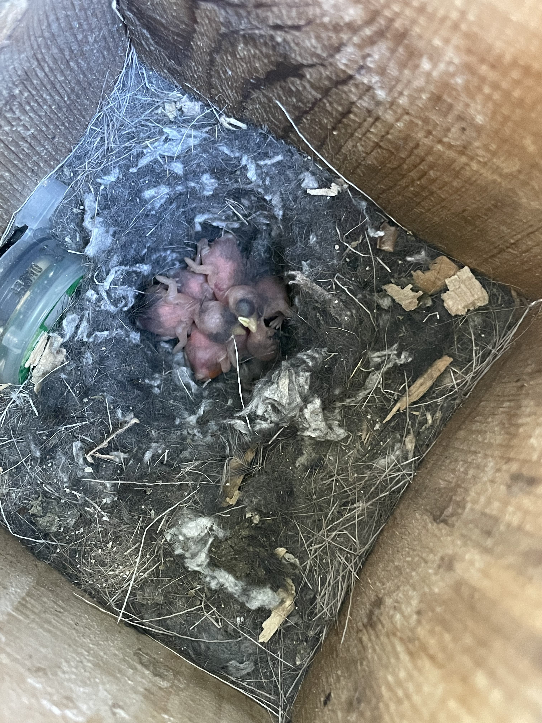
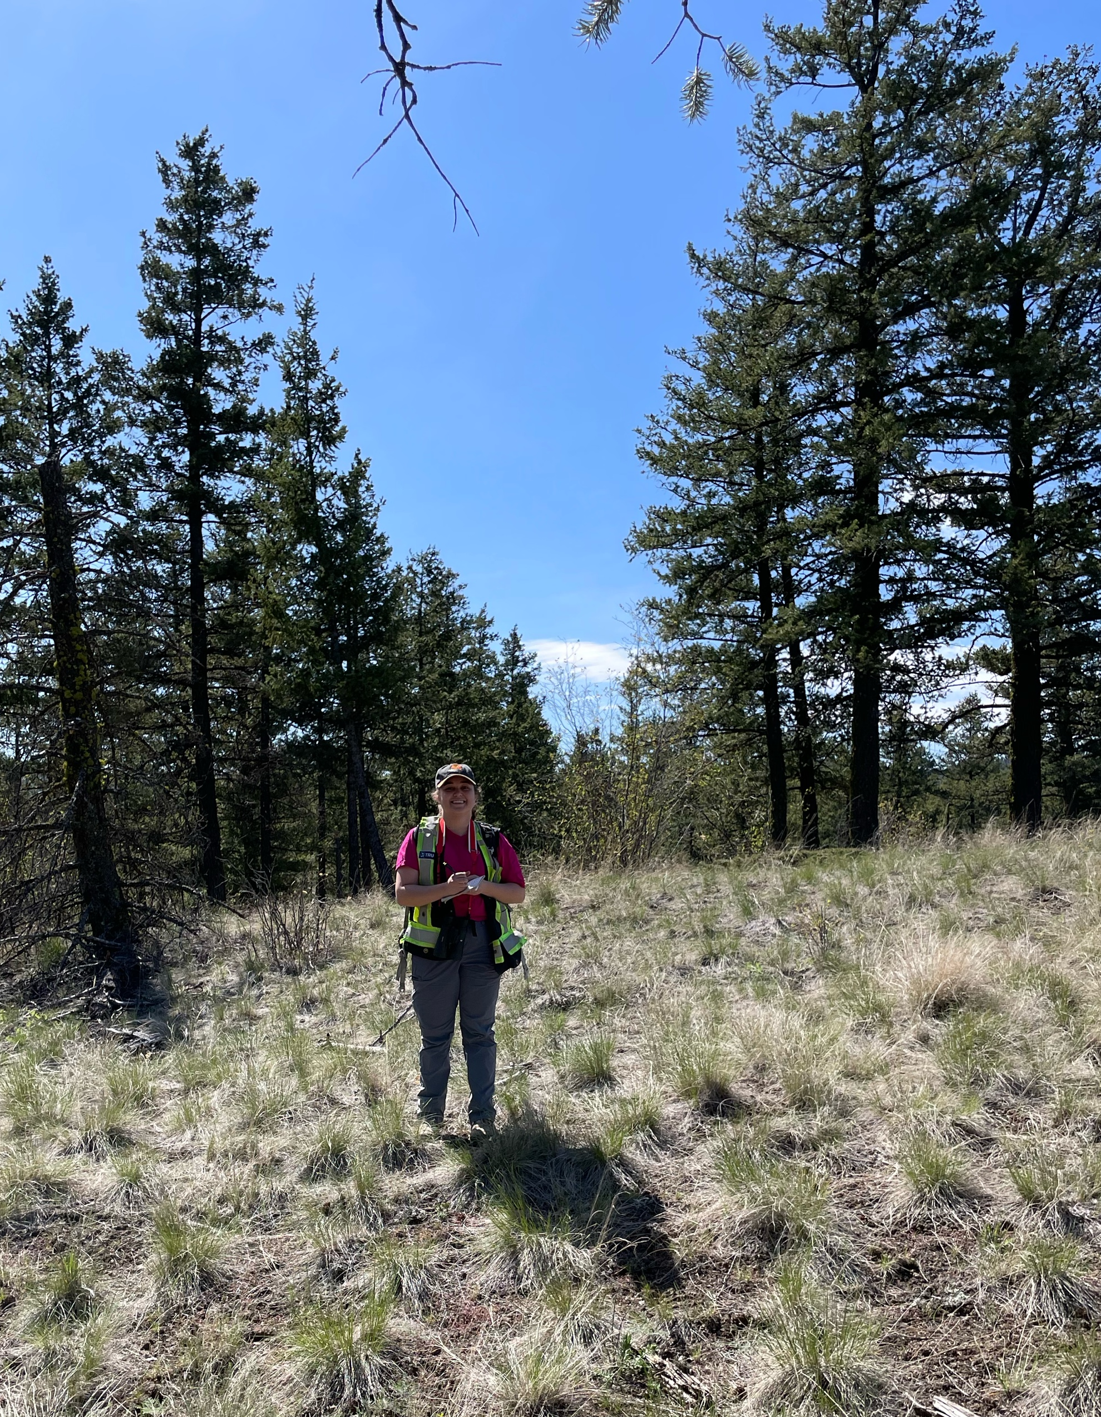
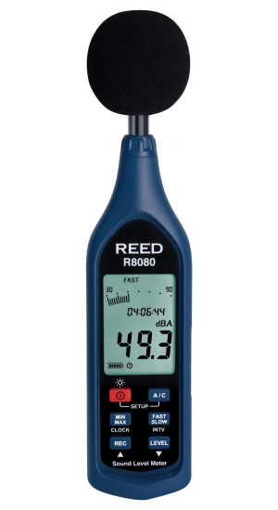
Goal #1
Monitor Activity
Nest Composition
Hatch date & Brood size
Temperature & Noise
Predators?!

Slide 6
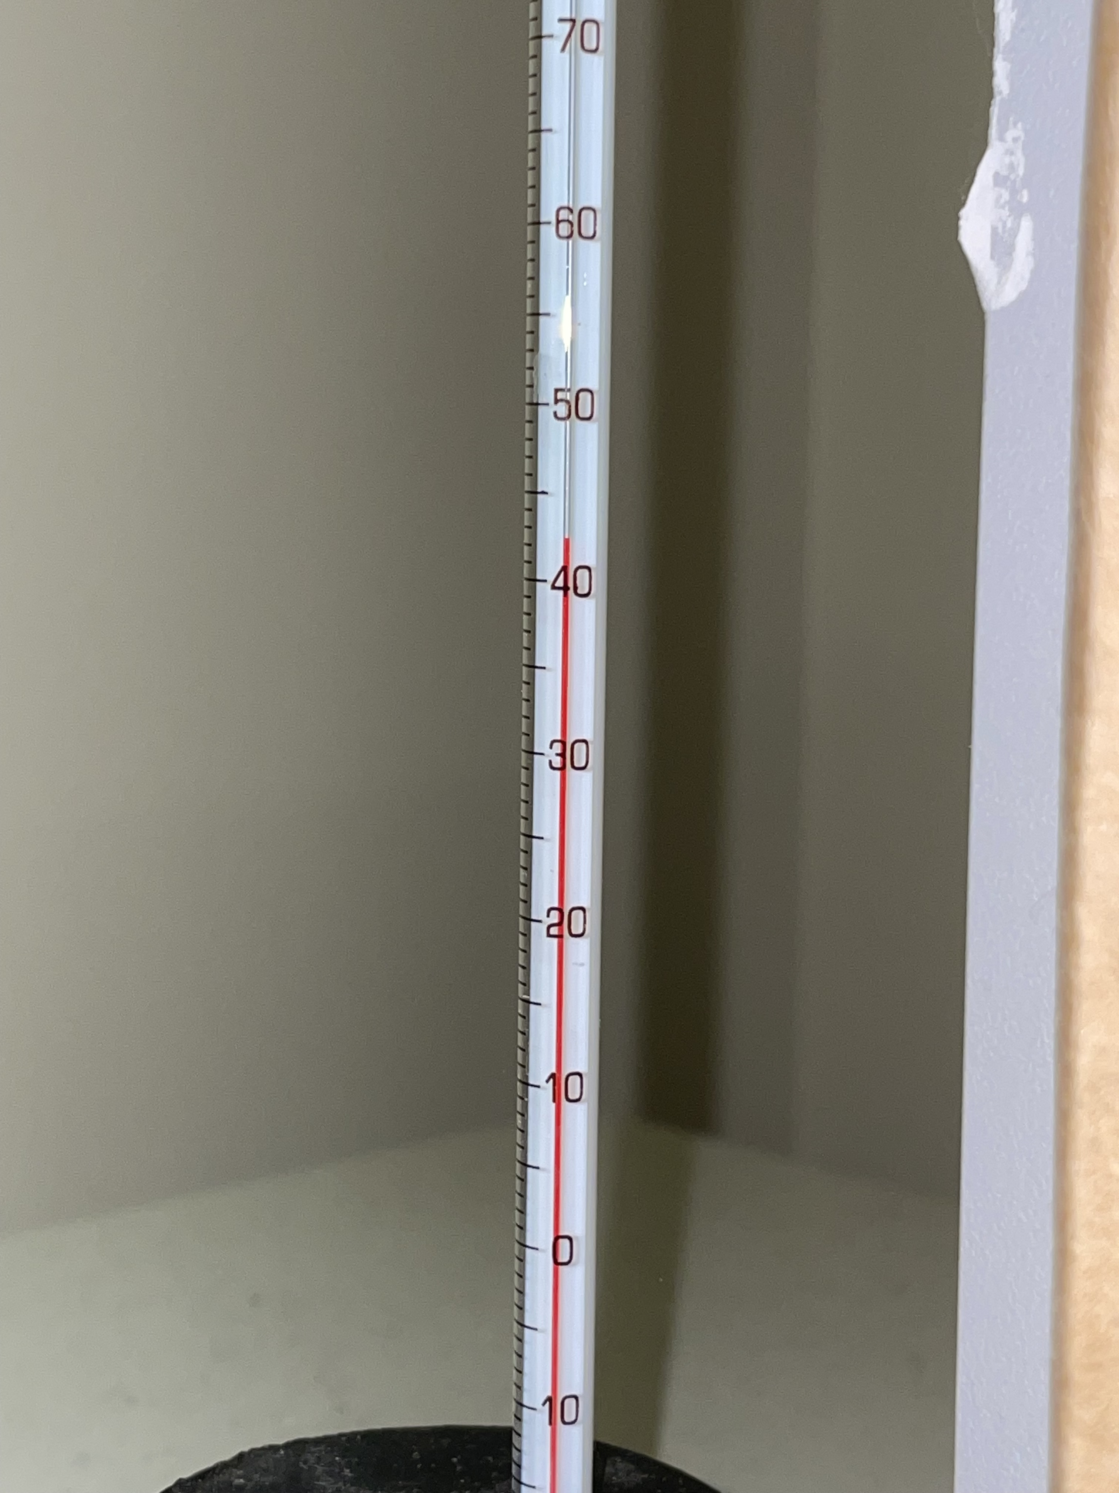
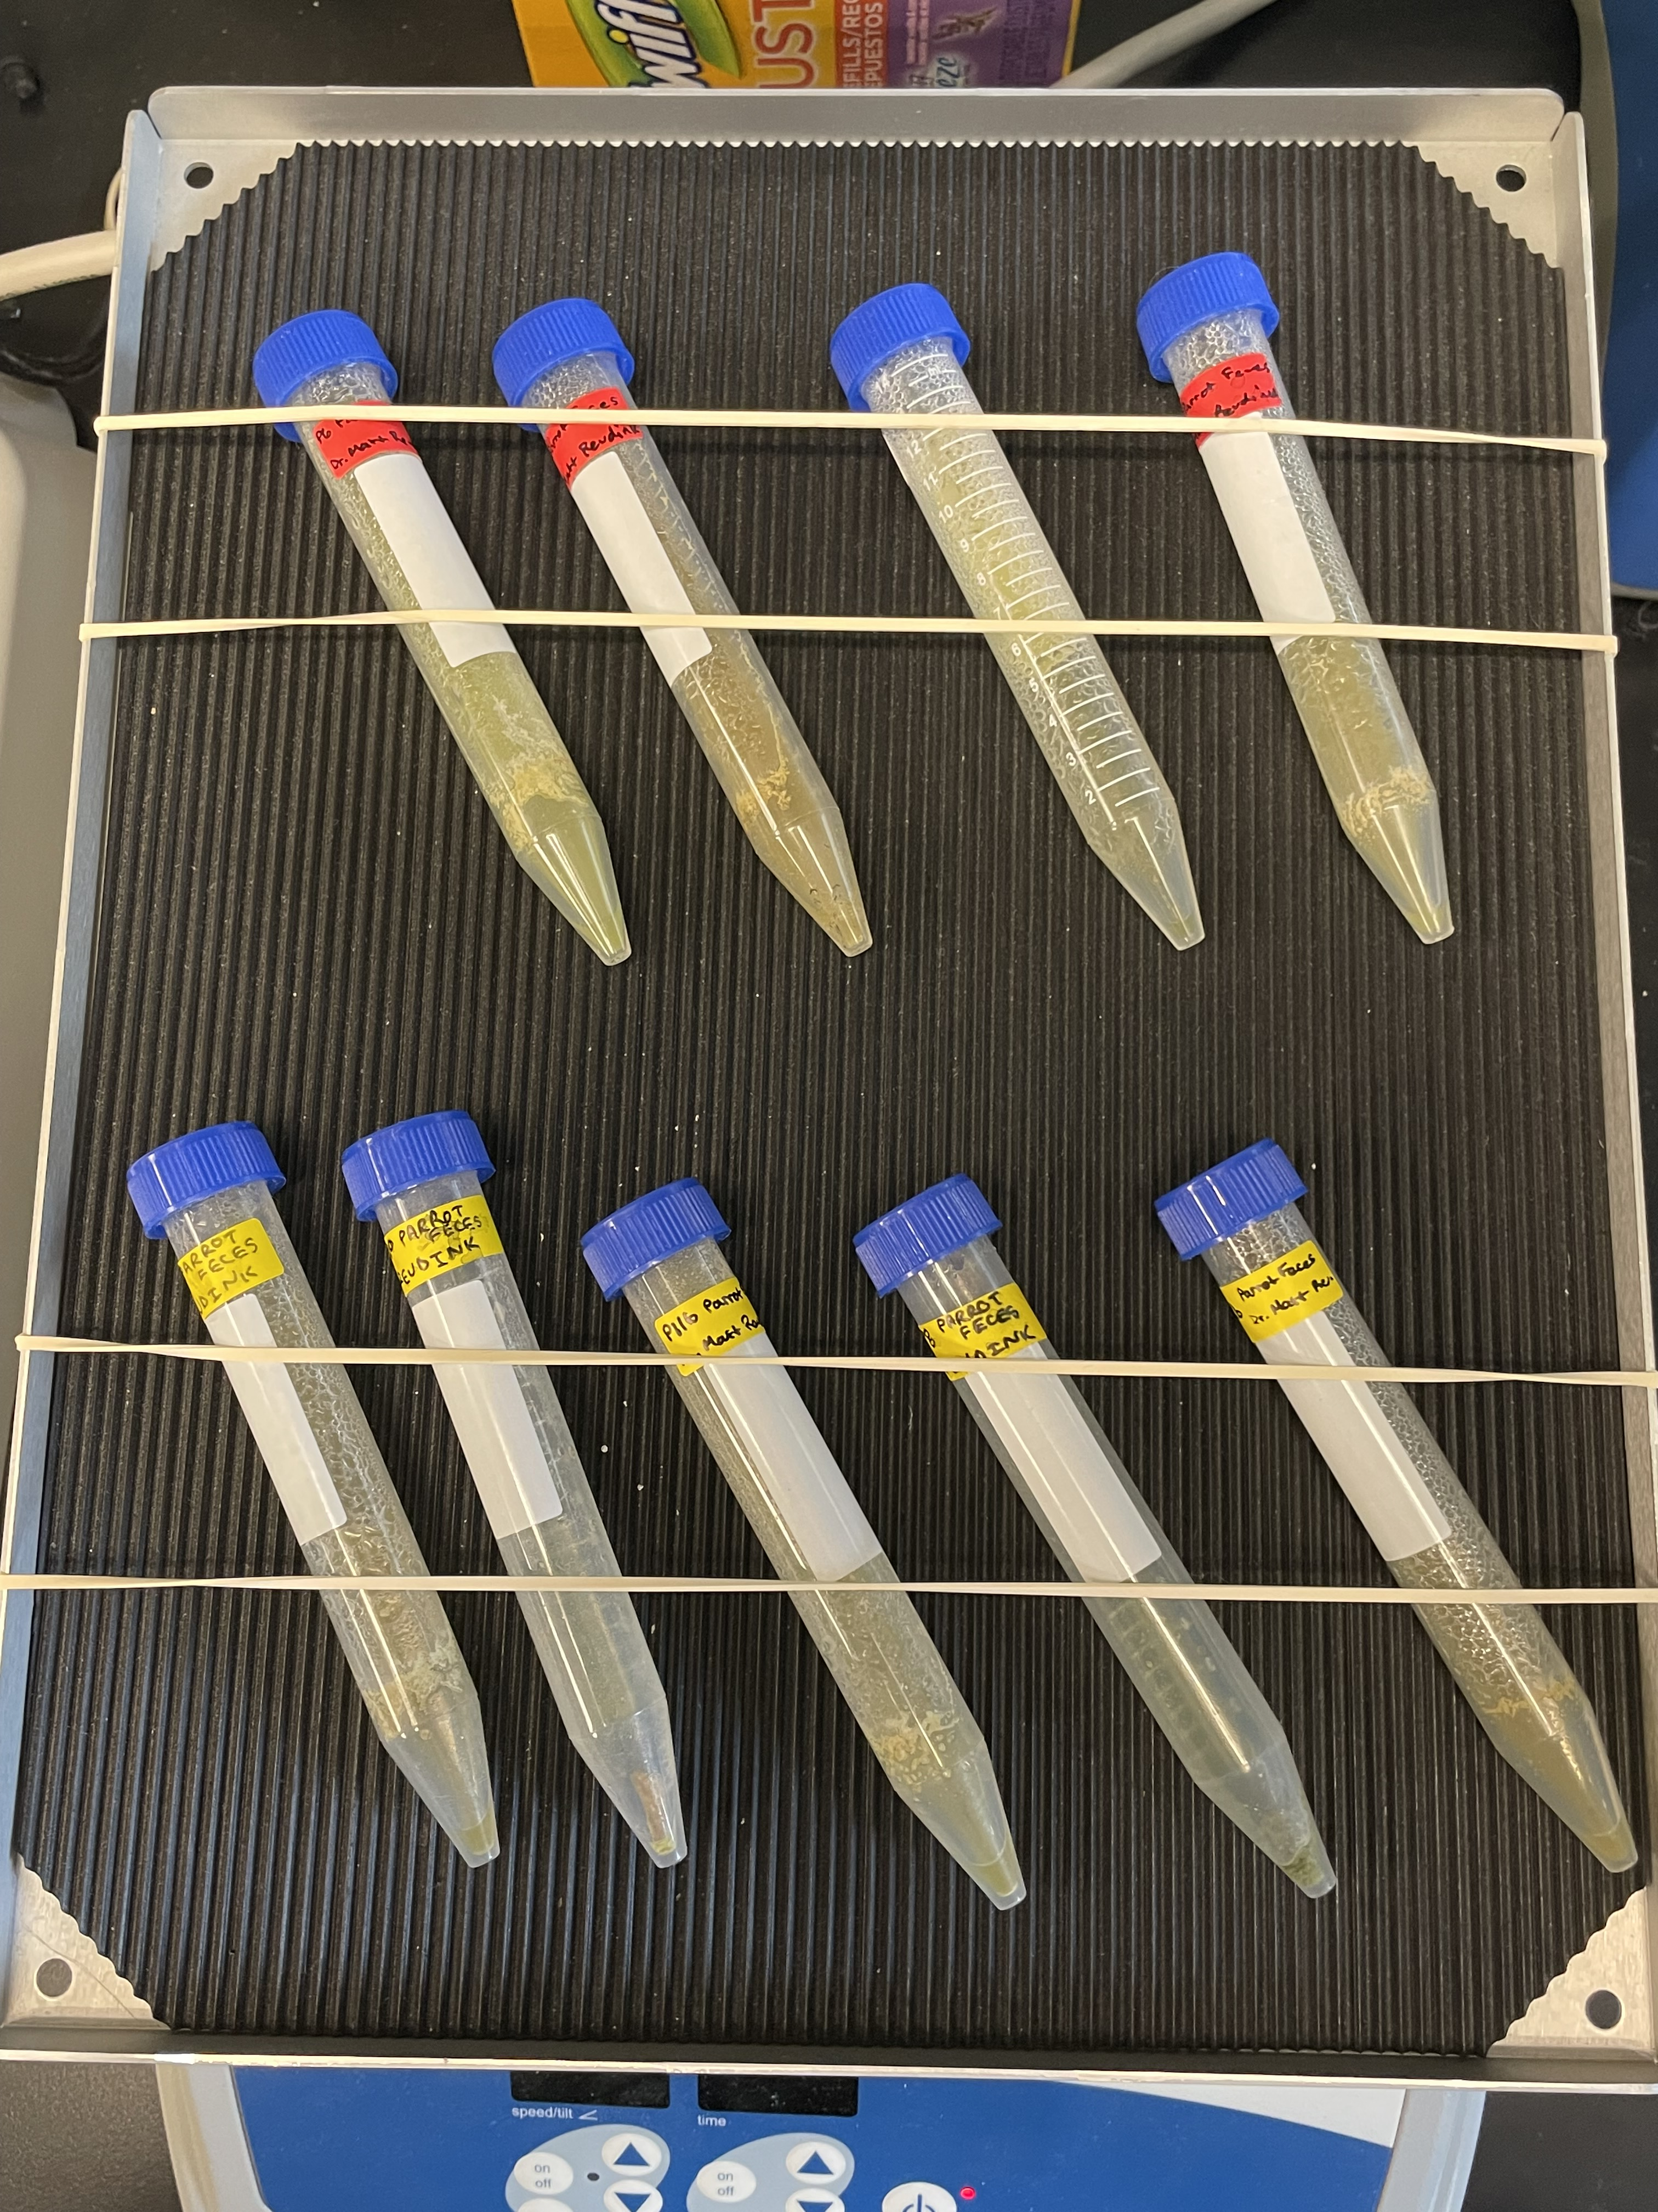
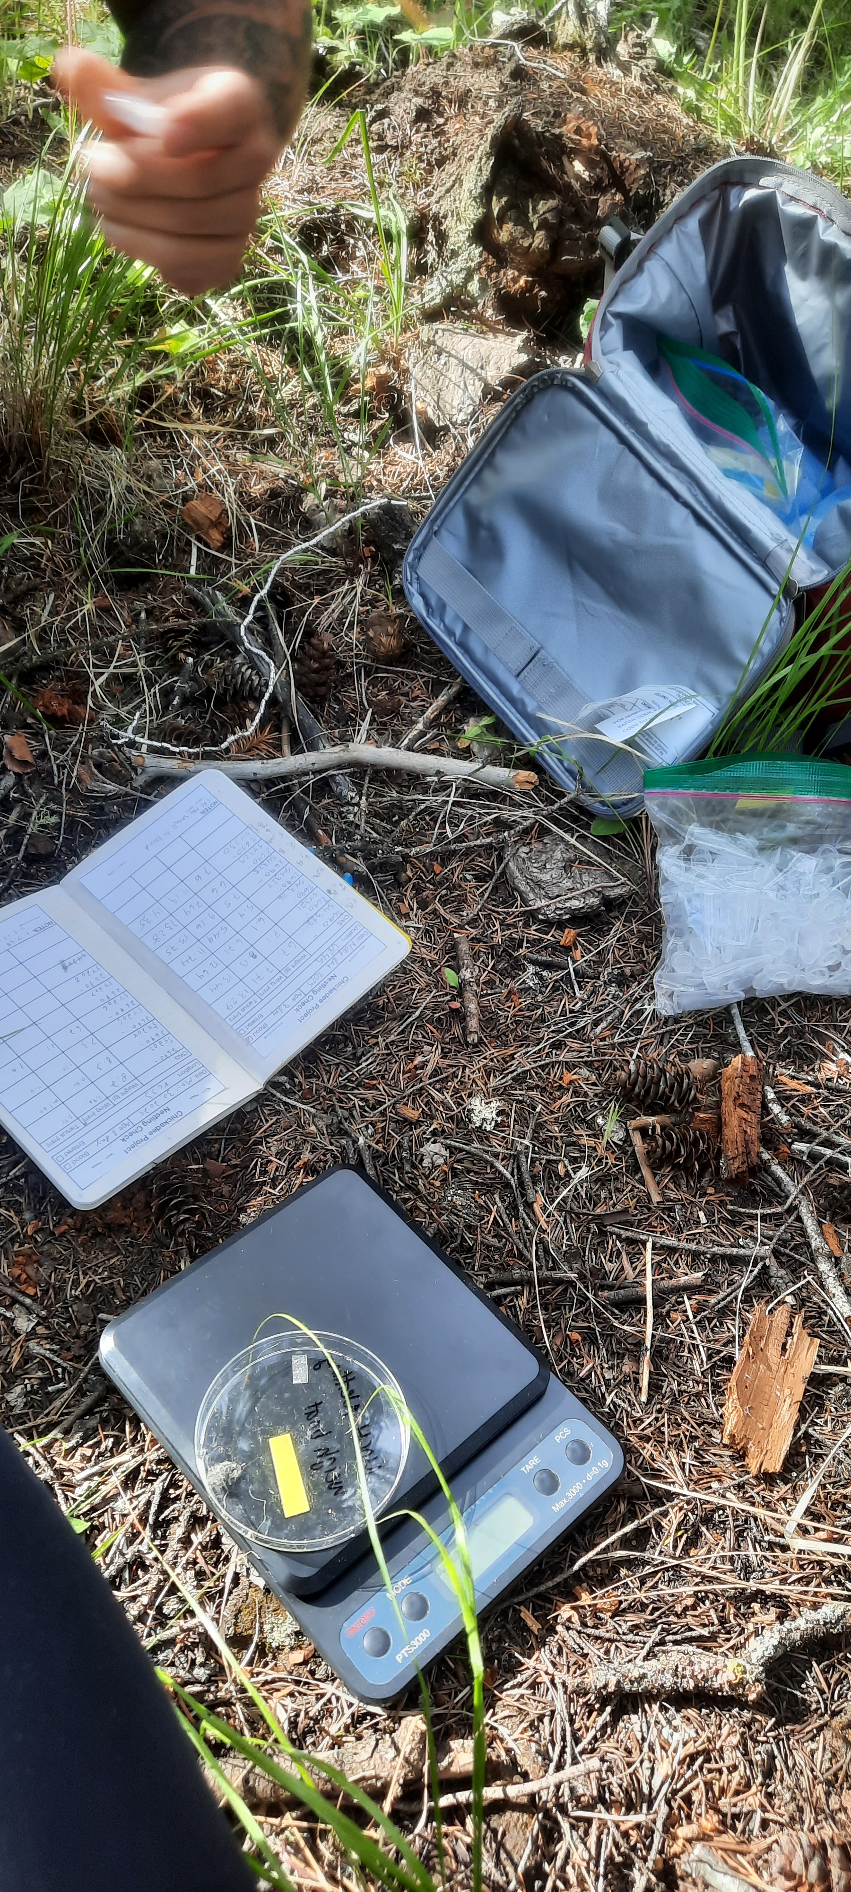
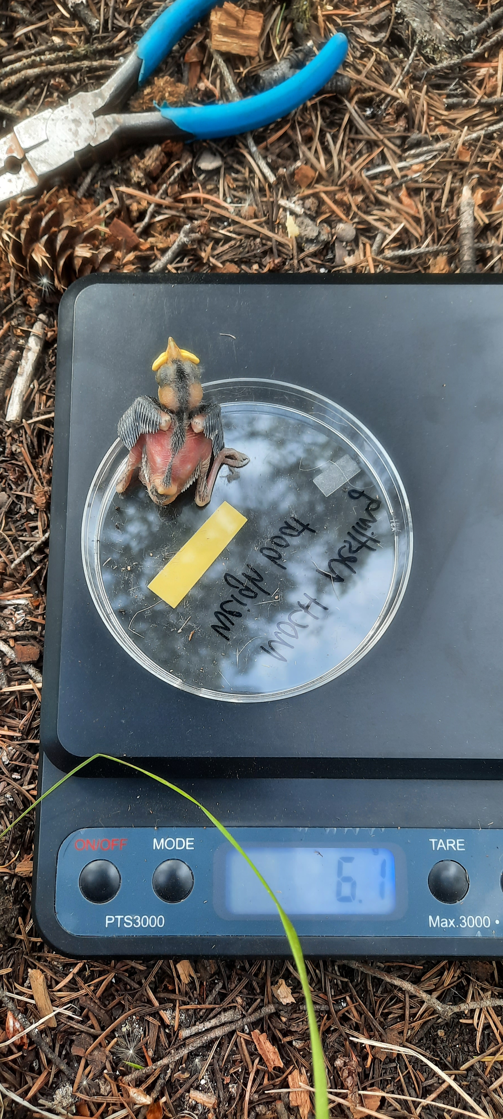
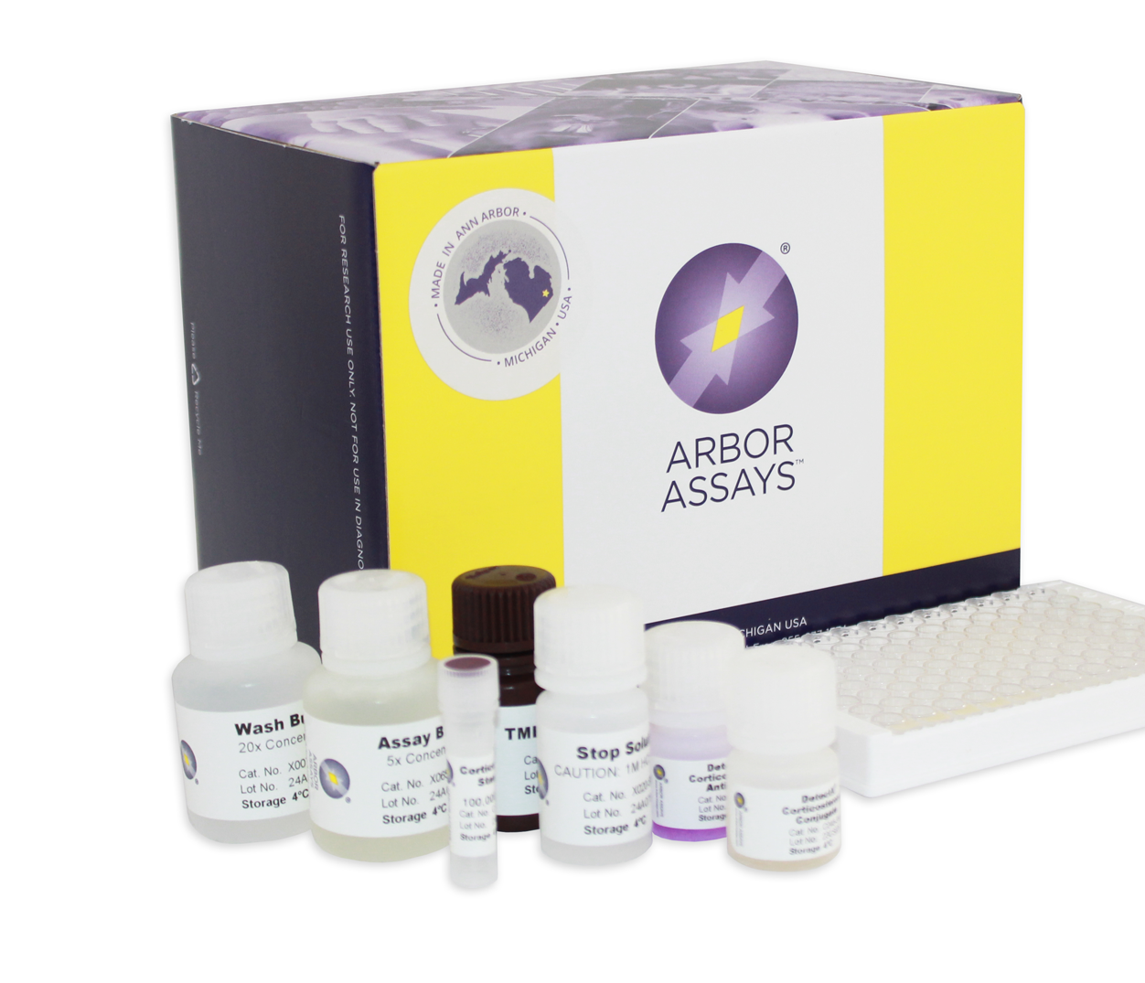
Goal #2
Collect Stress Data
Nestlings -> Cooler -> Freezer
Dry
Extract
ELISA

Slide 7
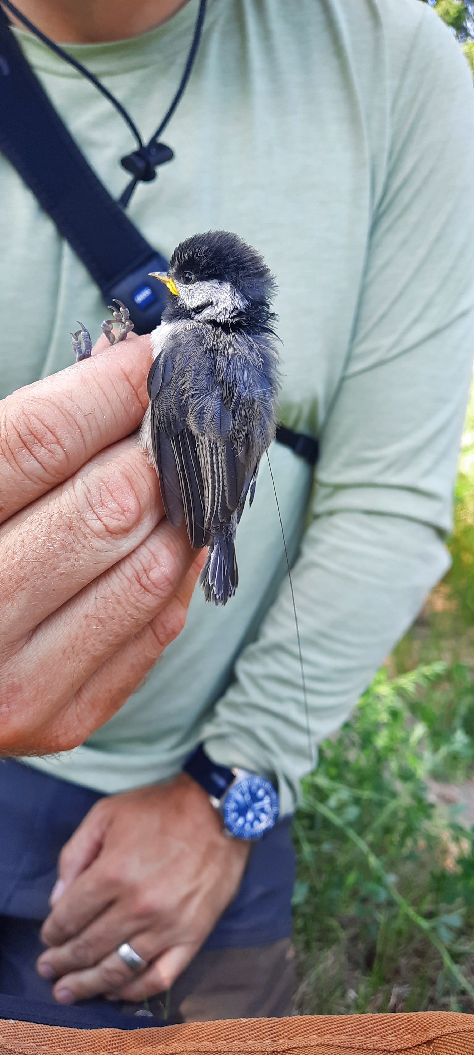
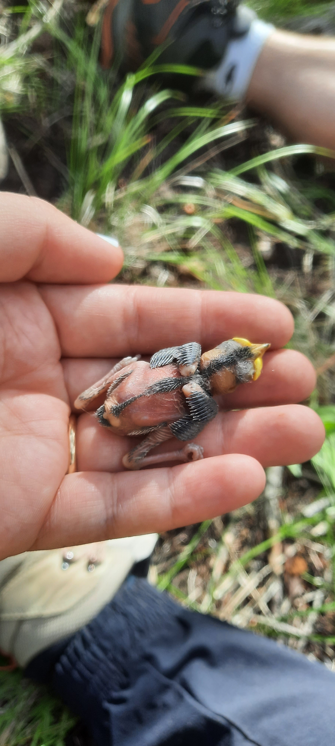
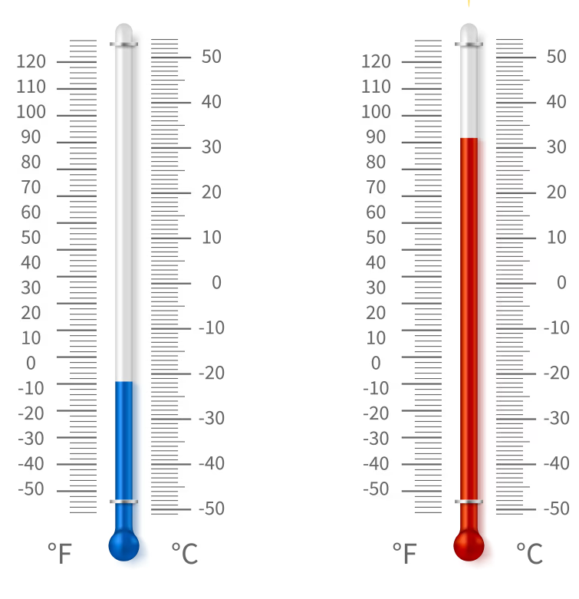

Goal #3
Compare stress data
Age
Noise
Temperature
Urban or Rural

Slide 8
Acknowledgements
Primary Supervisor: Dr. Matthew Reudink
Secondary Supervisor: Dr. Emily Studd
Sample collection assistance: Shae Turner, Anousheh Harirchi, Sophia Bawn, Trysten Kimberzinger, Lorena Munoz
Lab assistance: Dr. Mark Rakobowchuk

Slide 9
References
Brewer JH, O’Reilly KM, Buck CL. 2010. Effect of nestling status and brood size on concentration of corticosterone of free-living kittiwake chicks. General and Comparative Endocrinology. 166(1):19–24. doi:10.1016/j.ygcen.2009.08.005.
Heales HE, Flood NJ, Oud MD, Otter KA, Reudink MW. 2024. Exploring differences in neophobia and anti-predator behaviour between urban and rural mountain chickadees. Journal of Urban Ecology. 10(1):juae014. doi:10.1093/jue/juae014.
Palme R et al. 2013. Steroid extraction: Get the best out of faecal samples. WTM. [published online ahead of print]

