Slide 1
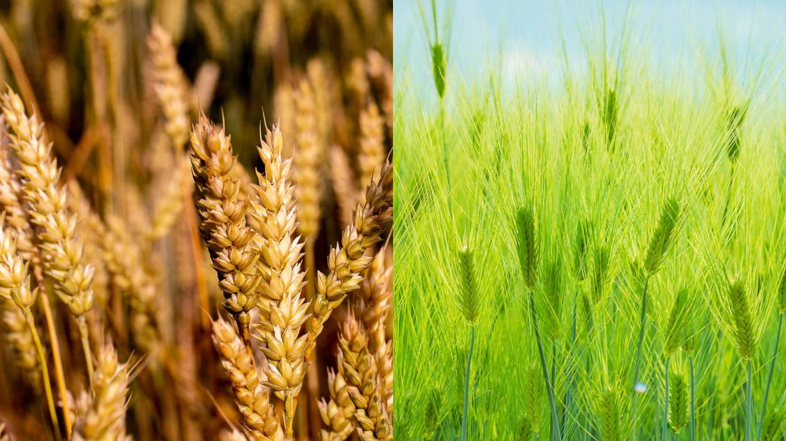
Effect of gibberellic acid on growth, photosynthesis and antioxidant defense system of wheat under zinc oxide nanoparticle stress
Journal: Environmental Pollution
Year: 2019
Azka Iftikhar a, Shafaqat Ali a, Tahira Yasmeen a, Muhammad Saleem Arif a, Muhammad Zubair b, Muhammad Rizwan a, *, Haifa Abdulaziz S. Alhaithloul c, Aisha A.M. Alayafi d, Mona H. Soliman e, f
A paper review by Domenico Comita

Slide 2
Introduction

Slide 3
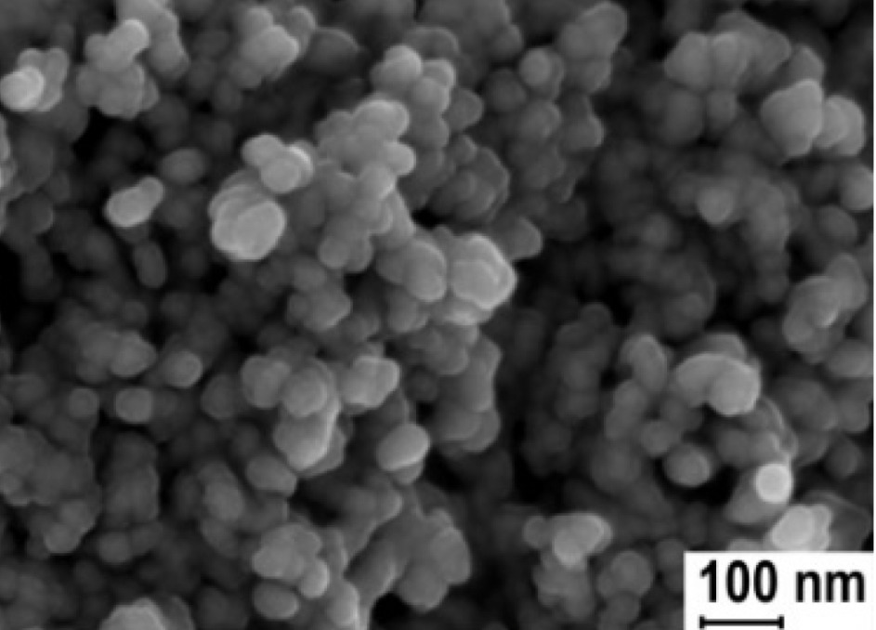

Background Information
What are Nanoparticles?
Tiny particles (1 - 100 nm in size)
Large surface area to volume ratio
Nanoparticles and Plants
Enhance drought stress tolerance
- Improve nutrient water uptake
- Increase photosynthesis
ZnO NPs are highly soluble and can easily be absorbed by plants
But too much can have adverse effects!
ZnO NPs
Foliar application

Slide 4
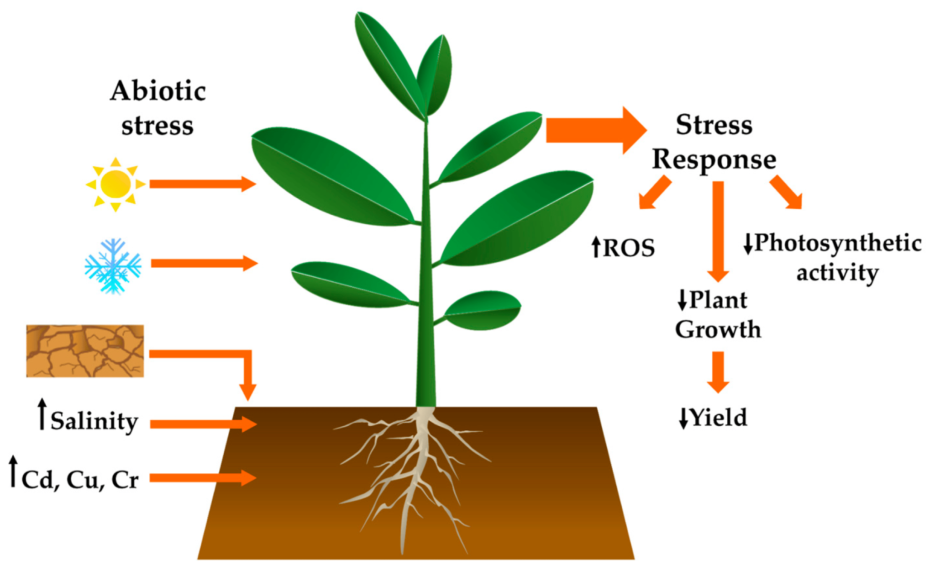
Previous Studies
ZnO NPs and Oxidative Stress (Bandyopadhyay et al., 2015)
Excess ZnO NPs induce oxidative stress.
Impair photosynthesis
Disrupt chlorophyll synthesis
Disrupt photosystem genes
Role of GA in Stress Response (Colebrook et al., 2014)
GA hormones regulate abiotic stress response
GA levels decrease under abiotic stress
Leads to restricted plant growth
⬇GA

Slide 5
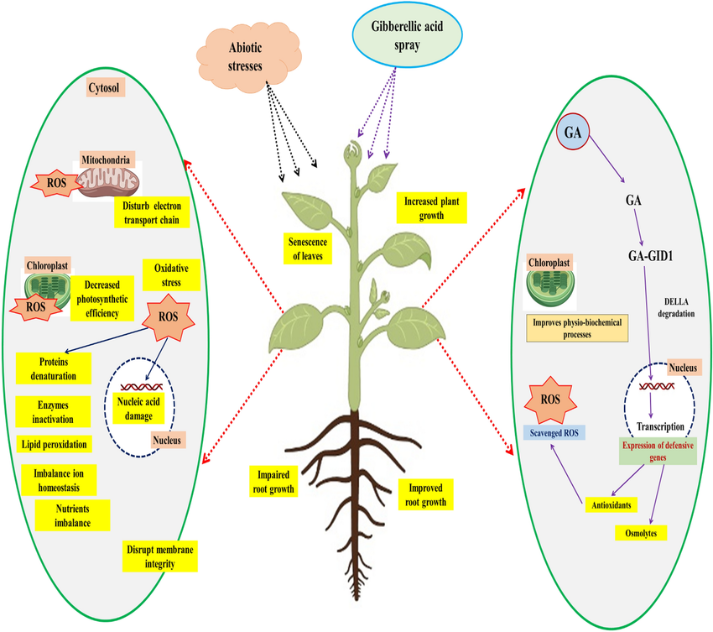
Gibberellin & Plant Stress
Gibberellin Reduces Abiotic Plant Stress By:
Increasing antioxidant activity
Regulating cell division
Protecting photosynthetic machinery
Increasing root and shoot growth
Research Question:
Can gibberrelin inhibit toxicity at high levels of ZnO NPs?

Slide 6
Objectives and Hypothesis
Objective: Explore the response of foliar application of different concentrations of GA on wheat crop to a soil contamination by different concentrations of ZnO NPs
Hypothesis: GA can be used to minimize toxicity due to ZnO NPs in plants.

Slide 7
Materials & Methods

Slide 8
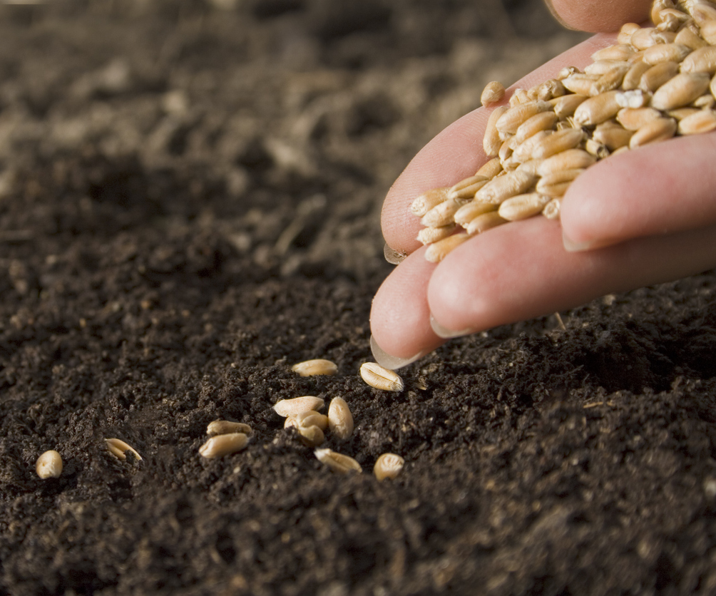
Experimental Setup
Experimental Setup
Soil Preparation & Planting Seeds:
Soil from agricultural farms in Pakistan
Spike soil with ZnO NPs (300, 600, 900, 1200 mg/kg).
Control pots contained untreated soil.
Wheat Cultivation:
Seeds sown under ambient conditions after one week
(64 ± 5% relative humidity, 32/21°C day/night).

Slide 9
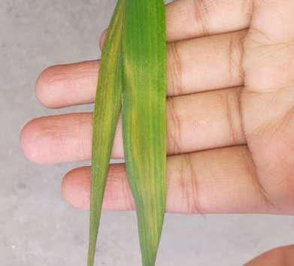
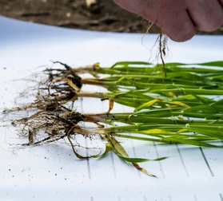
Procedures
GA Foliar Spray:
Applied at 0, 100, and 200 mg/L
Further sprays at 4, 6, and 8 weeks.
Control plants sprayed only with water
Root and Plant Processing:
Roots washed, dried and weighed
Leaves collected after 75 days for chlorophyll and stress marker analysis

Slide 10
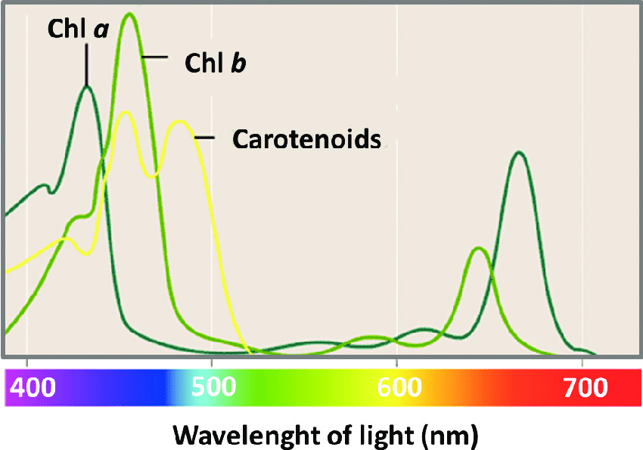
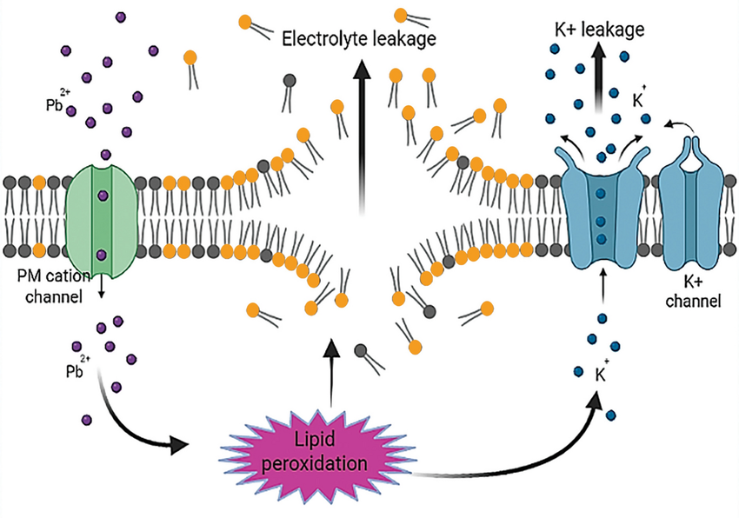
Measurements & Analysis
Photosynthetic Pigments:
Chlorophyll and carotenoids extracted using acetone under dark, cold conditions,
Measured with spectrophotometer.
Stress Markers:
Electrolyte leakage and antioxidant enzymes assessed.
Nutrient Content:
Plant samples (0.5 g) digested using nitric and perchloric acid
Data analyzed via two-way ANOVA; significant differences identified using Tukey’s test (p < 0.05).

Slide 11
Results

Slide 12
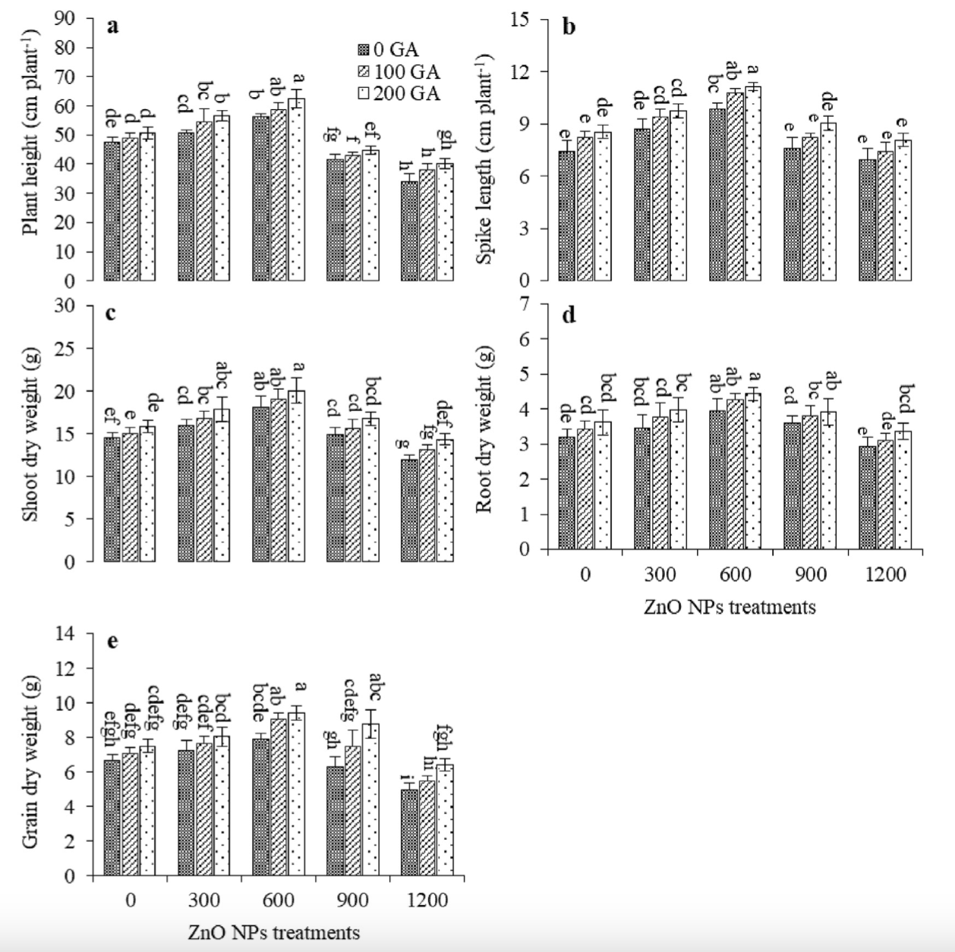
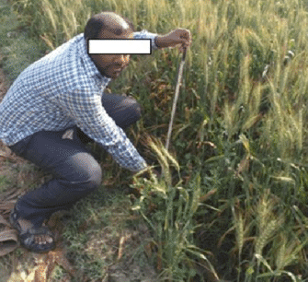
Growth Attributes & Yield
Low levels of ZnO NPs = 300, 600 mg/kg
High levels of ZnO NPs = 900, 1200 mg/kg
GA increased:
Plant height
Shoot height
Dry weight of
Shoot
Root
Grain

Slide 13
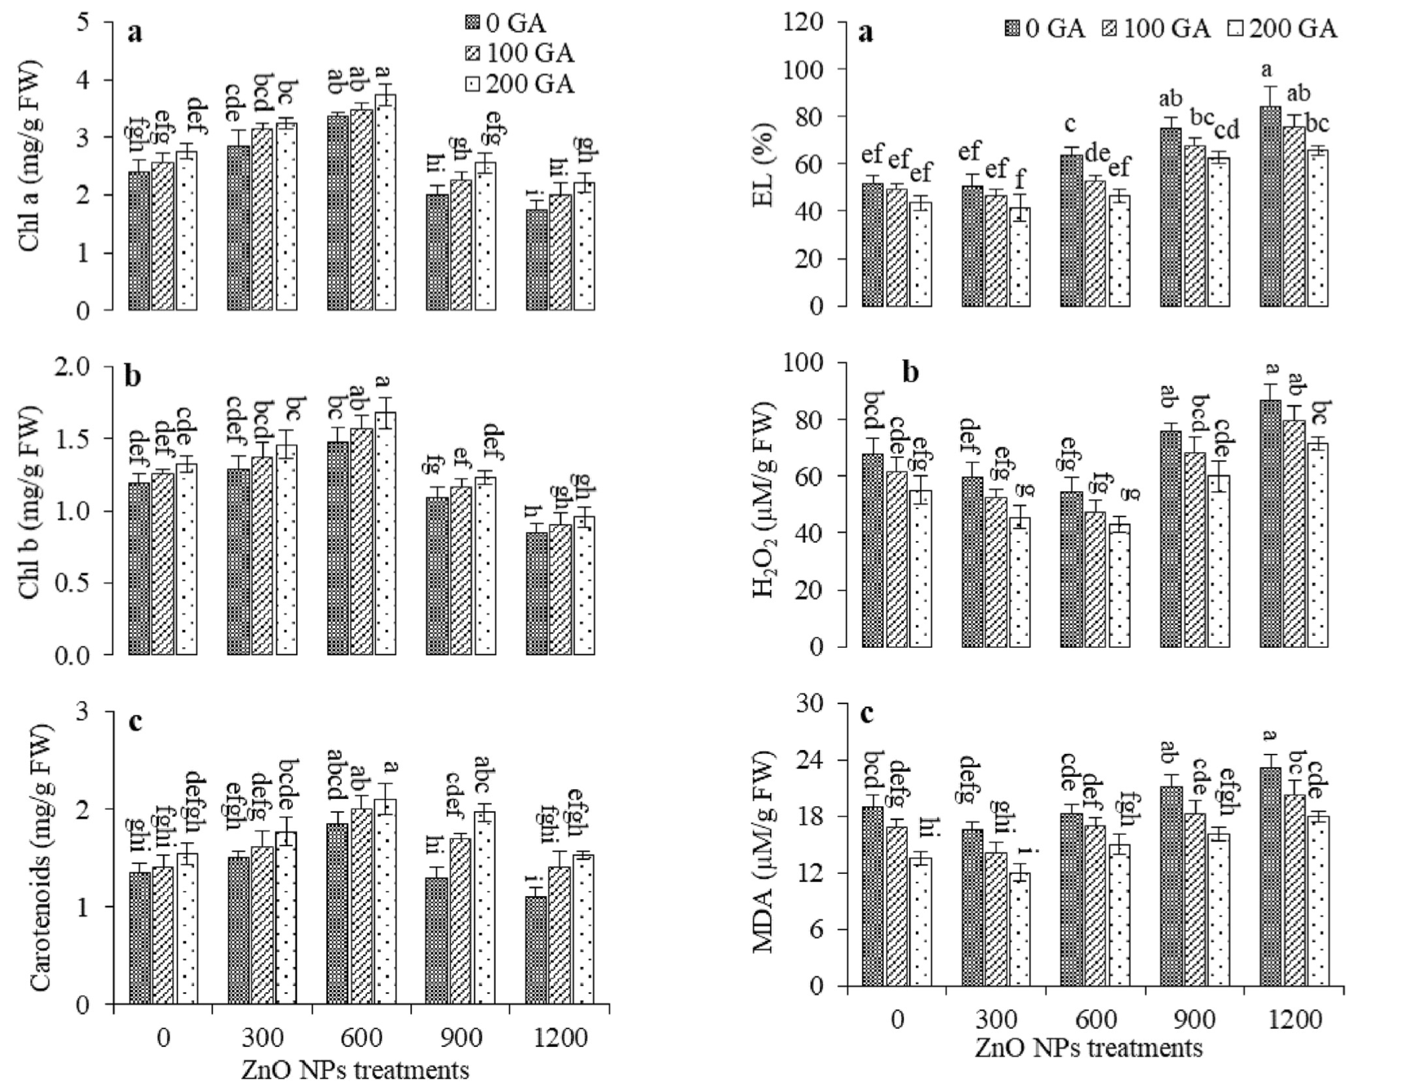
Photosynthesis & Oxidative Stress
Low levels of ZnO NPs:
Increase chlorophyll content
Reduce oxidative stress
High levels of ZnO NPs:
Decrease chlorophyll content
Increase oxidative stress
Chlorophyll content increases with GA; Oxidative stress reduced

Slide 14
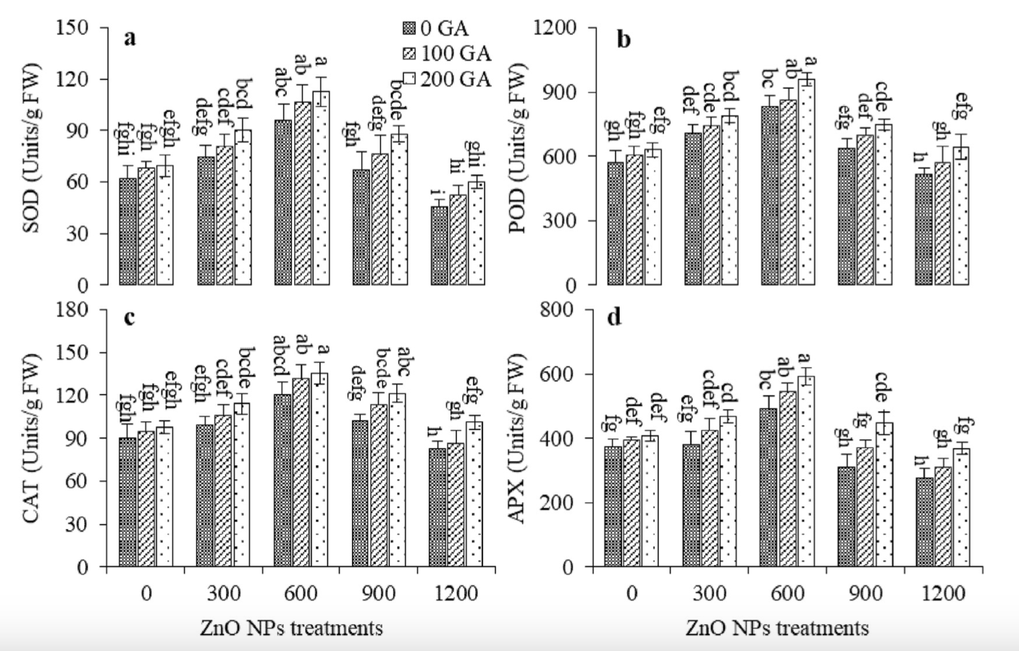
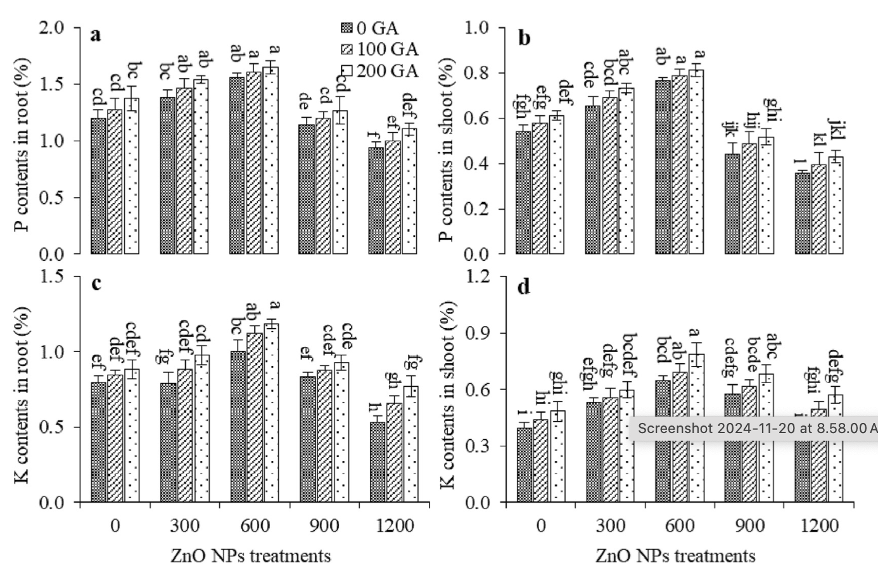
Antioxidant Enzymes & P + K Contents
Antioxidant enzymes increase with GA
P + K increase with GA

Slide 15
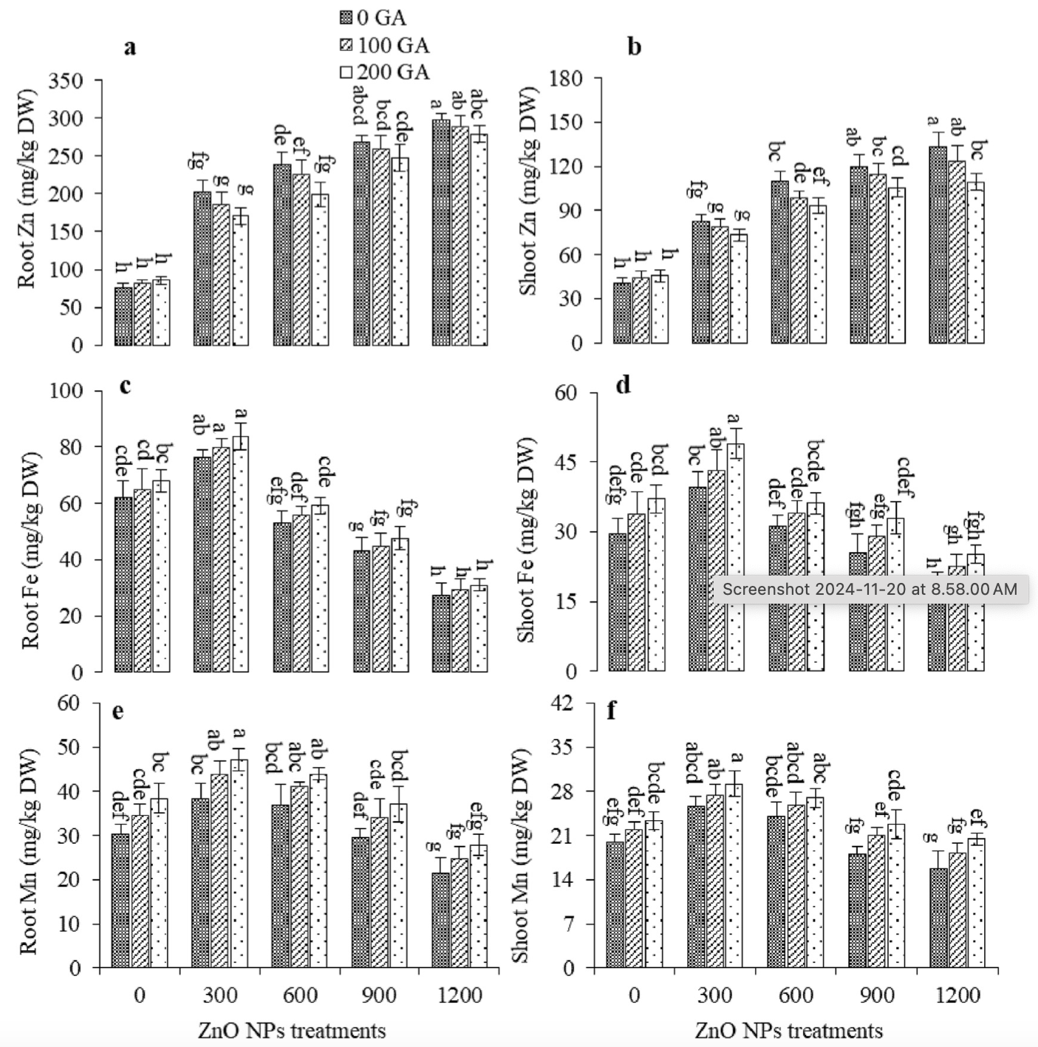
Zn + Fe + Mg Concentrations
GA increases:
Iron and Magnesium concentrations
GA decreases:
Zinc concentrations

Slide 16

Significance of the Results
In ZnO NP stressed plants, GA caused a significant:
Reduction in oxidative stress markers (EL, H₂O₂, MDA)
Boost in antioxidant enzyme activity (SOD, POD, CAT, APX)
Increase of nutrient uptake (P, K, Fe, Mn)
Reduction of excessive Zn accumulation
Significance of the results:
Demonstrates GA can reduce the negative effects of excessive ZnO NPs in wheat plants.
Thanks to our good friend gibberellin, this wheat plant is outgrowing all competition under ZnO NP stress! Nice work GA!

Slide 17
Discussion

Slide 18
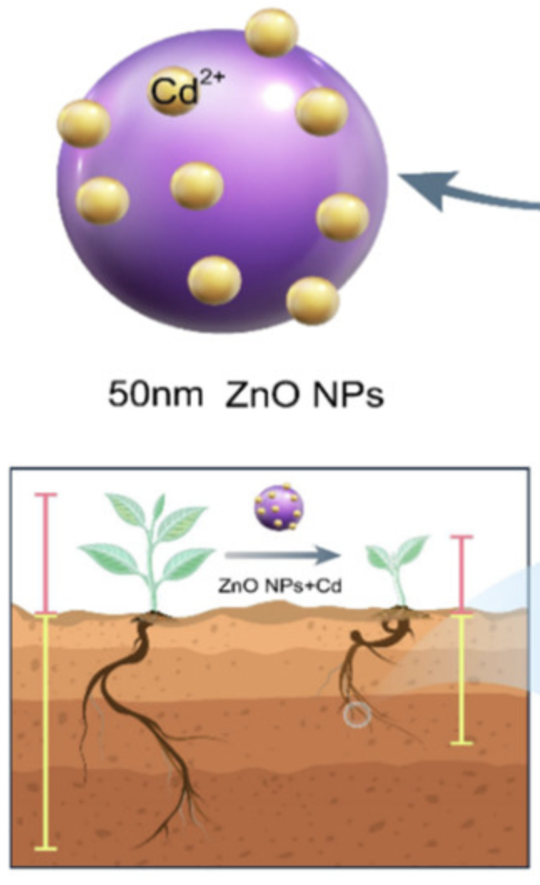
Interpretation of the Results
What do the results prove?
GA reduces toxicity from ZnO NP mediated stress
GA may be able to have the same effects on other NP stressors
GA can be used alongside NPs to boost crop yield
How does this relate to previous studies?
Excessive ZnO NP’s are toxic to the plant (Bandyopadhyay et al., 2015)
GA reduces abiotic oxidative stress effects (Colebrook et al., 2014)

Slide 19
Conclusion

Slide 20
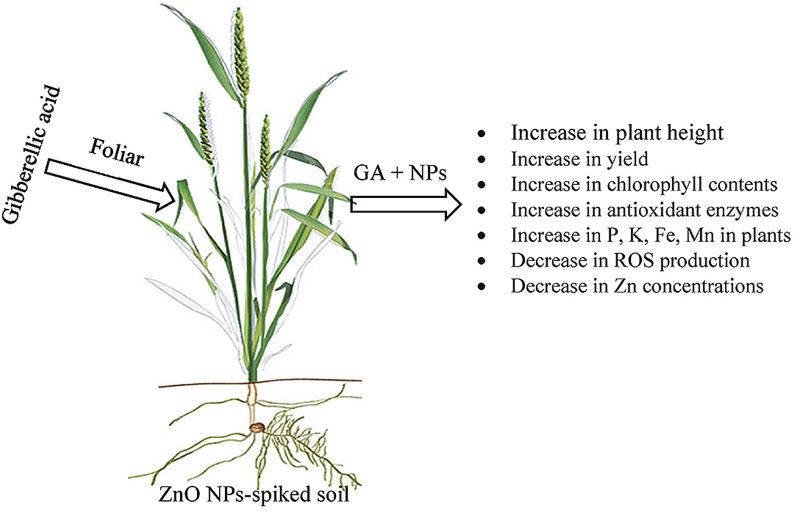
Increase in plant height
Increase in yield
Increase in chlorophyll contents
Increase in antioxidant enzymes
Increase in P, K, Fe, Mn in plants
Decrease in ROS production
Decrease in Zn concentrations

Slide 21
Concluding Remarks
GA alleviated the NPs toxicity by:
Sustaining the growth, nutrient contents and yield of wheat.
More studies are required to:
Verify the effects of GA on ZnO NPs in different plant species under various conditions and exposure durations
Verify the effects of GA on other NPs toxicities

Slide 22
Thanks for Listening!

Slide 23
References
Bandyopadhyay, S., Plascencia-Villa, G., Mukherjee, A., Rico, C. M., José-Yacamán, M., Peralta-Videa, J. R., & Gardea-Torresdey, J. L. (2015). Comparative phytotoxicity of ZnO NPs, bulk ZnO, and Ionic zinc onto the alfalfa plants symbiotically associated with Sinorhizobium meliloti in soil. Science of The Total Environment, 515-516, 60-69. https://doi.org/10.1016/j.scitotenv.2015.02.014
Colebrook, E. H., Thomas, S. G., Phillips, A. L., & Hedden, P. (2014). The role of gibberellin signalling in plant responses to abiotic stress. Journal of Experimental Biology, 217(1), 67-75. https://doi.org/10.1242/jeb.089938
Gowtham, H., Shilpa, N., Singh, S. B., Aiyaz, M., Abhilash, M., Nataraj, K., Amruthesh, K., Ansari, M. A., Alomary, M. N., & Murali, M. (2024). Toxicological effects of nanoparticles in plants: Mechanisms involved at morphological, physiological, biochemical and molecular levels. Plant Physiology and Biochemistry, 210, 108604. https://doi.org/10.1016/j.plaphy.2024.108604
Iftikhar, A., Ali, S., Yasmeen, T., Arif, M. S., Zubair, M., Rizwan, M., Alhaithloul, H. A., Alayafi, A. A., & Soliman, M. H. (2019). Effect of gibberellic acid on growth, photosynthesis and antioxidant defense system of wheat under zinc oxide nanoparticle stress. Environmental Pollution, 254, 113109. https://doi.org/10.1016/j.envpol.2019.113109
Kopittke, P. M., Lombi, E., Wang, P., Schjoerring, J. K., & Husted, S. (2019). Nanomaterials as fertilizers for improving plant mineral nutrition and environmental outcomes. Environmental Science: Nano, 6(12), 3513-3524. https://doi.org/10.1039/c9en00971j
Tymoszuk, A., & Wojnarowicz, J. (2020). Zinc oxide and zinc oxide nanoparticles impact on in vitro germination and seedling growth in allium cepa L. Materials, 13(12), 2784. https://doi.org/10.3390/ma13122784
Wang, Q., Xu, S., Zhong, L., Zhao, X., & Wang, L. (2023). Effects of zinc oxide nanoparticles on growth, development, and flavonoid synthesis in ginkgo biloba. International Journal of Molecular Sciences, 24(21), 15775. https://doi.org/10.3390/ijms242115775
Wen, F., Zhang, Z., Bai, T., Xu, Q., & Pan, Y. (2010). Proteomics reveals the effects of gibberellic acid (GA3) on salt-stressed rice (Oryza sativa L.) shoots. Plant Science, 178(2), 170-175. https://doi.org/10.1016/j.plantsci.2009.11.006

