Slide 1
Engineered Nose Bacteria Sneak
Drugs Into Brain
Domenico Comita & Manuel Centeno Duque

Slide 2
Introduction
01
Background about the paper
DISCLAIMER:
Lots of mice dying…

Slide 3
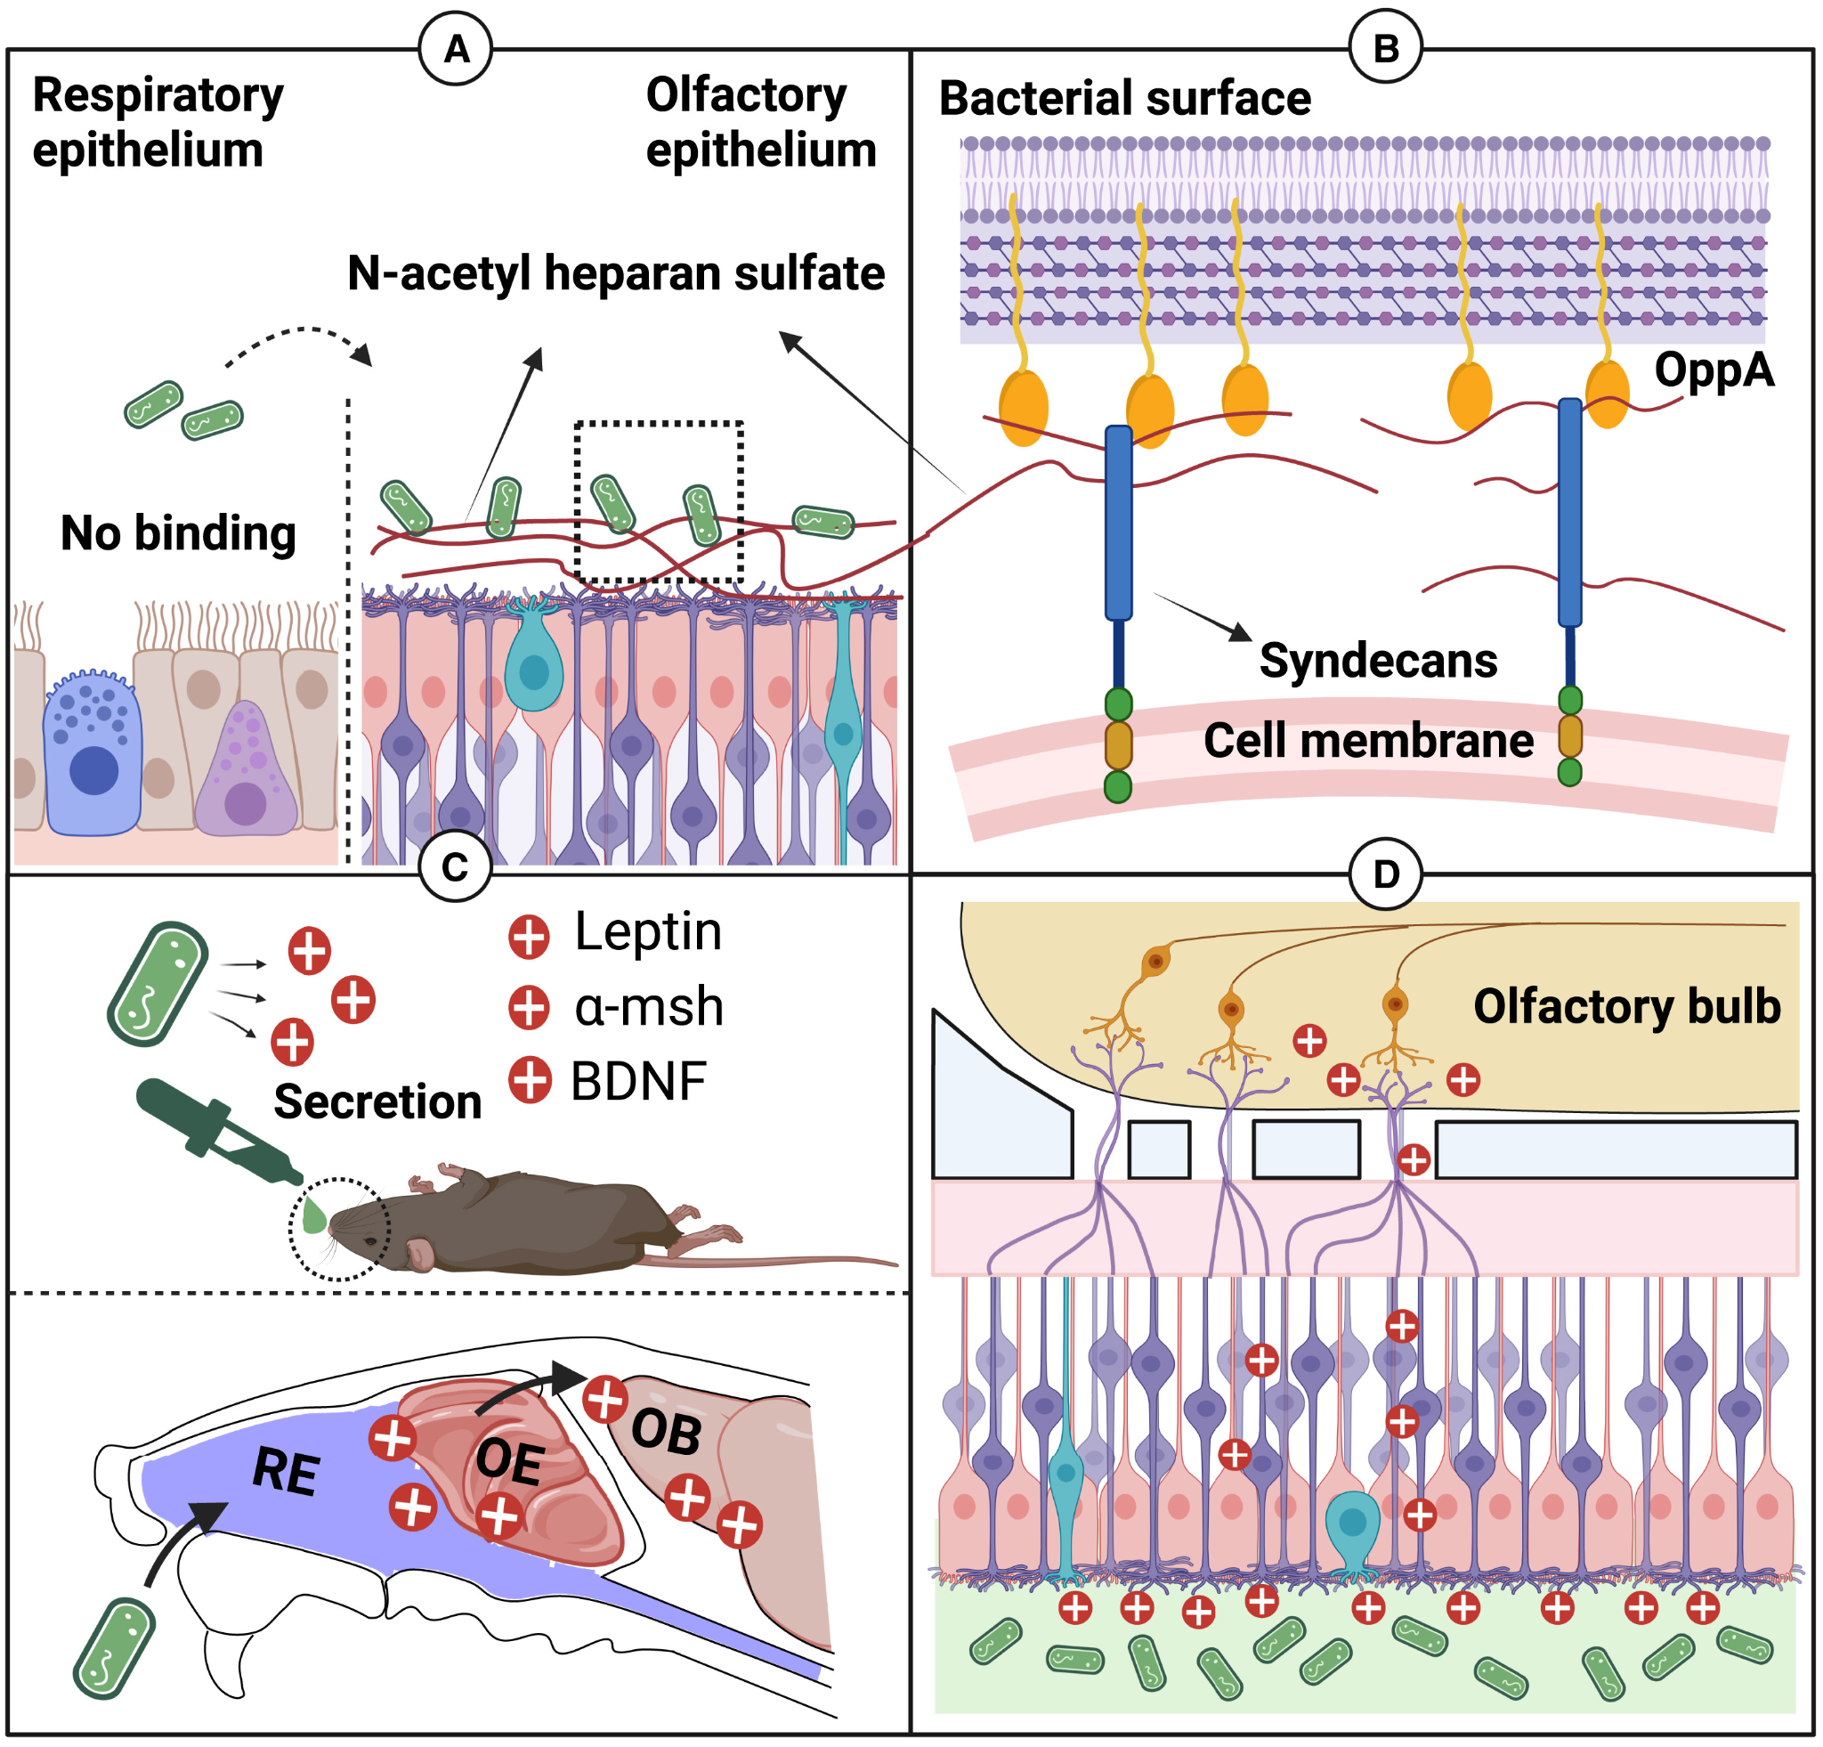
Cerebral drug delivery
01
Importance
Difficulties
  Blood brain barrier (BBB)
Intranasal delivery
  Olfactory epithelium (OE)

Slide 4
01
Commensal bacteria
Respiratory microbiome
  Microbiome-brain axis
Delivery vector
Specific binding to OE
  Less loss to circulation

Slide 5
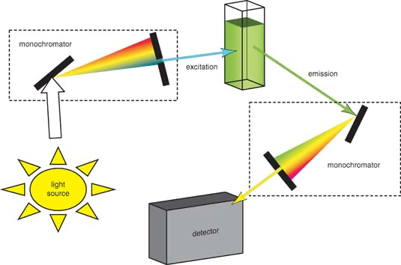
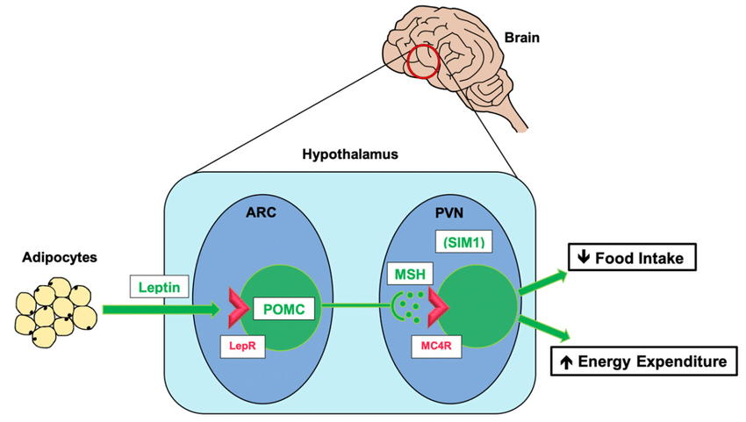
Appetite-regulation
01
Fluorescein isothiocyanate (FITC)
Leptin (Lep)
α-melanocyte-stimulating hormone (α-MSH)
Brain-derived neurotrophic factor (BDNF)

Slide 6
02
Identification of Bacteria
Which bacteria has highest affinity for the OE?

Slide 7
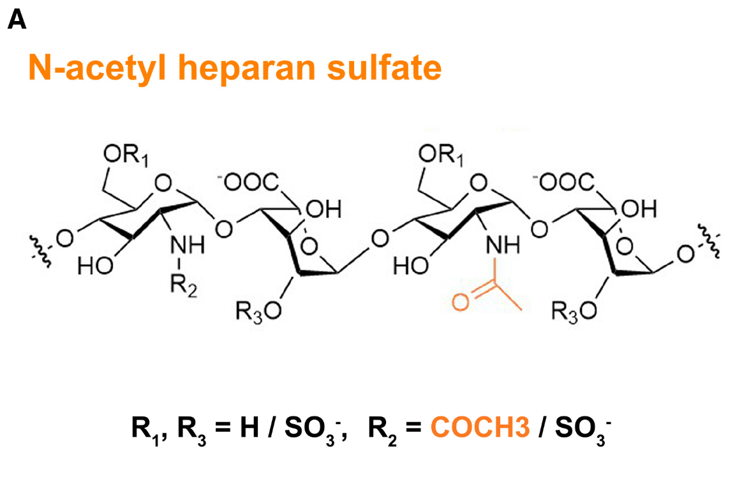
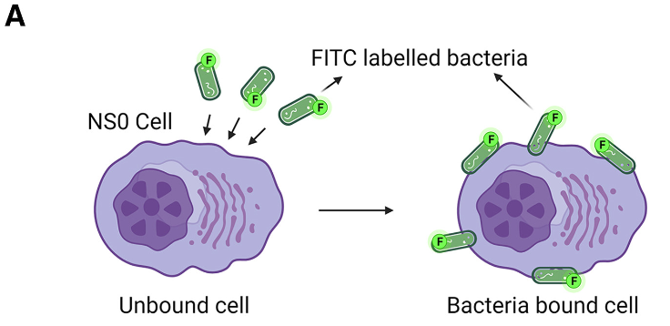
02
Complex microbiome
Methods
Different strains in OE
  Lactobacillus
  Streptococcus
  Escherichia
Using NaHS to localize
  NS0 cell line
Examine bacterial binding to NS0 cells to determine strain attachment

Slide 8
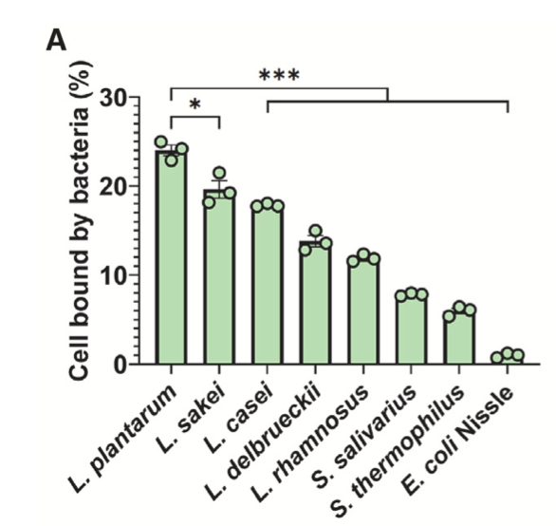
Lactobacillus plantarum
(Lp)
02
Results
Highest binding affinity to OE

Slide 9

OE Specific Localization
03
How is Lp localized in the nasal cavity?

Slide 10
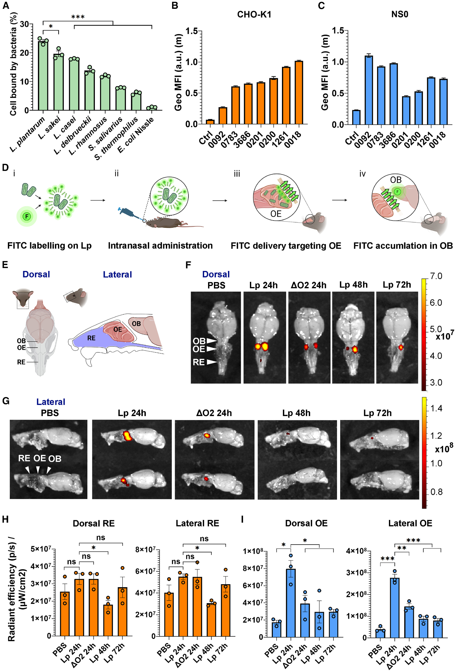
03
Metabolic labelling
FITC Lp intranasally
Harvested mice’s snouts and brains
Used fluorescence microscopy to assess localization of Lp
Methods

Slide 11
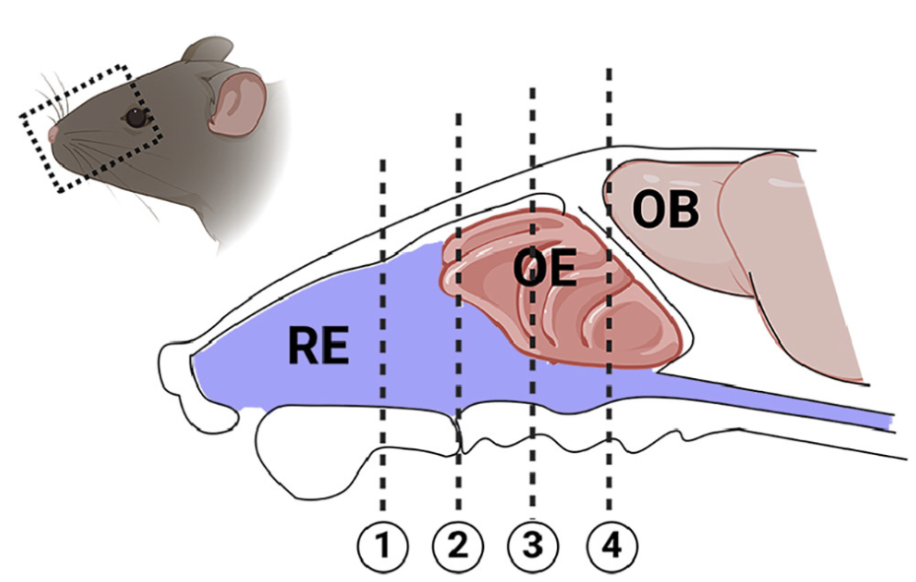
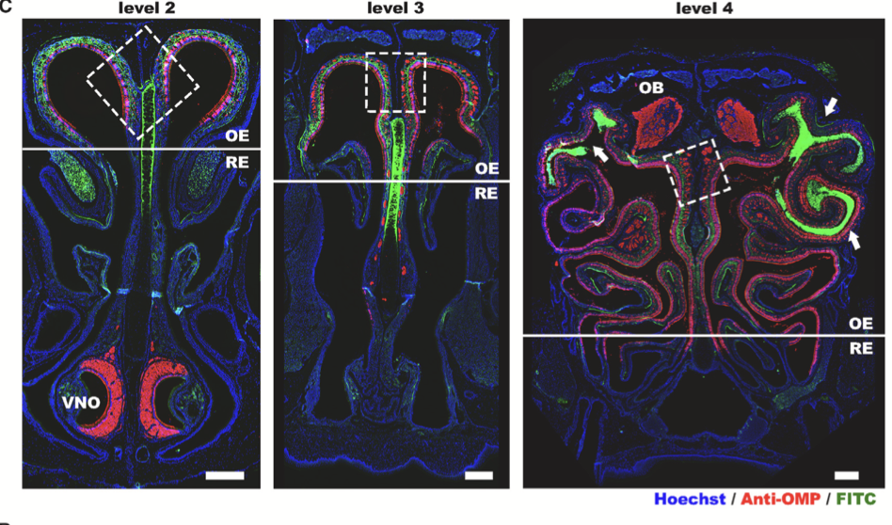
FITC Accumulation
03
Lp localized in OE
HOECHST
  label all cells
Anti-OMP
  label olfactory sensory neurons
FITC
  label Lp
Results

Slide 12
04
Intranasal Drug Transport
How are the drugs administered through the nasal cavity?

Slide 13
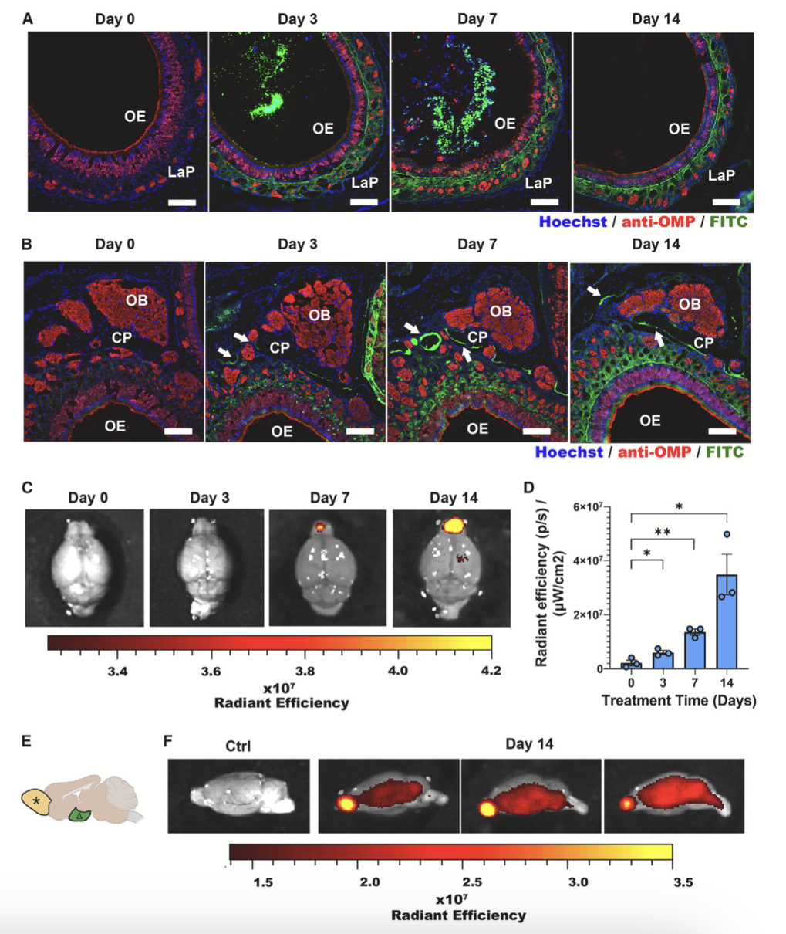
Delivery of FITC
04
Methods
Results
Lp effectively delivers FITC
Lp with FITC
Time:
3, 7, 14 days
Harvest:
24 h post

Slide 14
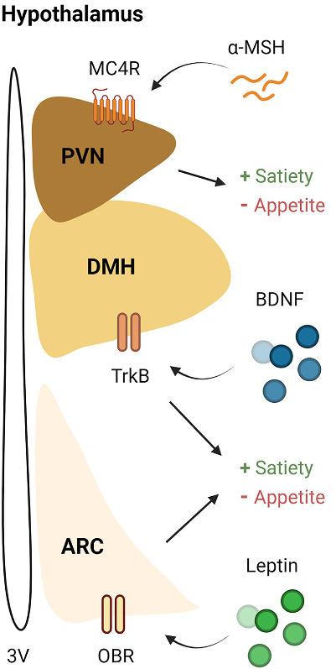
Activity of hormones
Methods
Recombinant Lep, α-MSH, BDNF
All acting at the hypothalamus
Tested in vitro with HEK cells and Neuro2A cells
Results
Both r-Lep and BDNF phosphorylated Stat 3
  Biologically active
α-MSH active:
  MC4R activation confirmed by increase in cAMP
04

Slide 15
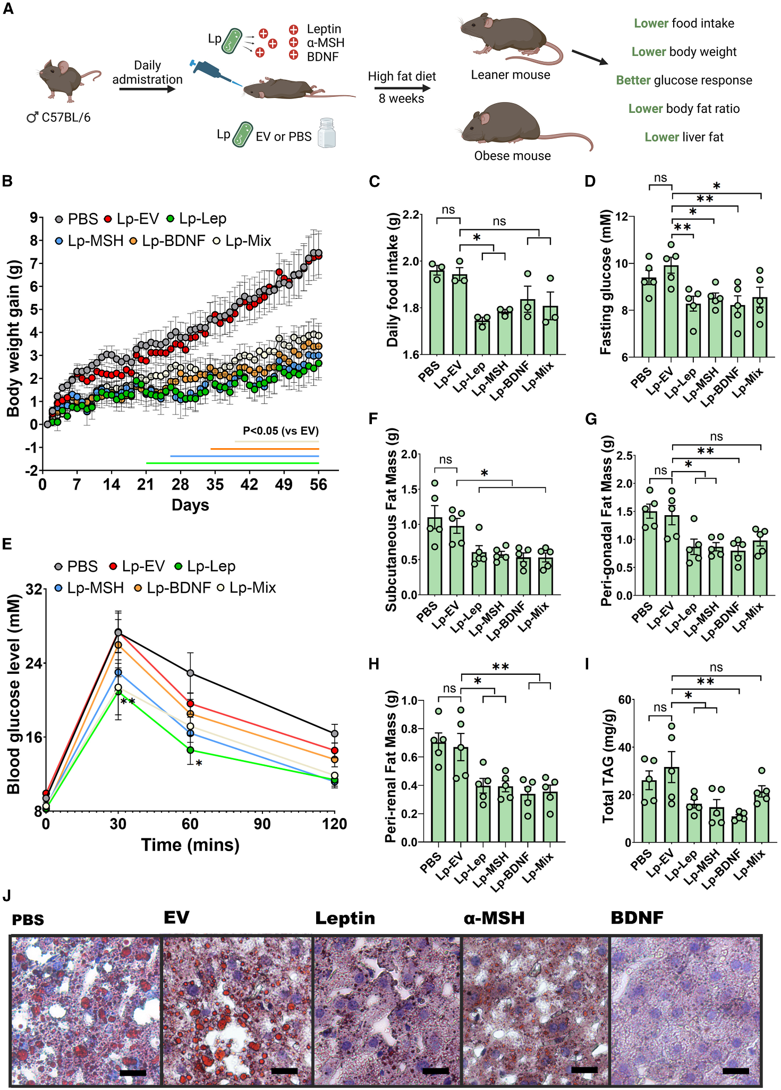
Methods
Delivery of hormones
05
Lp with Lep, α-MSH, BDNF administered (Lp-Mix as well)
Amount optimized to reduce nasal polyps
C57BL/6 mice on a high-fat diet for 8 weeks
IPGTT

Slide 16
Results
05
Following delivery of appetite-regulating hormones
Lower body weight
Lower food intake
Lower blood-sugar
  Better glucose response
Lower body fat ratio

Slide 17
06
Discussion
How is this relevant?

Slide 18
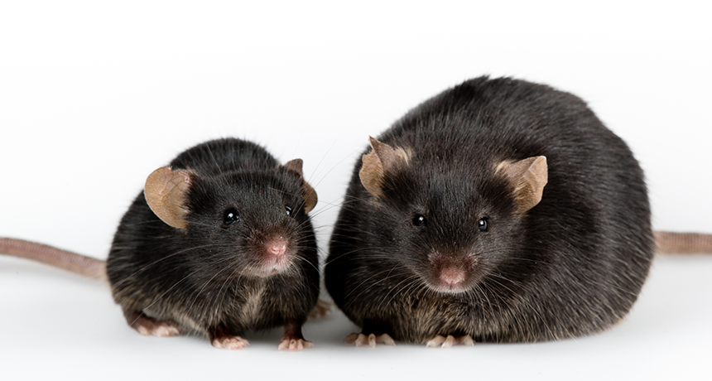
Key Findings
06
Intranasal delivery via Lp ✔
↓ food intake
↓ weight

Slide 19
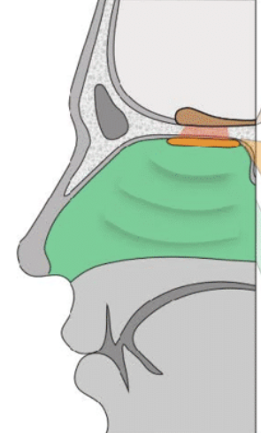
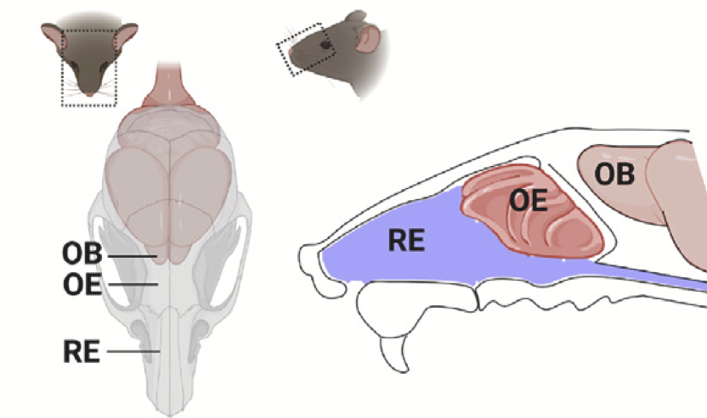
Limitations
06
Nasal polyps and respiratory complications
  From excessive bacteria colonization
OE surface area
  50% of nasal surface area in mice
  3% of nasal surface area in humans
Ingestion of bacteria
  Released engineered LP through feces → environment

Slide 20
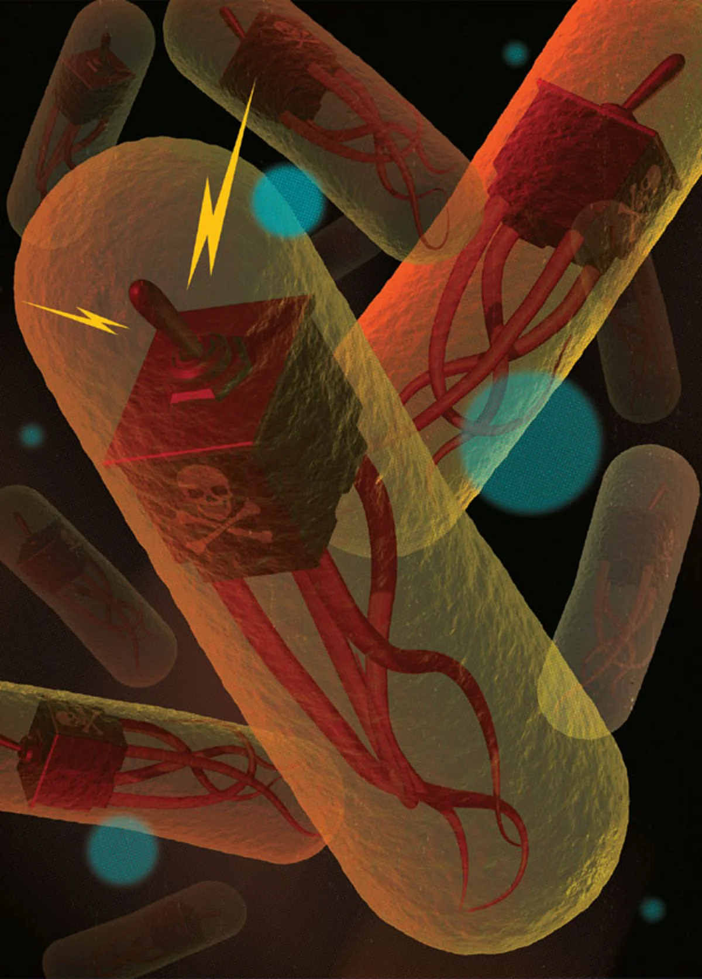
Future Research
06
Alternate Animal Models
Test on animals that closely mirror humans
Biocontainment
Kill switch?
Prevent release of modified Lp

Slide 21
Reference
Shen et al., Engineered commensals for targeted nose-to-brain drug
delivery, Cell (2025), https://doi.org/10.1016/j.cell.2025.01.017
Thank you!

