Slide 1
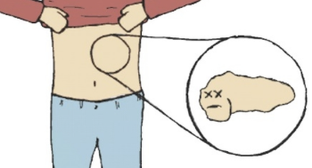
Type 1 Diabetes and the Immune System
By Domenico, Caitlyn & Tanner

Slide 2
Introduction

Slide 3
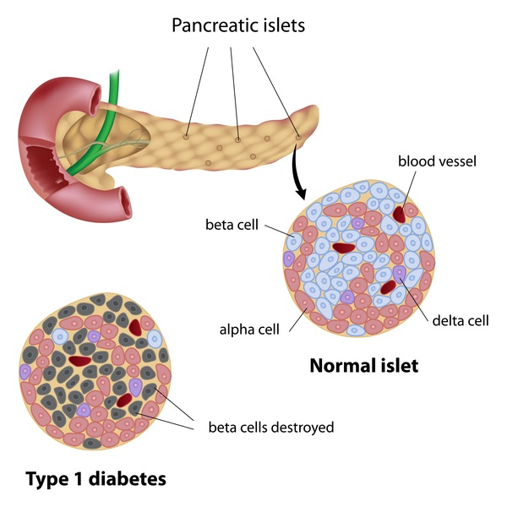
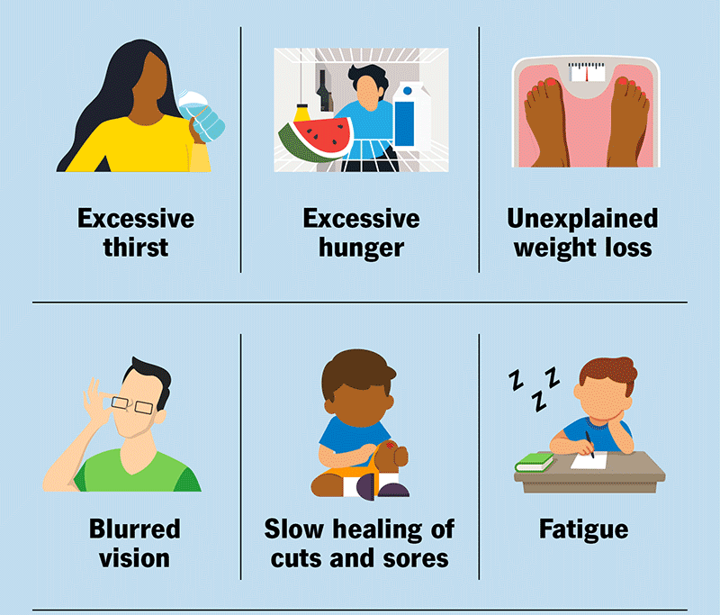
What is Type 1 Diabetes?
Also known as T1D
Chronic autoimmune disease
Insulin producing beta cells within pancreas are destroyed
Insulin regulates blood glucose levels
Without it, glucose remains in blood stream → leads to high blood sugar → hyperglycemia → short term problems
Long term problems = heart disease, vision loss or kidney damage
Notes:
Type 1 diabetes (T1D) is a chronic autoimmune disease where insulin-producing beta cells are destroyed within islets in the pancreas (Lucier & Mathias, 2024). Without enough insulin, the body cannot properly regulate its blood glucose levels. Thus, glucose remains in the bloodstream instead of going to the cells, which leads to persistently high blood sugar levels (Dhaliwhal et al., 2024). Elevated blood sugar can cause short-term problems such as thirst, fatigue, blurred vision and long-term issues like blood vessels and nerve damage. These long-term problems can ultimately lead to more severe conditions such as heart disease, vision loss or kidney damage (Dhaliwhal et al., 2024).

Slide 4
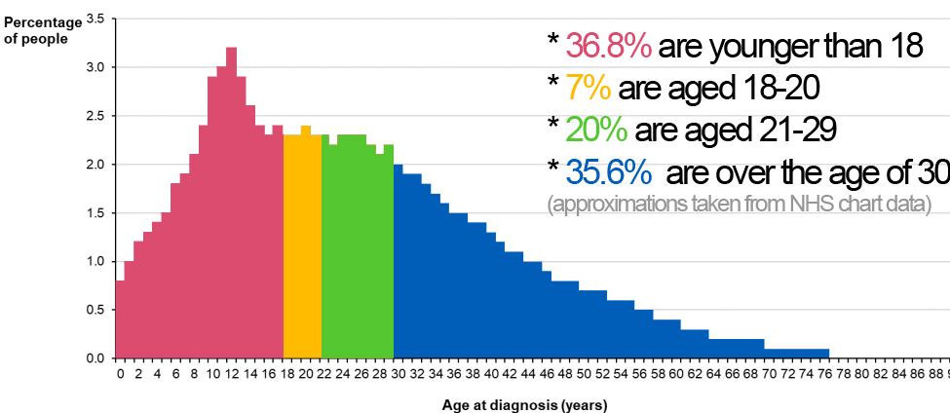
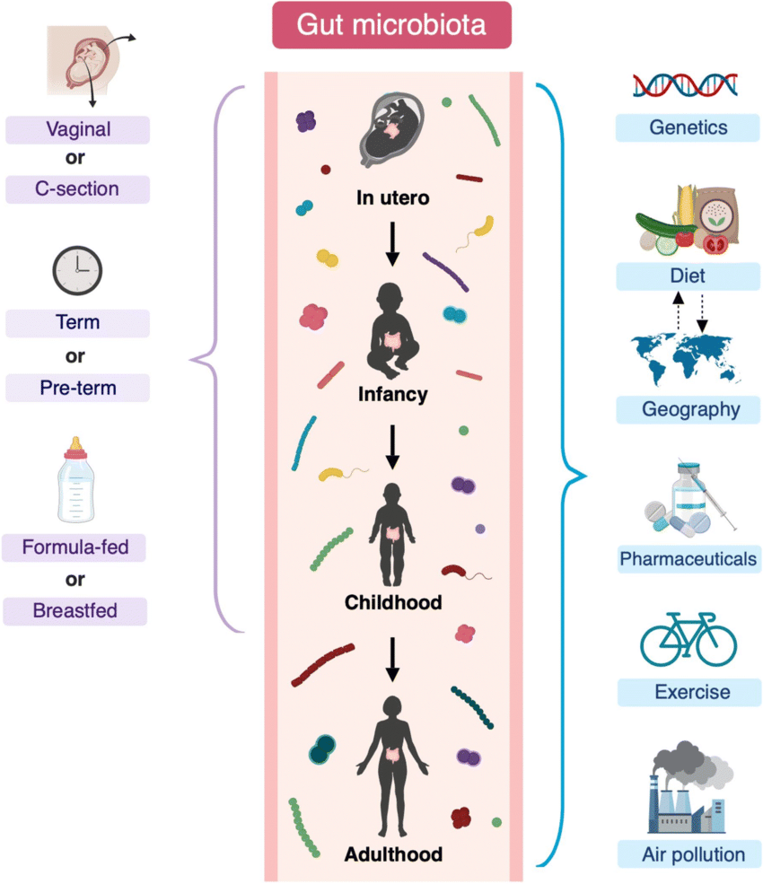
T1D Onset & Diagnosis
Diagnosis commonly occurs during early adolescence; less frequent in adults
Onset Factors:
Genetic predisposition: HLA genes = major influence.
Environmental factors: Gut microbiota has important role in immune T1D.
Microbiome & T1D:
Differences observed in microbiomes of children with vs. without T1D
Microbiome Development:
Starts at birth, influenced by delivery mode and breastfeeding
Vaginal birth and breastfeeding provide beneficial bacteria

Slide 5
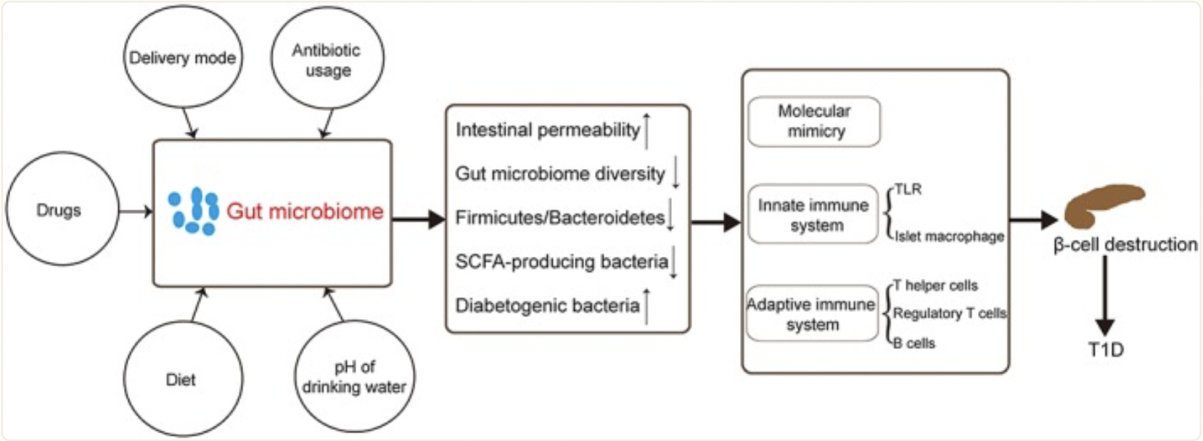
Figure 2. The role of the gut microbiome in Type 1 Diabetes (T1D).

Slide 6
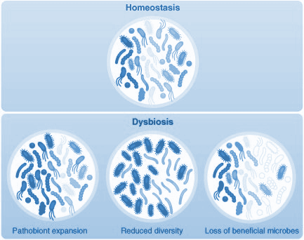
Dysbiosis & T1D
Imbalance (dysbiosis) in gut bacteria can interfere with synthesis of short-chain fatty acids (SCFAs)
E.g. Butyrate, acetate and propionate
SCFAs are derived from fermentation of complex carbohydrates by the gut bacteria.
SCFA’s control tight junction proteins like claudin-2 and occludin.
↓ SCFA production ↑ antigens crossing epithelial cells into bloodstream → "leaky gut".
Notes:
Disruptions in the balance of these microbes in particular may lead to a compromised intestinal barrier, permitting bacterial antigens to leak and trigger excessive immune responses. When bacterial antigens enter the bloodstream, the immune system may mistakenly identify insulin-producing β-cells as threats because of their similarity to these foreign antigens—a process known as molecular mimicry. This causes the activation of autoreactive

Slide 7
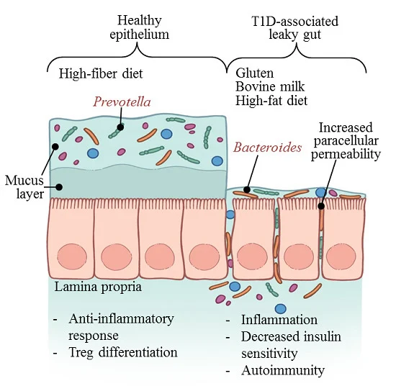
Within intestine
Outside intestine
Figure 1. Impact diet can have on the integrity of the intestinal wall, potentially causing "leaky gut,", a condition where the mucus layer is reduced and tight junctions between cells are weakened.
Notes:
This weakened barrier allows microbiome components to pass through the intestinal wall and interact with the gut-associated lymphoid tissue (GALT), triggering autoimmune responses that may enter the bloodstream and contribute to the development of Type 1 Diabetes.

Slide 8
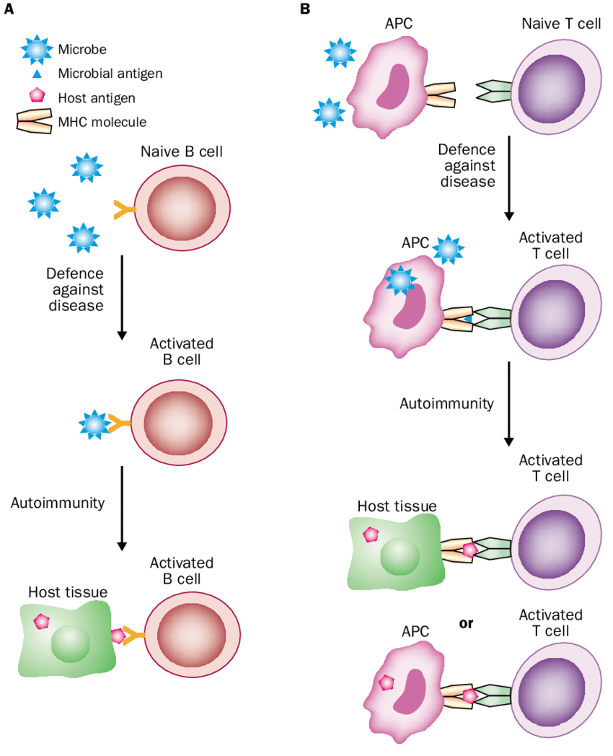
Molecular Mimicry & T1D
More bacterial antigens enter bloodstream due to leaky gut
↑ antigens ↑ probability of foreign antigens being similar to insulin-producing β-cell antigens
The immune system may mistakenly recognize β-cells as threats
This process is known as molecular mimicry.
Molecular mimicry can cause the activation of autoreactive T-cells on β-cells → Autoimmunity → T1D

Slide 9
Table 1. Summary of changes in gut microbiome composition and their potential effects in Type 1 Diabetes.
Human and animal studies indicate:
Decreased gut microbial diversity precedes T1D onset and persists post-diagnosis
Abundant fecal microbiota dominated by Bacteroidetes and Firmicutes
Lower Firmicutes to Bacteroidetes ratio.
Changes in Gut Microbes | Possible effect or function
Bacteroidetes/Firmicutes ↑ | Occurs before and at the diagnosis of T1D
Dialister invisus ↑ | Gut Permeability ↑
Gemella sanguinis ↑ | Inflammation ↑
Bifidobacterium longum ↑ | T1D Predisposition ↑
Clostridium perfringens ↑ | Intestinal integrity ↓
Diversity ↓ | SCFAs ↓ Inflammation ↑ T1D predisposition ↑
Notes:
Normally, the intestinal barrier maintains mucosal permeability and separates luminal (refers to space within bodily cavities, tracts, tubes) antigens from the body’s internal environment.
When this barrier is compromised, as seen in T1D patients, permeability increases which can activate pancreatic-draining lymph node T cells, especially CD8+ T cells, promoting inflammation of islets in the pancreas
We also see research showing that children with T1D have significantly higher intestinal permeability compared to controls. The associated changes in gut microbiome composition are summarized in this table here. Bacteria such as Clostridium perfringens, Dialister invisus, Gemella sanguinis, and Bifidobacterium longum have been linked to compromised gut integrity and heightened T1D risk.
This increase in intestinal permeability allows toxins, food antigens, and infection factors to move from the gut to pancreatic lymph nodes to potentially induce or worsen T1D.

Slide 10
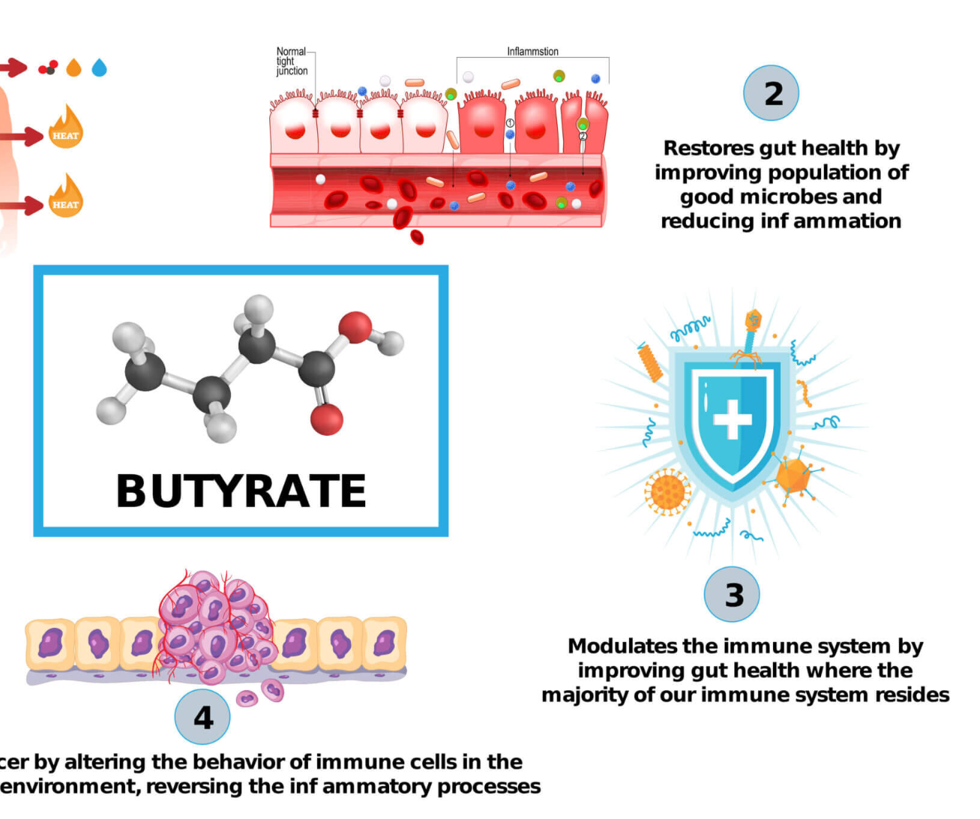
Butyrate and Gut Health
Butyrate:Stimulates cathelicidin-related antimicrobial peptides (CRAMP) in β cells, reducing pancreatic inflammation
Protection Against T1D: Shields β cells from immune attacks, potentially preventing Type 1 Diabetes
Beneficial Bacteria that produce butyrate and lactic acid are linked to lower T1D risk

Slide 11
Inulin Prebiotic Enhances Regulatory T-cell Homing and Gut Microbiota to Alleviate T1D in Mice
(Guimarães et al. 2023)
ub titile
Key Study 1

Slide 12
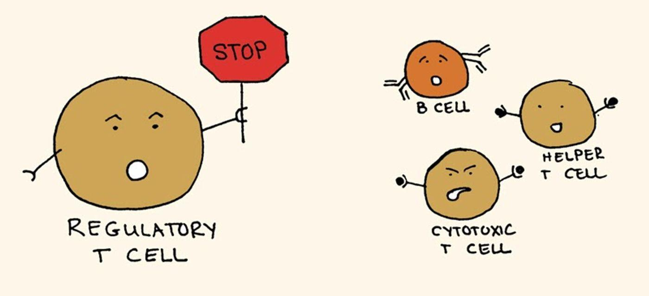
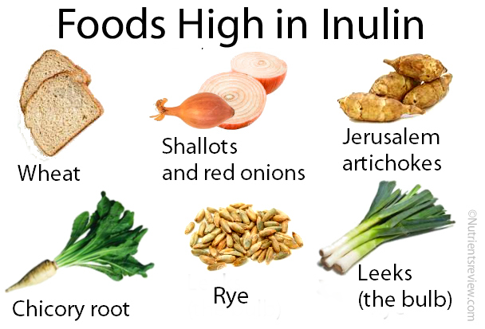
Background
Tested the effect of inulin (INU) on T1D development in mice
Regulatory T-cells play critical role in suppression of autoimmune response
Focus is on targeting CCR4 pathway
Notes:
INU = polysaccharide prebiotic, mainly found in starchy foods, that promotes beneficial bacteria to produce short chain fatty acids (SCFA’s) like butyrate
CCR4 receptor crucial in guiding T-reg cells top inflammation sites → these would be pancreatic islets in T1D → targeting pathway to hopefully protect beta cells

Slide 13
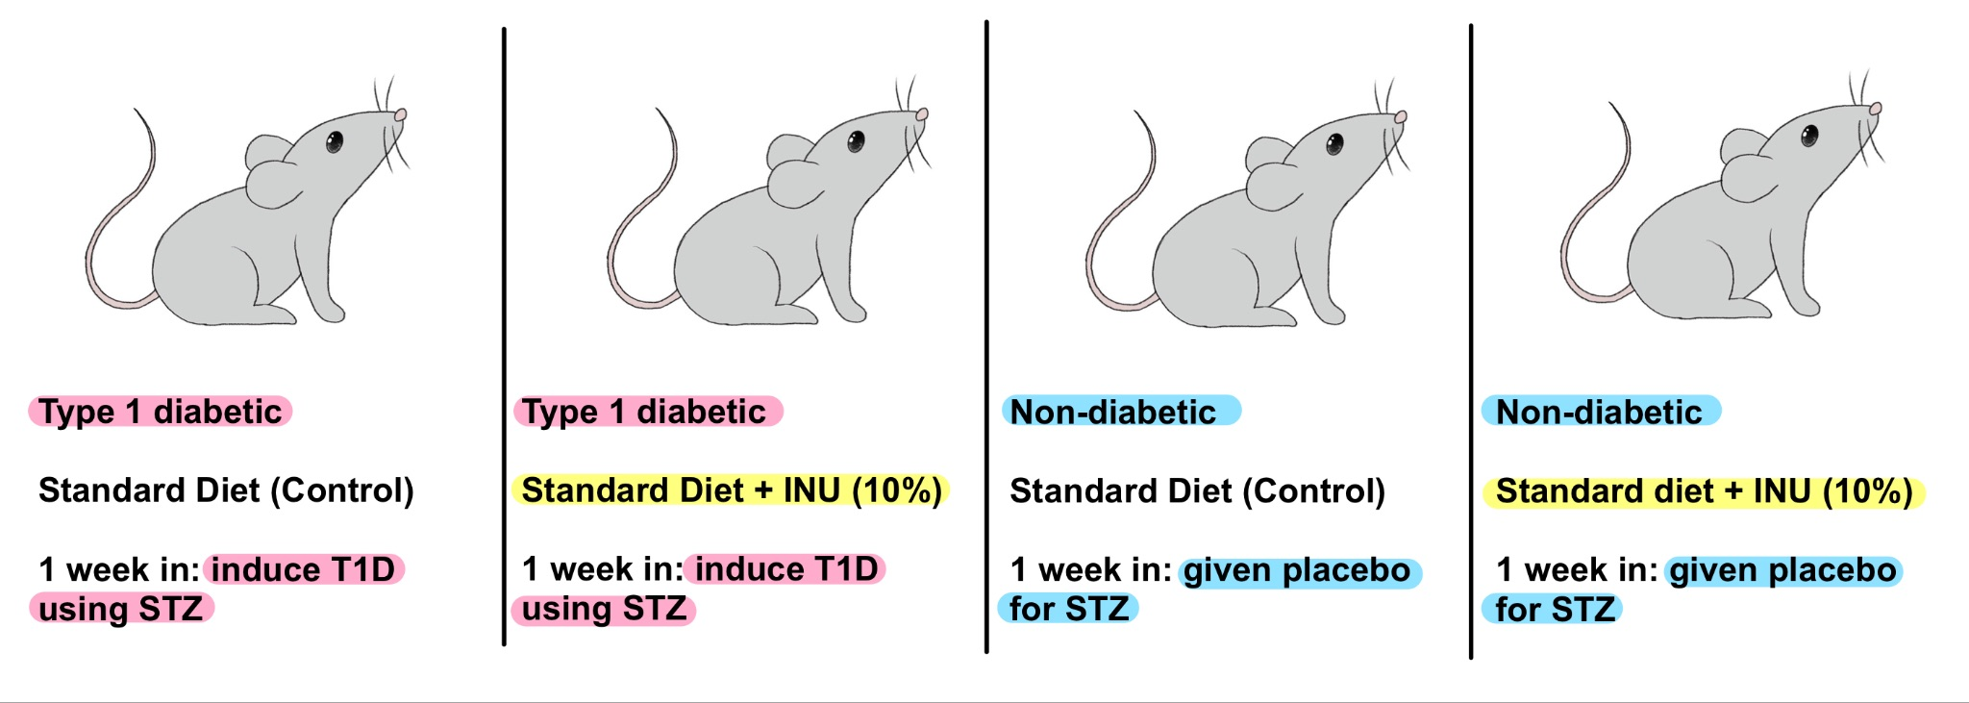
Methods
Figure 3. Experimental groups.
Analysis (after 8 weeks):
Pancreatic samples taken and assessed for amount of insulin and CCR4 expression
Colon samples taken to assess mucus production
Flow cytometry analysis of pancreatic and cecal lymph node cells
Enzymatic breakdown of pancreatic tissue to isolate and observe leukocytes
PCR of fecal samples
Notes:
For this experiment, four different groups of mice were used: two diabetic groups and two non-diabetic groups. Between the two diabetic groups, one was fed a standard diet, and for the other, 10% INU was incorporated into the standard diet.
For the other two non-diabetic groups, one was fed the standard diet, the other was fed the 10% INU diet.
The mice were fed their respective diets in the first week before the administration of STZ or a placebo of sodium citrate in the second week. T1D would be induced in the mice fed STZ.
After 8 weeks, pancreatic samples were fixed and hematoxylin-eosin staining was used to assess the abundance of insulin.
Pancreatic samples were also used for immunofluorescence assay to visualize CCR4 receptor expression.
Colon samples were taken to assess mucus production.
Pancreatic and cecal lymph node cells were analyzed by flow cytometry to assess leukocyte subsets including CD4+, CCR4+, and Foxp3+
Pancreatic tissue was broken down by enzymes and centrifuged, isolating the leukocytes for study.
Lastly, a PCR was run with fecal samples to analyze the amount of different bacteria present

Slide 14
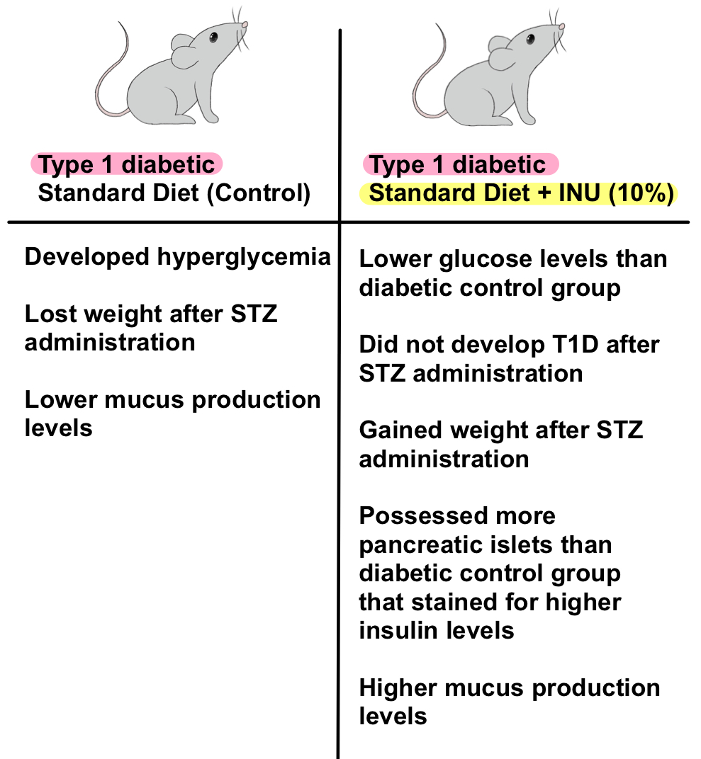
Results
INU proved to be effective in preventing T1D development after the administration of STZ → was supposed to induce T1D however INU diet group did not develop T1D
Difference in mucus levels supports the idea that increased intestinal permeability leading to T1D can be triggered by reduced mucus layer
Figure 4. Experiment results among STZ fed groups.
Notes:
Goblet cells, which act in mucus absorption and nutrient digestion in the colon, were found to have been reduced in the standard diet diabetic mice.
The diabetic mice also expressed reduced mucus production compared to the standard diet mice whereas the diabetic mice with the INU diet showed increased mucus production → not only demonstrates that INU can boost mucus production in goblet cells but also supports the idea that increased intestinal permeability, which can be triggered by a reduced mucus layer, plays a role in the development of T1D.

Slide 15
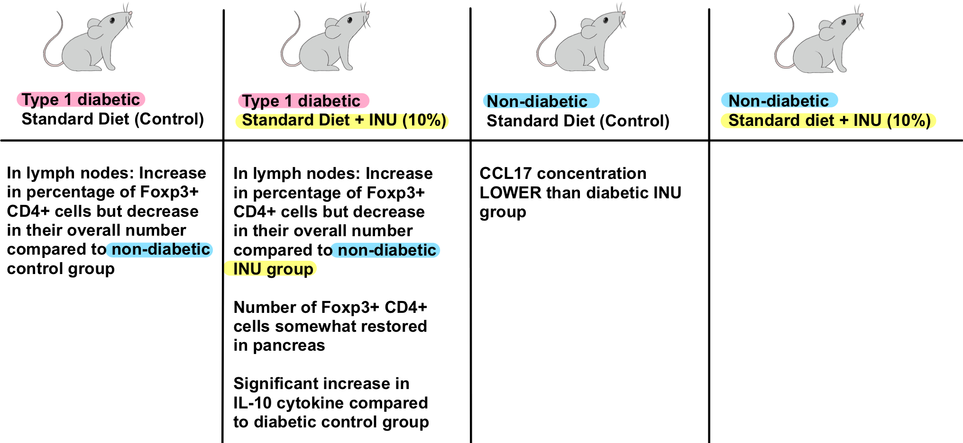
Flow Cytometry Results
Figure 5. Overall flow cytometry results between all experimental groups
No significant differences in IL-6 production between experimental groups
No significant difference in CCR4 receptors in the lymph nodes
Notes:
Flow cytometry revealed an increase in the percentage of regulatory T cells expressing Foxp3+ CD4+ in both diabetic groups compared to the non-diabetic groups.
Accumulation of CCR4+ dependent on anti-inflammatory cytokines (IL-10, IL-6) and CCL17 chemokine
However, analysis of Treg cells expressing CCR4 receptors in the lymph nodes showed no significant difference in CCR4 levels between the groups.

Slide 16
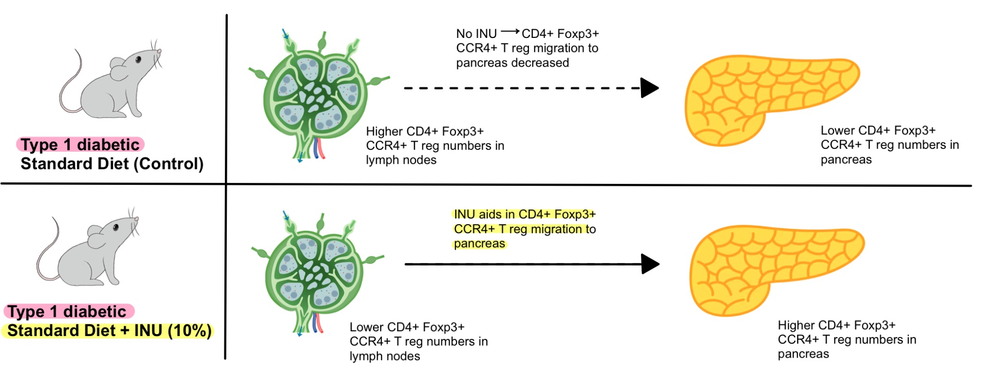
Implications:
Figure 5. Diagram showing potential effects of INU on regulatory T-cell generation and migration in T1D
Notes:
In the lymph nodes, percentage of CD4+Foxp3+CCR4+ Treg cells among the STZ-fed groups was similar, however the absolute number of these cells was lower in the INU diet group compared to the standard diet group.
The INU diet group showed higher numbers of these cells in the pancreatic islets.
This implies that inulin supplementation may effect T1D immunoregulation by promoting T-reg generation in gut-associated lymph nodes and facilitating their migration to pancreatic islets, where they could help control inflammation and protect beta cells.
Immunoregulation = regulation of the immune system, particularly the cellular and molecular mechanisms of activation, proliferation, and differentiation of human T and B cells.

Slide 17
Key Study 2
Corn silk extract alleviate type 1 diabetes via regulating gut microbiota and inflammation (Yang et al. 2024)

Slide 18
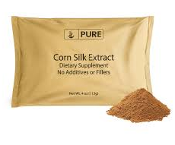
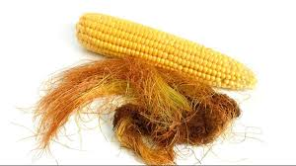
Background
Corn silk is a traditional Chinese medicine known for its medicinal and edible properties
Insulin is currently the primary treatment for T1D
Recent studies have indicated that the gut microbiome plays a role in the pathogenesis of T1D

Slide 19
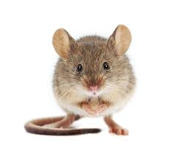
Methods
Table 2. Conditions for the different test groups of mice used in the experiment.
Test Groups of Mice
Non-Diabetic | Diabetic
Control | No Treatment (Model) | Insulin | Low corn silk 10 mg/kg | Medium corn silk 50 mg/kg | High corn silk 100 mg/kg
Key variables tested
Glucose levels
Islet damage
Ileum damage
IL-10, IL-6, and TNF-α
Microbiome diversity
SCFA and BCFA prevalence

Slide 20
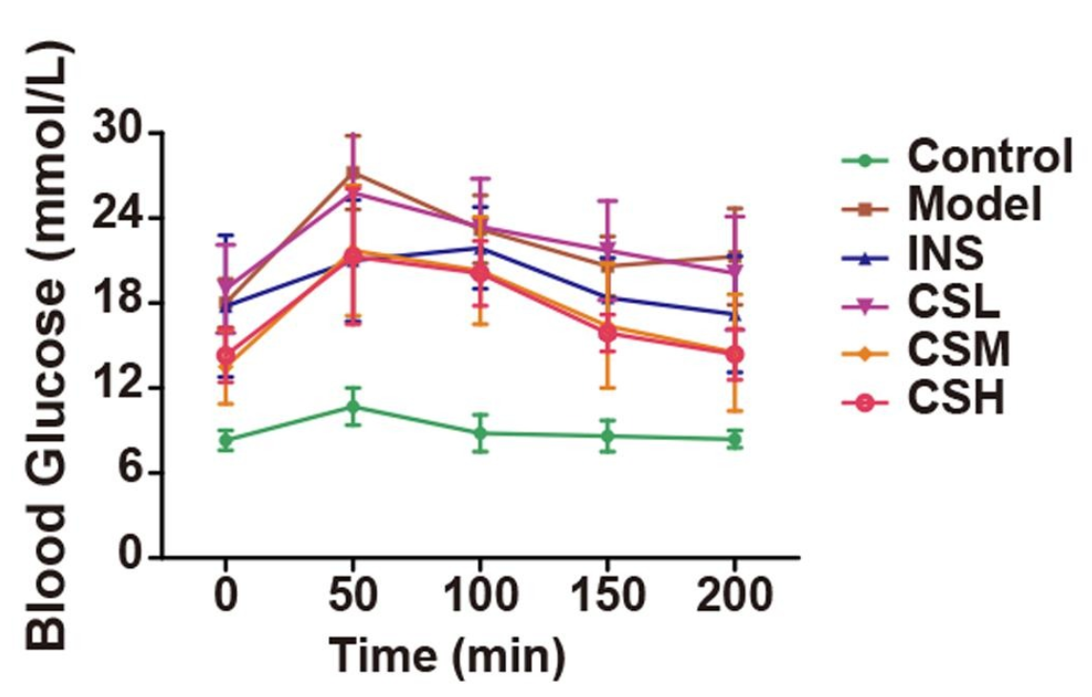
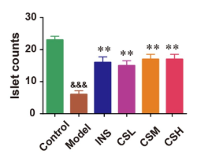
Results
Decreased blood glucose levels in high and medium corn silk groups
Reduced islet cell loss and pancreas damage
Increased IL-10 levels, decreased IL-6 and TNF-α production
Figure 6. Blood glucose levels in test groups of mice after overnight fast (Yang et al. 2024).
Figure 7. Islet count in test groups of mice (Yang et al. 2024).

Slide 21
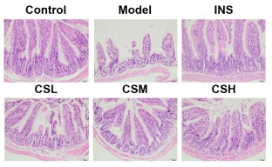
Less ileum damage
Improved ileum structure and reduced inflammatory cell infiltration
Figure 8. The intestinal ileum of Type 1 Diabetic mice, stained with hematoxylin-eosin to assess the effect of corn silk on ileum injury. The groups shown include the control group (non-T1D mice), the model group (mice with T1D), the INS group (mice fed insulin), CSL group (mice fed low-dose corn silk), CSM group (mice fed medium-dose corn silk), and CSH group (mice fed high-dose corn silk)(Yang et al. 2024).

Slide 22
Results of Gut Microbiome
Table 3. The effect different gut bacteria have on type 1 diabetes and your health.
Gut Bacterium | Effect
Patescibacteria, Firmicutes, Ileibacterium and Lachnospiraceae_NK4A136_group | Decrease in T1D Indicators
Proteobacteria | Correlation with T1D
Firmicutes, Desulfobacterota, Ileibacterium, and norank_f_Lachnospiraceae | Increased SCFA and Decreased BCFA
Bacteroides, Brachybacterium, and Corynebacterium | Decrease in T1D related indicators

Slide 23
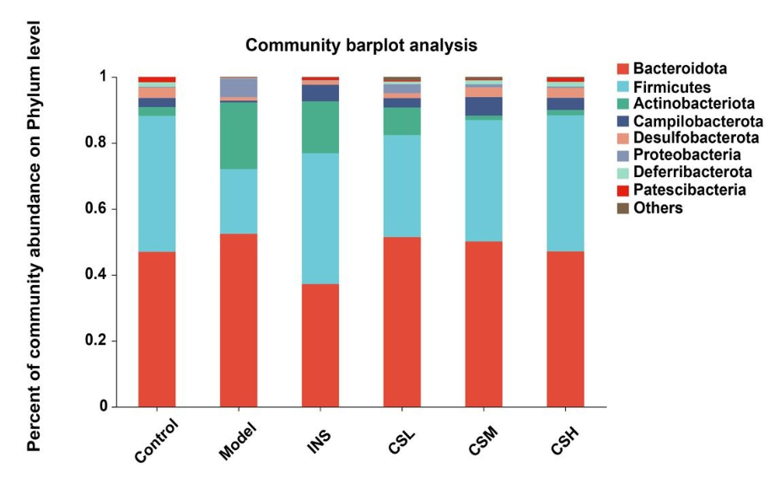
Results
Similar microbiome was present in the high corn silk group and the control
Figure 4. Change in microbiome diversity on the phylum level in different groups of mice that have been induced with type 1 diabetes (Yang et al. 2024).

Slide 24
ub titile
Conclusion

Slide 25
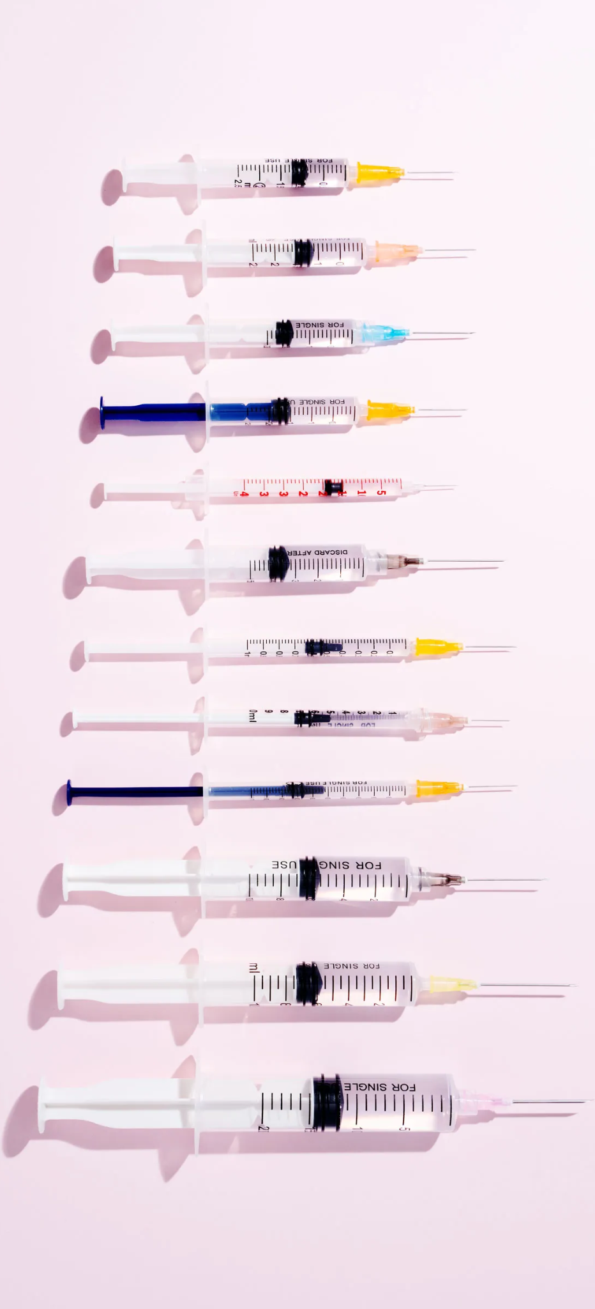
Key Takeaways & Future Research
Type 1 Diabetes (T1D) is a very complex autoimmune disease
Gut microbiota, influence the risk for T1D
Microbiome therapies could manage T1D
Further research is needed to better understand the complex mechanisms between the gut microbiota and T1D.

Slide 26
References
De Pessemier B, Grine L, Debaere M, Maes A, Paetzold B, Callewaert C. Gut-Skin Axis: Current Knowledge of the Interrelationship between Microbial Dysbiosis and Skin Conditions. Microorganisms. 2021 Feb 11;9(2):353. doi: 10.3390/microorganisms9020353. PMID: 33670115; PMCID: PMC7916842.
Dhaliwal SK, Dugdale DC, Conoway B. Type 1 Diabetes: Medlineplus medical encyclopedia. MedlinePlus. [accessed 2024 Feb 20]. https://medlineplus.gov/ency/article/000305.htm
Guimarães JB, Rodrigues VF, Pereira ÍS, Manso GM, Elias-Oliveira J, Leite JA, Waldetario MC, de Oliveira S, Gomes AB, Faria AM, et al. 2023. Inulin prebiotic ameliorates type 1 diabetes dictating regulatory T cell homing via CCR4 to pancreatic islets and butyrogenic gut microbiota in murine model. Journal of Leukocyte Biology 115:483–496.
Kolls J, Castillo P. 2015 Aug 24. Faculty opinions recommendation of pancreatic β-cells limit autoimmune diabetes via an immunoregulatory antimicrobial peptide expressed under the influence of the gut microbiota. Faculty Opinions – Post-Publication Peer Review of the Biomedical Literature.
Lucier J, Mathias PM. 2024 Oct 5. Type 1 Diabetes. National Library of Medicine. [accessed 2024 Oct]. https://www.ncbi.nlm.nih.gov/books/NBK507713/
Luppi S, Aldegheri L, Azzalini E, Pacetti E, Barucca Sebastiani G, Fabiani C, Robino A, Comar M. 2024. Unravelling the role of gut and oral microbiota in the pediatric population with type 1 diabetes mellitus. International Journal of Molecular Sciences 25:10611.

